Slide 1
Barring of Remedies

Slide 2
1. Settlor’s approval in trust
§ 111.0035
The settlor may waive anything except:
  1. Requirement of valid trust purpose.

Slide 3
1. Settlor’s approval in trust
§ 111.0035
The settlor may waive anything except:
  2. Limitations on exculpatory clauses under
  § 114.007.

Slide 4
1. Settlor’s approval in trust
§ 111.0035
The settlor may waive anything except:
  3. Statute of limitations

Slide 5
1. Settlor’s approval in trust
§ 111.0035
The settlor may waive anything except:
  4. Trustee’s duty to account for an irrevocable trust if beneficiary:
    Is entitled or permitted to receive current distributions, or
    Would receive a distribution if trust ended now.

Slide 6
1. Settlor’s approval in trust
§ 111.0035
The settlor may waive anything except:
  5. Trustee’s duty to act in good faith

Slide 7
1. Settlor’s approval in trust
§ 111.0035
The settlor may waive anything except:
  6. Trustee’s duty to inform beneficiaries unless:
    Beneficiary is under age 25, or
    Beneficiary is remote.

Slide 8
1. Settlor’s approval in trust
§ 111.0035
The settlor may waive anything except:
  7. Ability of court to take action, e.g.,
    Deviation
    Remove trustee
    Exercise jurisdiction over the trust
    Bond
    Trustee compensation

Slide 9
1. Settlor’s approval in trust
§ 111.0035
The settlor may waive anything except:
  8. In terrorem provision not enforceable if contest is in good faith and with just cause

Slide 10
2. Mandatory Arbitration
Rachal v. Reitz (Tex. 2013) – p. 664
  Mandatory arbitration clauses are enforceable.
    Beneficiary deemed to agree because beneficiary accepted trust benefits, that is, “direct benefits estoppel.”

Slide 11
3. Release by beneficiaries
§ 114.005
Requirements for valid release:
  Legal capacity
  Full information
  Written
  Delivered to trustee

Slide 12
3. Release by beneficiaries
§ 114.005
What may be released?
  Any duty, responsibility, restriction, or liability.
  “Forgive” past misconduct.
  Grant “permission” for future misconduct.

Slide 13
3. Release by beneficiaries
§ 114.005
Virtual Representation -- § 114.032
  1. Binding on beneficiary who can revoke binds all.

Slide 14
3. Release by beneficiaries
§ 114.005
Virtual Representation -- § 114.032
  2. Minor bound if:
    Parent signs, and
    No conflict of interest, and
    No court-appointed guardian

Slide 15
3. Release by beneficiaries
§ 114.005
Virtual Representation -- § 114.032
  3. Unborn or unascertained beneficiary bound if:
    Beneficiary is lineal descendant of consenting beneficiary, and
    Substantially identical interest.

Slide 16
3. Release by beneficiaries
§ 114.005
Virtual Representation -- § 114.032
  Less comprehensive than virtual representation in a court proceeding under § 115.013.
  Cannot use VR to modify or terminate trust.

Slide 17
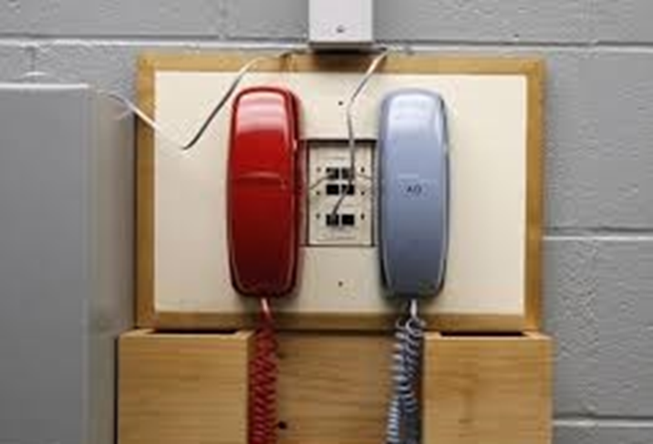
4. Court decree -- 115.001(a)(8)
The last hope

Slide 18
5. Statute of Limitations
Civ. Prac. & Rem. Code § 16.051
4 years.
Does not run from date of breach.
Discovery rule applies – when breach is or should have been discovered.
  Wright – p. 673

Slide 19
6. Laches
Unreasonable delay in asserting rights to disadvantage of defendant
  E.g., a good faith change in position.

