Slide 1
Remedies Against Trustee

Slide 2
1. Money Damages (trustee not in breach) -- § 114.001
Any profit through or arising out of the administration of the trust.
Exception for trustee’s compensation

Slide 3
1. Money Damages (trustee in breach) -- § 114.001
1. Lost value to trust
Causation required
No requirement that trustee personally benefited

Slide 4
1. Money Damages (trustee in breach) -- § 114.001
2. Profit made by trustee
Causation required
No requirement that trust have suffered a loss

Slide 5
1. Money Damages (trustee in breach) -- § 114.001
3. Lost profits
Causation required
Difficult to show

Slide 6
1. Money Damages (trustee in breach)
4. Punitive damages
“[A]n intentional breach of a fiduciary duty is a tort justifying the award of exemplary damages.”

Slide 7
2. Remove trustee -- § 113.082
Grounds are discretionary
Evaluated under “abuse of discretion” standard
1. Trustee has materially violated the trust (or attempted to do so)
AND
Trust suffered a material financial loss.

Slide 8
2. Remove trustee -- § 113.082
2. Trustee becomes incompetent
3. Trustee becomes insolvent
4. For other cause, in the discretion of the court

Slide 9
2. Remove trustee -- § 113.082
Court’s “attitude” toward removal
Reluctant to remove settlor-chosen trustee.
Hesitant to remove because of conflict between trustee and beneficiary.

Slide 10
2. Remove trustee -- § 113.082
Consequences of Removal
Court may deny all or part of trustee’s compensation.
Removal may be treated as breach of trust.

Slide 11
2. Remove trustee
Ditta v. Conte – Texas Supreme Court 2009 – p. 647
“[N]o statutory limitations period restricts a court’s discretion to remove a trustee. A limitations period, while applicable to suits seeking damages for breach of fiduciary duty, has no place in suits that seek removal rather than recovery.”

Slide 12

3. Decree to carry out the trust
Trustee,
Do your job!
Judge

Slide 13
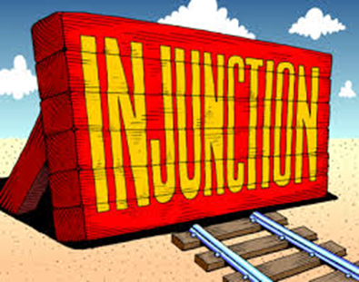
4. Injunction
Used if trustee threatens to commit a breach of trust.
If trustee does not obey, punishable as contempt.

Slide 14
5. Receivership
Used when court fears trustee will not obey injunction.
“Receivership is an extraordinary harsh remedy and one that courts are particularly loathe to utilize.”

Slide 15
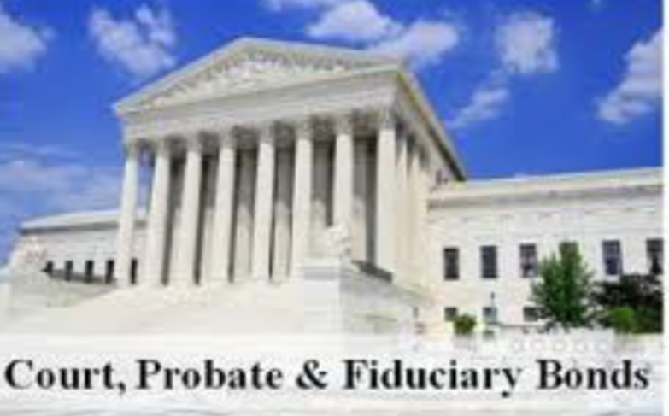
6. Require or increase bond

Slide 16

7. Declaratory Judgment
Court may determine any question arising during the administration of a trust.
Civ. Prac. & Rem. Code § 37.005

Slide 17

8. Award Attorney Fees -- § 114.064
Standard = equitable and just.
Award may be against any party.
Thus, all parties should request fees.

Slide 18

9. Criminal Sanctions – Penal Code § 32.45

Slide 19
9. Criminal Sanctions – Penal Code § 32.45
Misapplication by Fiduciary
State of mind
Intentional
Knowing
Reckless

Slide 20
9. Criminal Sanctions – Penal Code § 32.45
Misapplication by Fiduciary
Evil Act
Misapply trust property which involves
In violation of trust instrument, or
In violation of Trust Code, and
Substantial risk of loss to beneficiary

Slide 21
9. Criminal Sanctions – Penal Code § 32.45
Misapplication by Fiduciary
Penalty
If amount involved greater than $300,000, up to life sentence.
No requirement that trustee have personally benefited.
If trustee personally benefited, then it may also be theft under Penal Code Chapter 31.

Slide 22
10. Liability for acts of prior trustee § 114.002
1. Knowledge
New trustee knows (subjective), or
New trustee should know (objective)
and

Slide 23
10. Liability for acts of prior trustee § 114.002
2. Improper Conduct
Allows bad conduct to continue, or
Fails to make reasonable effort to compel old trustee to deliver trust property, or
Fails to make reasonable effort to compel redress of breach (e.g., sue prior trustee).

