Slide 1
Principal and Income

Slide 2
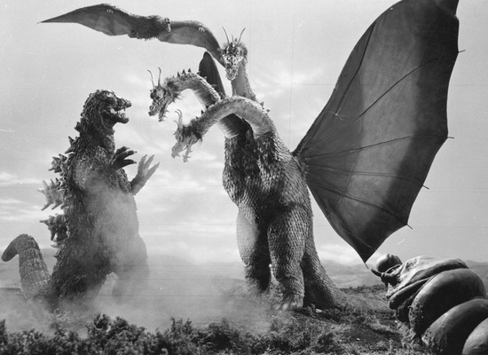
Conflict between beneficiary types
  Trustee owes duty of impartiality. § 117.008.
What does income B want?
What does remainder B want?

Slide 3
History of determining principal and income
Before January 1, 2004 = 1962 version of Uniform Principal and Income Act.
Beginning January 1, 2004 = 1997 version of Uniform Principal and Income Act.
  Many items significantly different from 1962 Act.
  Texas made some unique changes.
  Chapter 116.

Slide 4
Methods of allocating receipts and charging expenses -- § 116.004
1. Settlor’s instructions prevail
  Specific allocation rules
  Trustee’s discretion
    Note that following UPIA deemed fair and reasonable to all beneficiaries.

Slide 5
Methods of allocating receipts and charging expenses -- § 116.004
2. Trust Code rules

Slide 6
Methods of allocating receipts and charging expenses -- § 116.004
3. If no settlor instruction or Trust Code rule, allocate to principal.

Slide 7
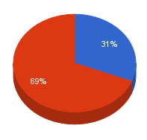
Basic Allocation Rules

Slide 8
Basic Allocation Rules
1. Capital gains = principal
  Basis = $10,000
  Sales price = $15,000
  Income = ?
  Principal = ?
  § 116.161

Slide 9
Basic Allocation Rules
2. Interest earned = income
  CD face value = $10,000
  Interest received = $50
  Income = ?
  Principal = ?
  § 116.163

Slide 10
Basic Allocation Rules
3. Rent = Income
  House value = $250,000
  Rent received each month = $1,000
  Income = ?
  Principal = ?
  § 116.162

Slide 11
Basic Allocation Rules
4. Eminent Domain Award = Principal
  House basis = $175,000
  Government pays FMV = $225,000
  Income = ?
  Principal = ?
  § 116.161

Slide 12
Basic Allocation Rules
5. Insurance Proceeds = Principal
  House basis = $175,000
  House burns
  Insurance company pays FMV = $225,000
  Income = ?
  Principal = ?
  § 116.161

Slide 13
Basic Allocation Rules
6. Dividends
  Cash dividend = income
  Stock dividend = principal
  Stock split = principal
  Stock received because of merger = principal
  § 116.151

Slide 14
Basic Allocation Rules
7. Business & Farm Receipts
  Determined according to GAAP (generally accepted accounting principals).
  § 116.153

Slide 15
Basic Allocation Rules
8. Liquidating or “Wasting” Asset
  Definition = Asset which goes down in value as it used in an amount greater than depreciation.
  Examples = ______________________________
  Note that natural resources have different rules.

Slide 16
Basic Allocation Rules
8. Liquidating or “Wasting” Asset
  Prior Law
    Income = receipts up to 5% of asset’s value
    Principal = receipts over 5% of asset’s value
  Current Law
    Income = 10% of each receipt
    Principal = 90% of each receipt
  § 116.173

Slide 17
Basic Allocation Rules
8. Liquidating or “Wasting” Asset
  Example:
    Book royalty interest FMV = $100,000
    Royalties received in year = $7,500
  Prior Law
    Income = $5,000
    Principal = $2,500
  Current Law
    Income = $750
    Principal = $6,750

Slide 18
Basic Allocation Rules
9. Oil & Gas Royalties
  Prior Texas Law
    Income = 72.5%
    Principal = 27.5%
  Uniform Law
    Income = 10%
    Principal = 90%
  Current Texas Law -- § 116.174
    Equitably
    If trust owned royalty interest on 1/1/2004, may use prior Texas law.
    Following IRS depletion allowances deemed equitable.

Slide 19
Basic Allocation Rules
10. Timber
  Income = timber removed that does not exceed regrowth
  Principal = timber removed that exceeds regrowth
  Texas -- § 116.175

Slide 20
Basic Allocation Rules
11. Non-income Earning Property
  When sold, all proceeds are principal
  Doctrine of “delayed income” which allocated some of the proceeds to income no longer followed.
  Texas -- § 116.176

Slide 21
Trustee’s Adjustment Power
§ 116.005
Basic Idea = allow trustee to ignore basic rules under certain circumstances.
Very controversial
  Delayed wide-spread adoption of UPIA.
  Many states omit or substantially revise.
Example:

Slide 22
Trustee’s Adjustment Power
§ 116.005
Factors trustee must consider:
  Nature, purpose, and expected duration of trust
  Settlor’s intent.
  Identity and circumstances of the beneficiaries

Slide 23
Trustee’s Adjustment Power
§ 116.005
Factors trustee must consider (continued):
  Need for liquidity, income, preservation, and appreciation.
  Is asset from settlor, used by beneficiary, or a mere investment?
  Terms of trust regarding principal invasion and income accumulation.

Slide 24
Trustee’s Adjustment Power
§ 116.005
Factors trustee must consider (continued):
  Tax consequences.
  Statute has others.

Slide 25
Trustee’s Adjustment Power
§ 116.005
When adjustment not allowed:
  Specifically prohibited by settlor (not just a statement of “no adjustment”).
  Trustee is a beneficiary.
  Trustee would directly or indirectly benefit from the adjustment.
  Adverse tax consequences.

Slide 26
Trustee’s Adjustment Power
§ 116.005
No notice to beneficiaries needed
  But, some states add this requirement
Court may reverse trustee’s decision to adjust (or not adjust) only if it finds trustee abused its discretion. § 116.006.
Trustee may seek court approval of an adjustment if trustee reasonably believes a beneficiary will object.

Slide 27
Apportionment Timing
Detailed rules exist for apportionment when:
  Trust begins (inter vivos and testamentary)
  Beneficiaries change
  Trust ends
  §§ 116.051 through 116.103.

Slide 28
Disbursements
1. Trustee Compensation
  Presumption
    Principal = 50%
    Income = 50%
  But, trustee may allocate in any manner as long as it is consistent with the trustee’s fiduciary duties.
  §§ 116.201 & 116.202

Slide 29
Disbursements
2. Accounting Expenses
  Principal = 50%
  Income = 50%
  §§ 116.201 & 116.202

Slide 30
Disbursements
3. Ordinary Repairs
  Income
  § 116.201

Slide 31
Disbursements
4. Capital Improvements and Extraordinary Repairs
  Principal
  § 116.204

Slide 32
Disbursements
5. Debt Payment (including mortgages)
  Interest = Income
    § 116.201
  Principal = Principal
    § 116.202

Slide 33
Disbursements
6. Insurance Premiums on Principal
  Income
    § 116.201

Slide 34
Disbursements
7. Income Taxes
  If based on receipts allocated to income = income
  If based on receipts allocated to principal = principal
  § 116.205

Slide 35
Disbursements
8. Property Taxes
  Income
  116.201(3)

Slide 36
Disbursements
9. Depreciation
  Does some income need to be allocated to principal to compensate for depreciation?
  Prior law = yes
  Current law = trustee’s discretion
  § 116.203

Slide 37

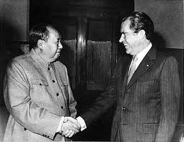
Unitrust

Slide 38
Unitrust -- Operation
Basic idea = Current beneficiary receives a fixed percentage of trust’s fair market value each year.
Thus, all beneficiaries want value of trust to increase.
Not concerned about why – income or principal.

Slide 39
Unitrust -- Issues
How to set the unitrust rate?
Can P/I trusts be converted to unitrusts?

