Slide 1
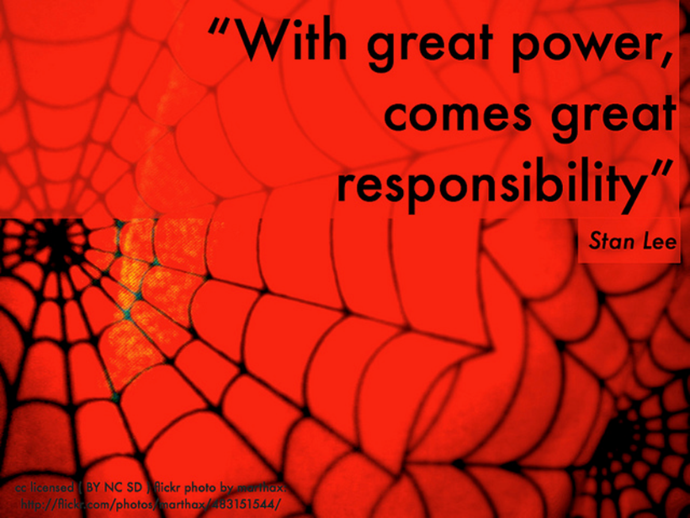
Duty of Loyalty

Slide 2

Introduction
Trustee owes duty of undivided loyalty:
  Avoid self-dealing.
  Avoid conflicts of interest.
Trustee can make no profit (except trustee fee) for being a trustee, even without a breach of duty. § 114.001(a).

Slide 3

Standard
Strictly liable for breach
  Trustee is personally liable regardless of:
    Trustee’s good faith
    Fairness of transaction
    Trustee did not personally benefit

Slide 4
Standard
Reasons for strict rule:
  Eliminate motive to breach
  Deterrence
  Actual “evil” hard to prove

Slide 5
Avoid Self-Dealing
1. Buy/Sell -- § 113.053
  Trustee cannot buy trust assets from the trust.
  Trustee cannot sell his/her assets to the trust.
  Prohibition includes affiliates, employees, relatives, employers, etc.

Slide 6
Avoid Self-Dealing
2. Lending -- § 113.052
  Trustee cannot lend trust funds to trustee or the other prohibited persons.
  Exceptions:
    Settlor expressly authorized the loan in trust.
    Corporate trustee deposits under § 113.057 if
      Authorized in trust, or
      Pending investment, distribution to beneficiaries, or debt payment if FDIC insured or security fund maintained.

Slide 7
Avoid Conflicts of Interest
1. Purchase of Trustee’s Securities -- § 113.055
  Corporate trustee
    Cannot purchase own or affiliate’s securities.
  Individual trustee
    Cannot purchase if individual connected as director, owner (shareholder), manager, etc.
  But, trustee may retain stock already in the trust if reasonable to do so.

Slide 8
Avoid Conflicts of Interest
2. Sales from one trust to another
§ 113.054
  Policy?
  Exception = Obligation issued or fully guaranteed by U.S. government sold for its current market price.

Slide 9
Avoid Conflicts of Interest
3. Other transactions with beneficiary
  Trustee owes duty of fair dealing to beneficiary in non-trust transactions.
  Full disclosure of all applicable facts and law.
  Not an arms-length transaction.

Slide 10
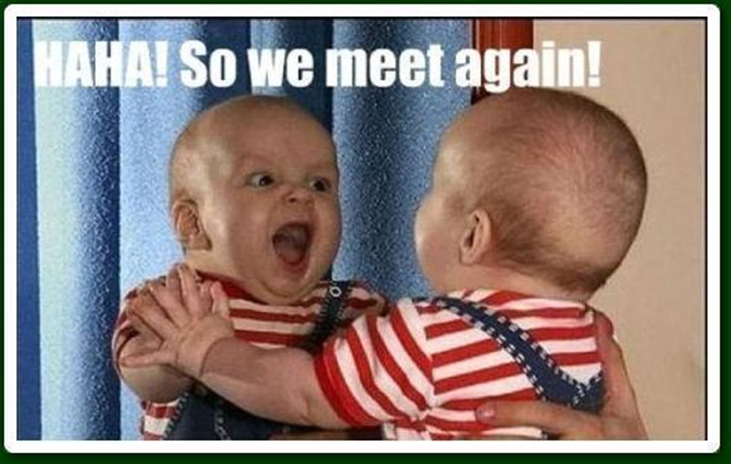
Conflicts of Interest
4. Trustee employing self

Slide 11
Settlor’s Authorization of Breach of Loyalty
Settlor may waive the self-dealing and conflict of interest restrictions.
But, waivers are strictly construed against the trustee.
Price v. Johnston – p. 603

