Slide 1
Introduction to Trust Administration

Slide 2
Overview of Administration
1. Trustee accepts (or not)
Review § 112.009
Signature = conclusive evidence
Exercise power or duty = presumption
No liability until accept

Slide 3
Overview of Administration
2. Post bond
Review § 113.058
Required unless:
Settlor waives
Trustee is a corporation

Slide 4
Overview of Administration
3. Obtain possession and/or control of trust property.

Slide 5
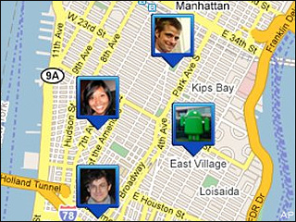
Overview of Administration
4. Ascertain identity and location of beneficiaries.

Slide 6

Overview of Administration
5. Follow settlor’s instruction in the trust
Investments
Management
Distribution

Slide 7

Overview of Administration
6. Follow requirements of Trust Code

Slide 8
Overview of Administration
7. Exercise appropriate standard of care
Management
Investment
Distribution

Slide 9

Overview of Administration
8. Act with high degree of fiduciary loyalty
Avoid self-dealing
Avoid conflicts of interest

Slide 10


Overview of Administration
9. Personal liability for failure to comply
Civil
Criminal

Slide 11
Safeguarding and preserving trust property
§ 117.004
Exercise reasonable care, skill, and caution.
Example actions:

Slide 12
Duty to Earmark
Common law rule = strict
Modern rule = liable only if failure to earmark causes loss.
Holding as nominee -- § 113.017
Corporate stocks and other securities
Other assets?

Slide 13
Commingling Prohibited
1. With trustee’s own assets
Strictly liable

Slide 14
Commingling Prohibited
2. With assets of other trusts
Why would a trustee want to do so?
“Common trust funds” for corporate trustees under §§ 113.171 & 113.172.
How does non-corporate trustee obtain these benefits?

Slide 15

Duty to Support Trust
Defend trust from attacks.
Attorney fees and court costs of reasonable defense paid by trust even if trustee loses.
Duty to appeal, unless no reasonable ground.

Slide 16
Certification of Trust -- § 114.086
Alternative to providing copy of trust to a person other than beneficiary.
Allows third parties to get assurance that trustee has authority.
But, keeps terms of trust (e.g., who gets how much, when, and why) private.

