Slide 1
Charitable Trusts

Slide 2
Introduction – Basic Purposes
Basic categories of charitable purposes:
Relief of poverty
Advancement of education
Advancement of religion
Promotion of health
Government or municipal purposes

Slide 3
Size of charitable class
General rule = sufficiently large or indefinite class of beneficiaries so community is interested in enforcement of trust.
But, see notes 1-3, p. 580.

Slide 4
Mortmain Provisions
Statute which limits gifts to charity under specified circumstances.
Often held to be unconstitutional under 14th Amendment’s equal protection clause.
Texas does not have one.

Slide 5
Determination of Charitable Purpose
Must have altruistic motive
Who determines?
Settlor, as he/she determines
Court, as question of law
Jury, as question of fact

Slide 6
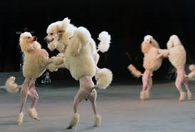
Standard
“Generally accepted”

Slide 7
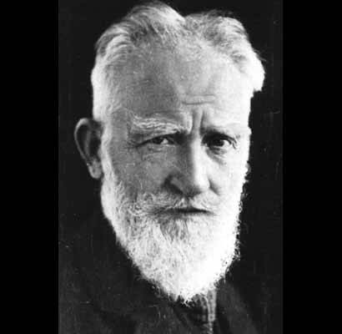
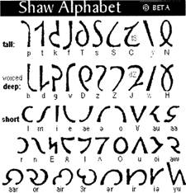
55 Letter English Alphabet
George Bernard Shaw
Charitable?
Yes
No
Notes:
Like we don’t have enough trouble with the 26 letters we already have. George Bernard Shaw. (Pygmalion, My Fair Lady, etc.).
There are still clubs of people who use his alphabet.
The court in England did NOT enforce this provision thinking it had no real social value.

Slide 8
Marsh – p. 581
Trust for every American 18 years old or older with no one being denied a share due to race, religion, marital status, sexual preference, or amount of wealth.
Charitable?
Yes.
No.

Slide 9
Charitable purpose?
Advancement of ideas
Held by many?
Unique to settlor?
Whims?
Religious purposes?

Slide 10
Other Charitable Trust Issues
Tax benefits
Successor trustees (§ 113.083(b))
Enforcement by attorney general
Cy pres to prevent lapse
RAP not applicable
Split interest trusts

