Slide 1
Pour Over Provisions
Mini-Review from Wills

Slide 2
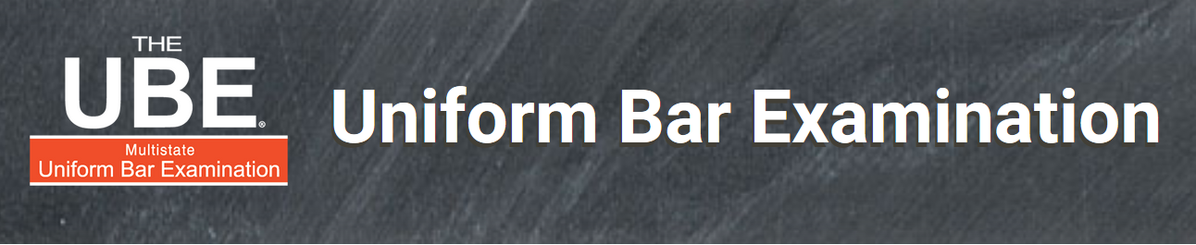
UBE Alert!
Pour over provisions are a Top 10 tested UBE topic.

Slide 3
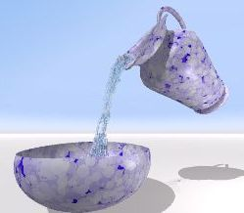
Defined
Will provision leaving property to inter vivos trust.
Why used?
  __________
  __________
  __________
  __________
Will
Trust

Slide 4
Texas – EC § 254.001
Expressly authorizes pour over technique.

Slide 5
Types of trusts into which pour overs allowed
1. Trust created by testator, even if after will execution.

Slide 6
Types of trusts into which pour overs allowed
2. Trust created by another person, even if after will execution.

Slide 7
Types of trusts into which pour overs allowed
3. Trust not yet in existence at date of testator’s death due to lack of funding as long as trust is:
  In writing, and
  Identified in will.
  Thus, pour over can be initial trust funding!

Slide 8
Types of trusts into which pour overs allowed
4. Cannot pour over into revoked or terminated trust.
  If attempted, gift lapses.

Slide 9

Governance of poured-over property
Current terms of trust, even if amendments made after testator’s death.

