Slide 1
Discretionary Trusts

Slide 2
Basic Idea
Trustee has discretion regarding:
which beneficiaries to pay, and/or
how much to pay.
May (or may not) be subject to a stated standard.
Also called “spray” or “sprinkle” trusts.

Slide 3
Interest of Beneficiary
No interest in income or principal until the trustee exercises discretion.
In effect, beneficiary hopes to receive property under a power of appointment the settlor placed into the trust.

Slide 4
Availability of interest to creditors
General rule = not reachable until paid
Exceptions:
Settlor and beneficiary same person
Child support under Family Code § 154.005
Court may order from income, but not principal.

Slide 5
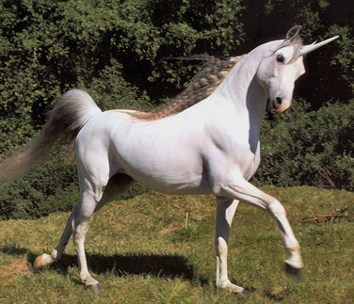
What does “discretion” mean?
Trust Code § 113.029(a).
Dillard – p. 569

