Slide 1
The Settlor

Slide 2
Generally
Creates trust by manifesting trust intent.
Also called:
Trustor (old term)
Grantor (tax, overbroad as applies to all transferors)
Donor (overbroad as applies to all gift givers)
Corporations, partnerships, etc. can be settlors. § 111.004(10).

Slide 3
Capacity -- § 112.007
Inter vivos trust = inter vivos gift
Testamentary trust = testamentary capacity

Slide 4
Retention of Powers by Settlor
Westerfeld v. Huckaby – p. 544
Texas Supreme Court 1971
Did settlor reserve too many powers?
5-4 decision of Supreme Court of Texas.

Slide 5
Retention of Powers by Settlor
Trust Code § 112.033
Settlor may retain:
Legal title (serve as trustee)
Life interest (considerable beneficial title)
Power to amend, modify, and revoke
Power to change beneficiary
Control over trust administration
Ability to add property to trust

Slide 6
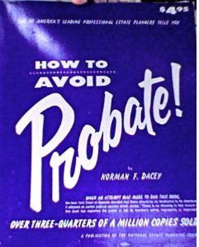
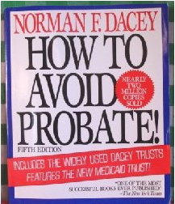
Retention of Powers by Settlor
“Dacey” Trusts
5 editions from 1965-1993.

