Slide 1
TRUST CREATION

Slide 2
Elements of a Valid Trust
Trust intent
Settlor with capacity
Compliance with Statute of Frauds
Legal purpose
Transfer of property
Trustee holding legal title
Beneficiary holding equitable title
Compliance with Rule Against Perpetuities

Slide 3
TRUST INTENT

Slide 4
Threshold Requirement
“A trust is created only if the settlor manifests an intention to create a trust.”
Trust Code § 112.002.

Slide 5
Basic Elements
Split of legal and equitable title. and
Imposition of enforceable (fiduciary) duties on the holder of legal title.

Slide 6
Basic Principals
1. Exact use of trust language not needed.
Perfect Union – p. 502

Slide 7
Basic Principals
2. “Weak” language showing intent may be sufficient.
Tomlinson v. Tomlinson – p. 507

Slide 8
Basic Principals
3. Settlor need not know or understand technical trust words.

Slide 9
Basic Principals
4. Use of trust language is not conclusive.

Slide 10
Basic Principals
5. Duties must be legally enforceable; not moral or ethical.
Precatory language insufficient.

Slide 11
Basic Principals
6. Present intent needed.
Intent to create a trust in the future is insufficient.

Slide 12
Problems
Page 509
Trust created.
No trust created.
I really thought about it but unfortunately could not figure out how to decide.
I did not think about it. I’m a slacker and did not read the assignment.

Slide 13
Statute of Uses
Source of trust intent requirements.
History of Uses:
Before 15th Century – honorary only; not enforceable.
During 15th Century – enforced in equity, even though not at law.
Uses used to avoid duties of property ownership under feudal land ownership system.

Slide 14
Statute of Uses
English Statute of Uses enacted in 1535.
Converted beneficiary’s equitable interest into legal interest thereby eliminating legal interest formerly held by the trustee.
Called “executing the use.”

Slide 15
Statute of Uses
Exception developed at common law
The “active” use where the trustee had actual duties to perform (not just a mere title holder).

Slide 16
Statute of Uses
Texas -- § 112.032
Applies to real property (but same result with personal property likely).
Trust continues if trustee has a power or duty relating to trust administration.
If trustee does not, legal title will vest in beneficiary.

Slide 17
Permissible combination of parties
At time of trust creation
During existence of trust.
[live demonstration]
Attempt to ascertain one rule to resolve all questions.

Slide 18
Permissible combination of parties
Basic principles
Any combination of parties is permissible as long as sole trustee is not sole beneficiary.
If all legal and equitable title in one person, merger occurs and no trust exists.
Trust Code § 112.034.

Slide 19
Distinguishing Trusts From Other Legal Relationships

Slide 20
Distinguishing trusts from other legal relationships
Litigants often want a relationship to be a trust to enhance recovery chances.
Key to distinguishing is to remember that only a trust has both:
Split of legal and equitable title, and
Imposition of enforceable duties on holder of legal title.

Slide 21
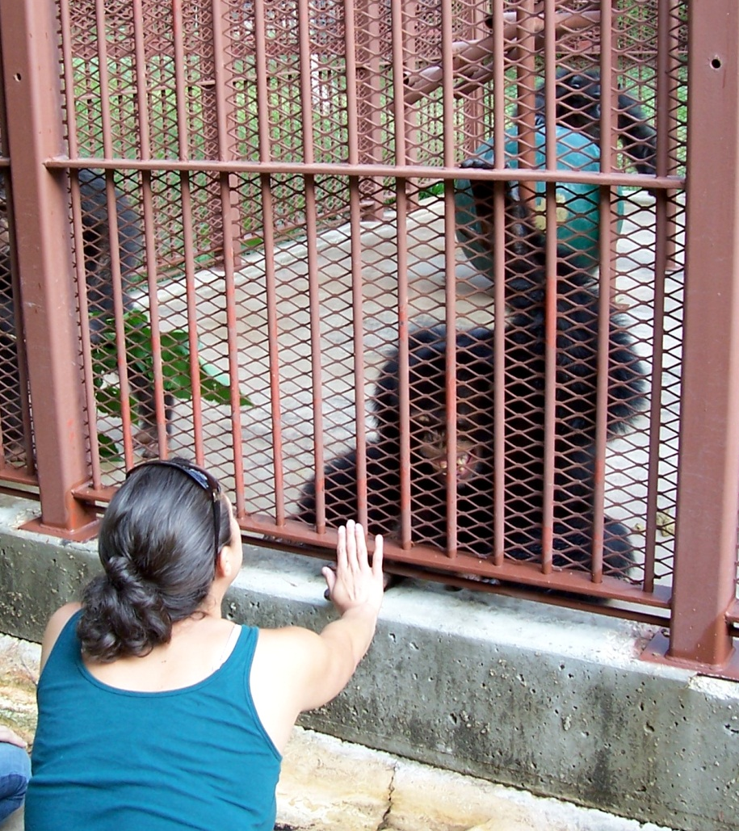
Distinguishing trusts from other legal relationships
Sarah – p. 512

Slide 22
Distinguishing trusts from other legal relationships
Problems – p. 518
Trust
No trust
I tried but I can’t figure it out.
I didn’t even try – I am still in that “Spring Break state of mind.”

