Slide 1
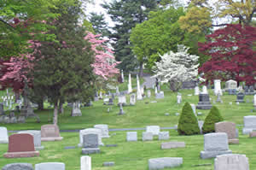
Burial Plots

Slide 2
Specific mention required
Health & Safety Code § 711.039(h).
Must make specific mention of plot in will to devise the plot.
If not:
Spouse automatically gets one plot.
Rest of plots pass to heirs (not will beneficiaries).

