Slide 1
Election Wills

Slide 2
Basic Idea
A will which attempts to devise/bequeath property which a beneficiary owns.
“I leave Bill Smith’s car to Margaret and I leave Bill Smith $1,000.”
“I leave the house described as [proper legal description of community property house] to Bill Smith. I leave the rest of my estate to Margaret.”

Slide 3

Choices available to Beneficiary
1. Elect against the will
Beneficiary retains all of beneficiary’s property.
But, Beneficiary may not receive any property under the will.

Slide 4
Choices available to Beneficiary
2. Elect under the will
Beneficiary consents to disposition of beneficiary’s property in the will.
Beneficiary then receives devise/bequest under the will.

Slide 5
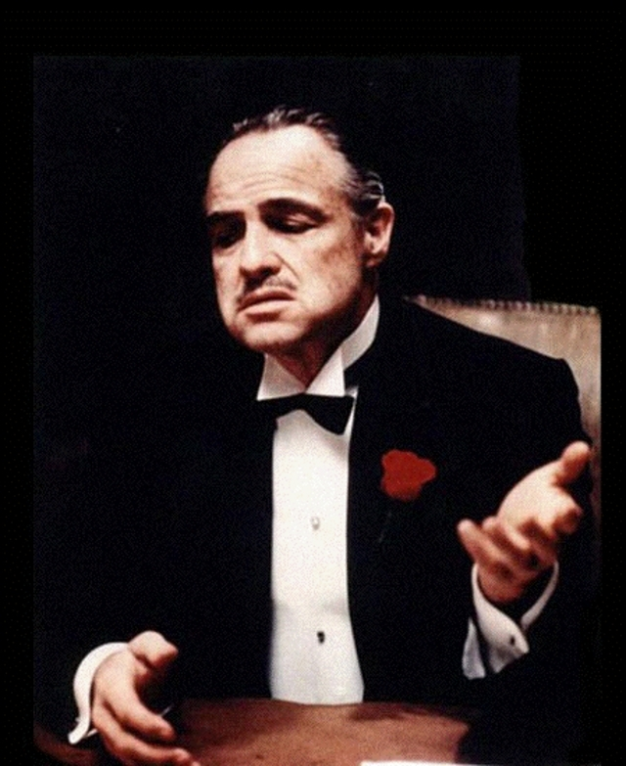
Use by “Controlling” Spouse
The wage-earning spouse wants to control where wages go upon death but normally can only control ½ because it is community property.
So, wage-earning spouse gives away all the community but leaves property (e.g., a life estate in entire community and separate) to spouse.

Slide 6
Interpretation Rules
Election exists only if will is open to no other construction.
Burden of proof is on person trying to show that an election exists.
Wright v. Wright – p. 300

Slide 7
Warning for married testators
Do not create an election will by mistake.
E.g., by describing a specific gift so that it includes the surviving spouse’s community share.
Advice – include anti-election provision

