Slide 1
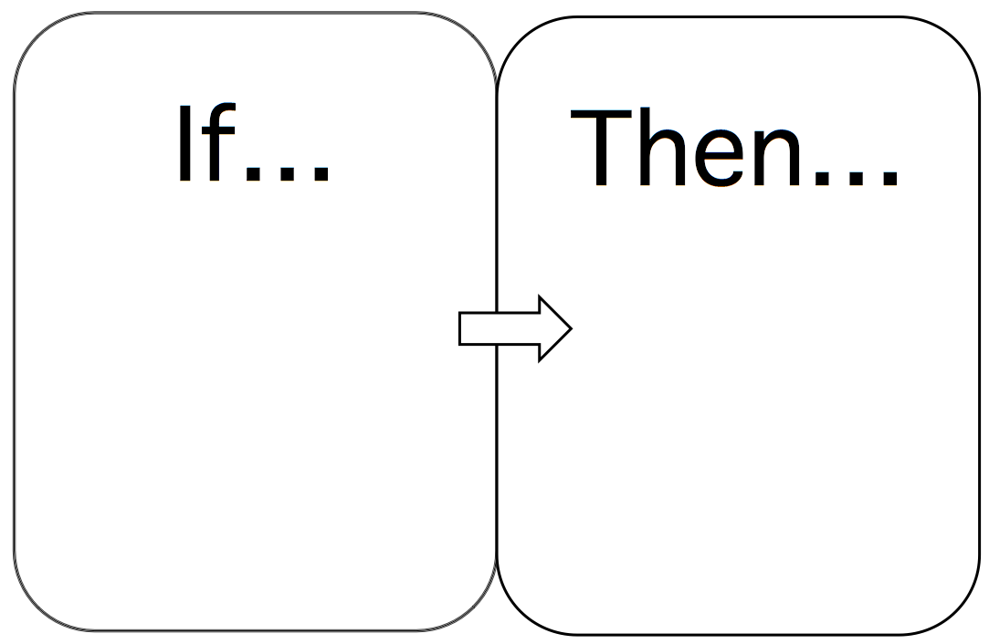
Conditional Wills

Slide 2
Defined
A will which states that it is effective only if a stated event occurs (or does not occur).
“This will is effective only if I die in 2059.”
“This will is effective only if the Texas Tech football team is ranked by the AP poll at least number 10 or better the year in which I die.”

Slide 3
Determining if a will is conditional
1. Presumption
Will is general, not conditional.
Events stated in the will are presumed to be inducements, not condition precedents.

Slide 4
Determining if a will is conditional
2. Cases
Ferguson – p. 281
“I am going on a journey and I may never come back alive so I make this will, but I expect to make changes if I live.”
Inducement only; not conditional.

Slide 5
Determining if a will is conditional
2. Cases
Perez – p. 283
“I make the following disposition to be fulfilled in case my death occurs during the surgery.”
Conditional.

Slide 6
Determining if a will is conditional
Note 2, page 286.

