Slide 1
Ante-Mortem Probate

Slide 2
Basic Idea
Obtain declaratory judgment while testator is alive that will is valid.
Thus, cannot contest after testator dies.
Allowed in Alaska, Arkansas, New Hampshire, North Dakota, and Ohio.

Slide 3
Advantages
Testator available for observation and to testify.
Reduces will contests.
Carries out testator’s intent.
Absolute certainty.

Slide 4
Disadvantages
Disruptive to family.
Contents of will revealed.
Potential for testator embarrassment.
Cost.

Slide 5

The Uniform Probate Code Story

Slide 6
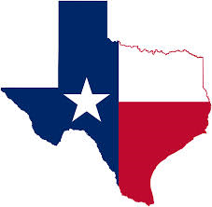
The Texas Story

