Slide 1

Will Contest Prevention

Slide 2
Will Contests Generally
Rare
  Less than 5% of wills are contested.
But, you must be on guard for contest-likely situations and plan accordingly.

Slide 3
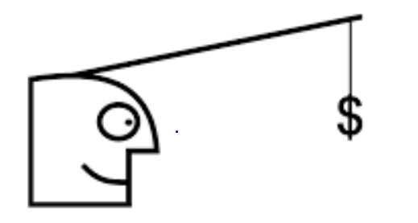
Incentive to Contest
Whenever a person would take more either:
  Under intestacy, or
  Under a prior will.

Slide 4
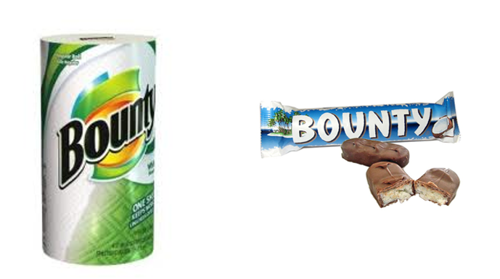
Reasons to Anticipate Will Contest
1. Exclusion of natural objects of bounty

Slide 5

Reasons to Anticipate Will Contest
2. Unequal treatment of children

Slide 6

Reasons to Anticipate Will Contest
3. Sudden or significant change in
disposition plan

Slide 7
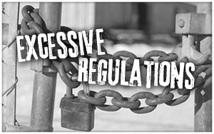
Reasons to Anticipate Will Contest
4. Excessive restrictions on gifts to
beneficiaries who are also heirs

Slide 8
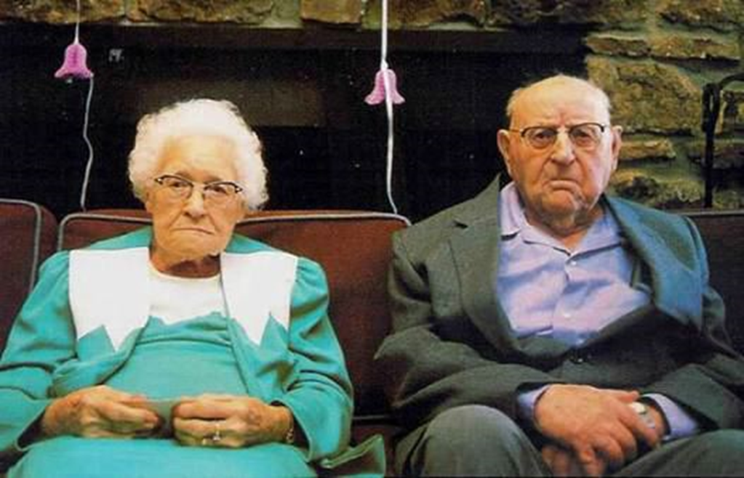
Reasons to Anticipate Will Contest
5. Elderly or disabled testator

Slide 9
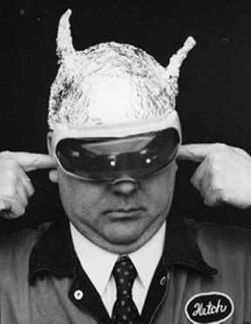
Reasons to Anticipate Will Contest
6. Testator who behaves strangely

Slide 10
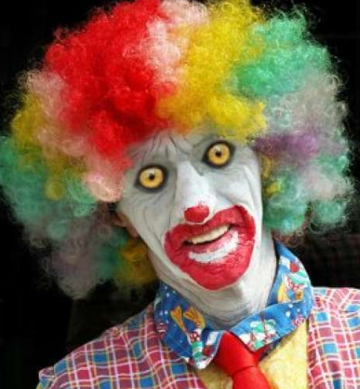
Techniques – The “Tool Box”
1. Include in terrorem (no contest) (forfeiture) provision
  Beneficiary who contests and loses forfeits testamentary gift.

Slide 11
Techniques – The “Tool Box”
1. Include in terrorem (no contest) (forfeiture) provision
  Good faith/just cause contests will not trigger forfeiture.
    EC § 254.005

Slide 12
Techniques – The “Tool Box”
1. Include in terrorem (no contest) (forfeiture) provision
  Strictly construed.
  Will not enforce if violate public policy such as forfeiture for suing executor for breach of duty.

Slide 13

Techniques – The “Tool Box”
1. Include in terrorem (no contest) (forfeiture) provision
  Drafting guidelines:
    Create substantial risk

Slide 14
Techniques – The “Tool Box”
1. Include in terrorem (no contest) (forfeiture) provision
  Drafting guidelines:
    Create substantial risk
    Describe triggering conduct

Slide 15
Techniques – The “Tool Box”
1. Include in terrorem (no contest) (forfeiture) provision
  Drafting guidelines:
    Create substantial risk
    Describe triggering conduct
    Indicate beneficiary of forfeited property

Slide 16
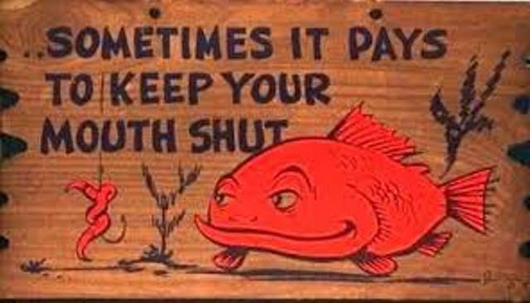
Techniques – The “Tool Box”
2. Do not explain reasons for property
disposition.

Slide 17
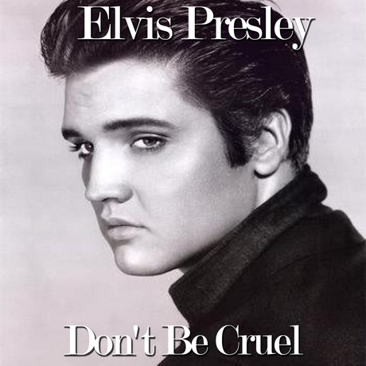
Techniques – The “Tool Box”
3. Avoid bitter or hateful language.

Slide 18
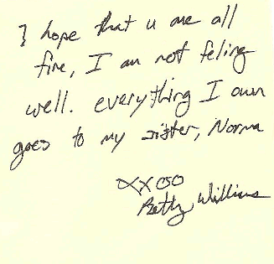
Techniques – The “Tool Box”
4. Use holographic “back up” will.

Slide 19

Techniques – The “Tool Box”
5. Enhance will execution ceremony.

Slide 20


Techniques – The “Tool Box”
6. Video-record will execution ceremony

Slide 21
Techniques – The “Tool Box”
6. Video-record will execution ceremony
  Potential benefits
    Accurate
    Preserves otherwise unavailable evidence:
      Tone of voice
      Demeanor
      Gestures
    Psychological benefit to testator

Slide 22
Techniques – The “Tool Box”
6. Video-record will execution ceremony
  Potential Disadvantages
    Not wish to expose testator to judge or jury
    Difficulty if recording turns out bad
    Alteration
    Inadvertent destruction
    Malpractice liability for not making recording?
    Unable to play

Slide 23
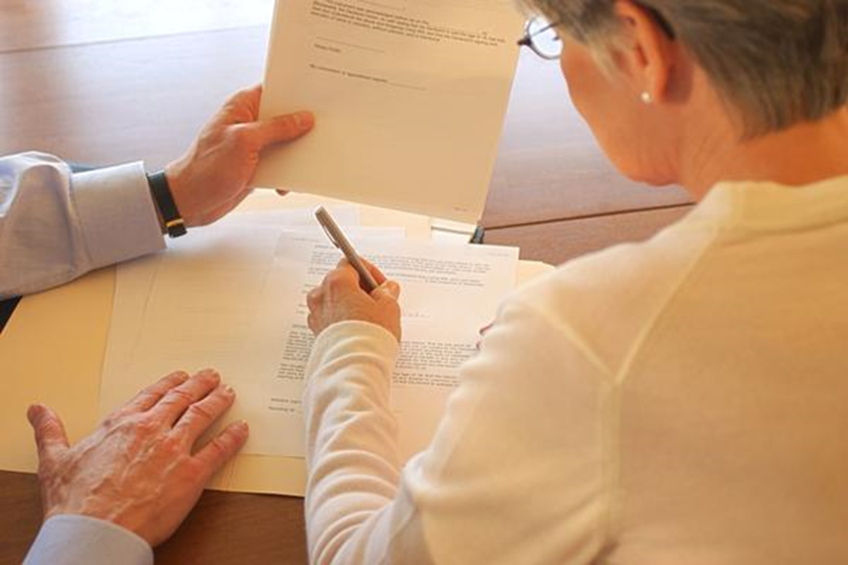
Techniques – The “Tool Box”
7. Select witnesses thoughtfully

Slide 24
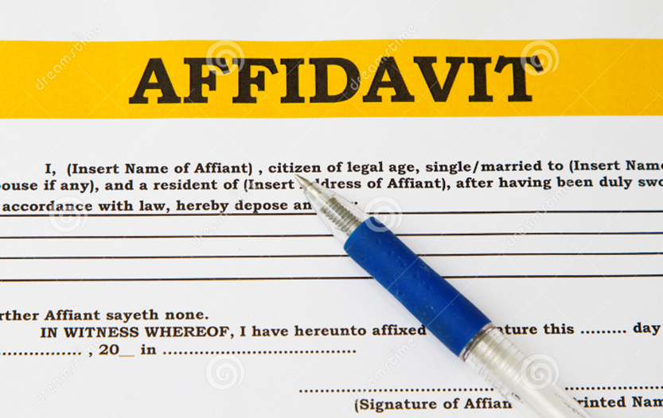
Techniques – The “Tool Box”
8. Obtain affidavits of individuals familiar
with testator.

Slide 25

Techniques – The “Tool Box”
9. Document transactions with testator
verifying intent.

Slide 26

Techniques – The “Tool Box”
10. “Coincidental” Doctor Appointment

Slide 27

Techniques – The “Tool Box”
11. Obtain other evidence to document
testator’s actions

Slide 28

Techniques – The “Tool Box”
12. Preserve prior will if better than
intestacy.

Slide 29

Techniques – The “Tool Box”
13. Reexecute same will on regular basis.

Slide 30

Techniques – The “Tool Box”
14. Consider a more “traditional”
disposition

Slide 31

Techniques – The “Tool Box”
15. “Trick” disinherited potential heir with
inter vivos gift.

Slide 32
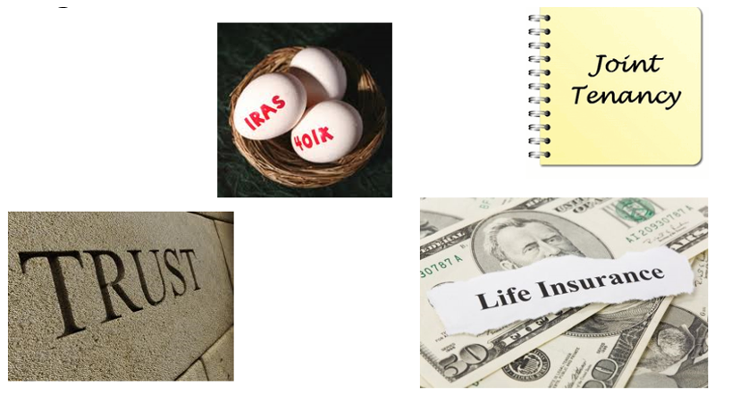
Techniques – The “Tool Box”
16. Use non-probate techniques.

Slide 33
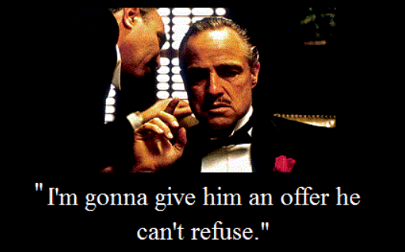
Techniques – The “Tool Box”
17. “Buy off” disinherited potential heir – contract not to contest.

