Slide 1

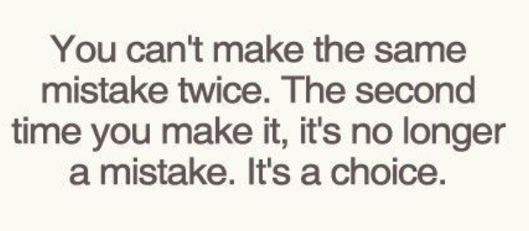
Mistake

Slide 2
Types of Mistake
1. Mistake in the Factum/Execution
  Testator did not know testator was signing a will or its contents but not because of someone’s evil conduct.
  No testamentary intent.
  Notes 1-4, p. 247-248
    Yes, admit to probate.
    No, deny probate.
    It is a close call because of the new “scrivener’s error” statute.

Slide 3
Types of Mistake
2. Mistake in the Inducement
  Testator mistaken as to extrinsic fact and makes will based on that fact.
  “I knew I was signing a will but would not have done so if I knew the truth but no one defrauded me.”

Slide 4
Types of Mistake
Remedy for mistake in the inducement
  Carpenter v. Tinney – p. 248
  No remedy
  Courts have no right to vary or modify the terms of a will or to reform it on the grounds of mistake.
    Unless scrivener’s error proved by clear and convincing evidence.

Slide 5
Public Policy

Slide 6
“Evil” Reason to Disinherit Child
Merrick v. Helter – p. 250

