Slide 1
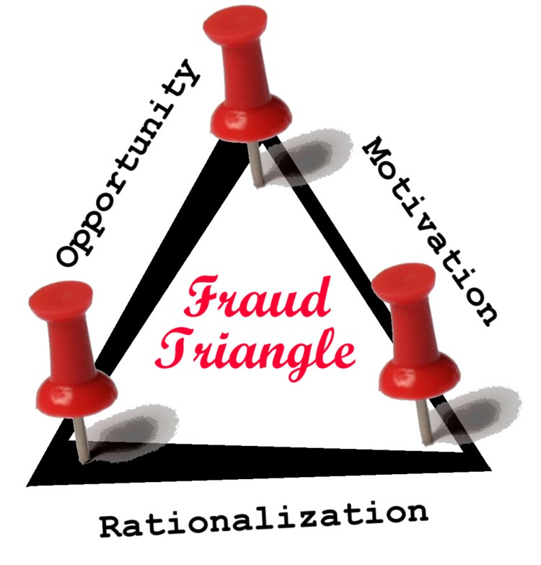
Fraud

Slide 2

Elements
1. False representation to testator.

Slide 3

Elements
1. False representation to testator.
2. Knowledge of falsity.

Slide 4
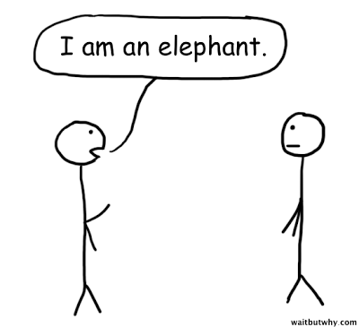
Elements
1. False representation to testator.
2. Knowledge of falsity.
3. Testator reasonably believed representation.

Slide 5
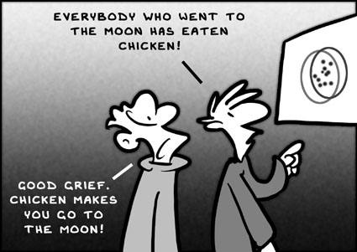
Elements
1. False representation to testator.
2. Knowledge of falsity.
3. Testator reasonably believed representation.
4. Causation

Slide 6
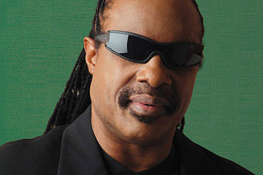
Types of Fraud
1. Fraud in the Factum (Fraud in the Execution)
Testator deceived as to identity or contents of instrument.
“I did not know I was signing a will.”
[actually, no testamentary intent]

Slide 7

Types of Fraud
2. Fraud in the Inducement
Testator deceived as to extrinsic fact and makes will based on that fact.
“I knew I was signing a will but would not have done so if I knew the truth.”
[actually, no testamentary intent]

