Slide 1
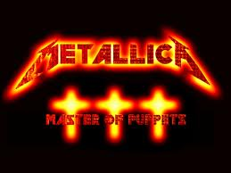
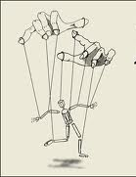
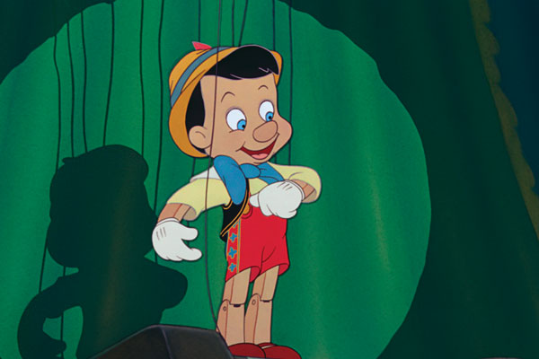
Undue Influence

Slide 2
Basic Elements
1. Influence
Existence
Be exerted

Slide 3
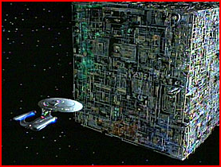
Basic Elements
2. Subvert testator’s mind
“Resistance is futile”

Slide 4
Basic Elements
3. Causation
Testator executed a will testator would not have executed but for the influence.

Slide 5
Burden of Proof
The burden of proof to show undue influence is on the contestant.

Slide 6
Proving Undue Influence
1. Direct Evidence
Rare

Slide 7
Proving Undue Influence
2. Circumstantial Evidence
a. Unnatural disposition

Slide 8
Proving Undue Influence
2. Circumstantial Evidence
a. Unnatural disposition
b. Opportunity (access)

Slide 9
Proving Undue Influence
2. Circumstantial Evidence
a. Unnatural disposition
b. Opportunity (access)
c. Relationship

Slide 10
Proving Undue Influence
2. Circumstantial Evidence
a. Unnatural disposition
b. Opportunity (access)
c. Relationship
d. Susceptibility/ability to resist

Slide 11
Proving Undue Influence
2. Circumstantial Evidence
a. Unnatural disposition
b. Opportunity (access)
c. Relationship
d. Susceptibility/ability to resist
e. Beneficiary connected with will preparation or execution.

Slide 12
Effect of Mere Opportunity
Rothermel v. Duncan – p. 234
Note 6, p. 238
Note 7, p. 238

Slide 13
Mortmain Statute
Statute which limits gifts to charity under specified circumstances.
Often held to be unconstitutional under 14th Amendment’s equal protection clause.
Texas does not have one.

Slide 14
Attorney as Will Drafter and Beneficiary -- Impact on Gift
Gifts deemed void
EC § 254.003
1. To drafting attorney.
2. To attorney who supervised will preparation.
3. To parent of #1 or #2.
4. To descendant of parent of #1 or #2.
5. To employee of #1 or #2.
6. To spouse of any of the above.

Slide 15
Attorney as Will Drafter and Beneficiary -- Impact on Gift
Exceptions:
1. Beneficiary is testator’s spouse.
2. Beneficiary is testator’s ancestor.
3. Beneficiary is testator’s descendant.
4. Beneficiary is related to testator within 3rd degree (blood or marriage).
5. BFP from “prohibited” beneficiary.

Slide 16
Attorney as Will Drafter and Beneficiary -- Impact on Law License
Texas Rules of Professional Conduct 1.8(c)
Presumption – violates Rules
Impact – Gift not automatically voided but attorney subject to discipline

Slide 17
Attorney as Will Drafter and Beneficiary -- Impact on Law License
Beneficiaries within scope of prohibition:
Attorney
Parent of attorney
Child of attorney
Sibling of attorney
Spouse of attorney

Slide 18
Attorney as Will Drafter and Beneficiary -- Impact on Law License
Exceptions:
1. Gift not substantial.
2. Testator related to beneficiary.

Slide 19
Attorney as Will Drafter and Beneficiary -- Cases
Shields – p. 240
Jones – p. 243

Slide 20

Attorney as Will Drafter and Beneficiary -- Advice
Don’t do it, even for family members.

Slide 21
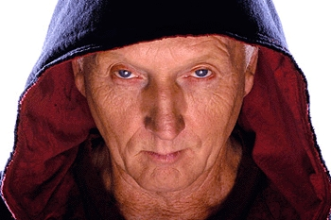
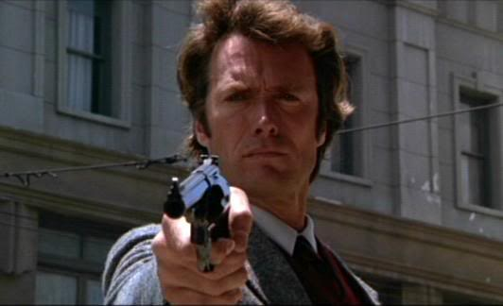
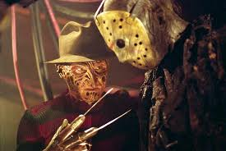
Duress
Same as undue influence but connotes physical (as compared to cerebral) pressure.

