Slide 1
Will Contest Grounds

Slide 2
Failure to satisfy will requirements
Lack of legal capacity
Very rare
Lack of testamentary capacity
Very common
Lack of testamentary intent
Rare
Failure to comply with formalities
Common

Slide 3
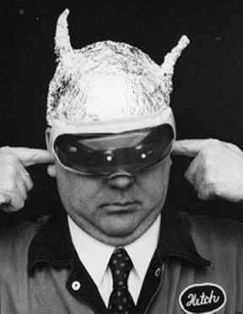
Insane Delusions

Slide 4
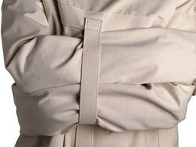
“Classic” Definition
Testator believes a state of supposed facts that:
1. Do not exist, and
2. No rational person would believe.

Slide 5
Examples?
1. Gulf Oil
2. Maringo
3. Lindley – p. 230
4. Reincarnation gift
5. Personal Revival Trusts

Slide 6

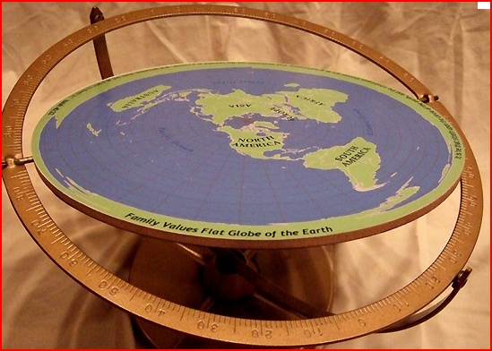
Analysis of Definition
Is classic definition a good test?
How tell an insane delusion from a false belief?

Slide 7
Will all insane delusions invalidate will?
Which one of the following is most likely to invalidate a will based on insane delusion?
I believe I am the supreme ruler of the universe. My will leaves my estate to Margaret.
I believe you are a space alien. My will leaves my estate to Margaret.
I discover Margaret is a space alien. I change my will to leave my estate to my mom.
I believe I’ve been abducted and probed by space aliens. I leave my estate to Margaret.

Slide 8

Nexus Requirement
Even if testator had an insane delusion, will remains valid unless insane delusion impacts property disposition.

