Slide 1

Will Contests: Introduction and Procedural Matters

Slide 2
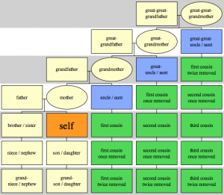
Who has motive to contest?
1. Heirs who would benefit by an intestate distribution.

Slide 3
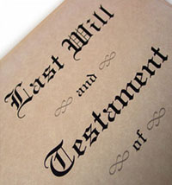
Who has motive to contest?
2. Beneficiary of prior will who would take if new will is invalid.

Slide 4
Standing to Contest -- EC § 55.001
Interested person
EC § 22.018
Spouse
Heir
Beneficiary
Creditor
Other person with property right in or claim against estate.

Slide 5
Necessary Parties -- EC § 55.052
Beneficiaries who are:
Institutions of higher education
Charities
Practice Tip:
Make parties everyone else you want bound by the court decision.

Slide 6
Type of Trial -- EC § 55.002
Contestant is entitled to a jury trial.

Slide 7
Statute of Limitations -- EC § 256.204
Non-Fraud Grounds
Lack of testamentary capacity
Failure to comply with formalities
Two years from when will admitted to probate.
Some states have very short SoLs such as 3 months.

Slide 8
Statute of Limitations -- EC § 256.204
Forgery or other fraud
Two years from discovery

Slide 9
Statute of Limitations -- EC § 256.204
Tolling
Two years from when an incapacitated person’s disabilities removed
Minors
Persons non compos mentis

Slide 10
Temporary Administration EC § 452.051
Court may appoint temporary administrator to handle estate while will contest is pending.

Slide 11
Practice Tip
Should you contest will before or after its admission to probate?
Why?

