Slide 1
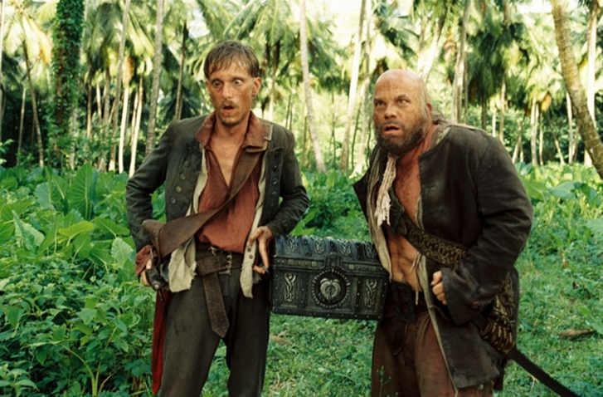
Dead Persons Statute

Slide 2
Issue
Can evidence of what testator said or did be used as evidence in will litigation?

Slide 3
Texas Rule of Evidence 601(b)
1. Only parties to the lawsuit might fit within the rule.
  Thus, Rule has no impact on non-party witnesses.

Slide 4
Texas Rule of Evidence 601(b)
2. Applies only if action by or against a personal representative.

Slide 5
Texas Rule of Evidence 601(b)
3. Only oral statements of the testator are covered
  not written statements
  not actions (conduct)

Slide 6
Texas Rule of Evidence 601(b)
4. Exceptions to exclusion:
  Corroborated, or
  Called by opposite party to testify.

Slide 7
Texas Rule of Evidence 601(b)
5. Examples – Note 3, page 226
  Yes, can testify.
  No, cannot testify.
  I’m not sure and would need to consult an evidence expert.

