Slide 1
Pour Over Provisions

Slide 2
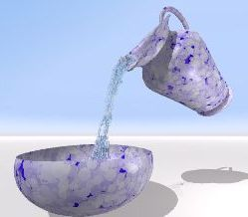
Defined
Will provision leaving property to inter vivos trust.
Why used?
__________
__________
__________
__________
Will
Trust

Slide 3

Historical Development
1. Not allowed.

Slide 4
Historical Development
2. Incorporation by reference.

Slide 5
Historical Development
3. Facts of independent significance.

Slide 6
Historical Development
4. Uniform Testamentary Additions to Trusts Act
1960
1991

Slide 7
Texas – EC § 254.001
Expressly authorizes pour over technique.

Slide 8
Types of trusts into which pour overs allowed
1. Trust created by testator, even if after will execution.

Slide 9
Types of trusts into which pour overs allowed
2. Trust created by another person, even if after will execution.

Slide 10
Types of trusts into which pour overs allowed
3. Trust not yet in existence at date of testator’s death due to lack of funding as long as trust is:
In writing, and
Identified in will.
Thus, pour over can be initial trust funding!

Slide 11
Types of trusts into which pour overs allowed
4. Cannot pour over into revoked or terminated trust.
If attempted, gift lapses.

Slide 12

Governance of poured-over property
Current terms of trust, even if amendments made after testator’s death.

