Slide 1
Facts of Independent Significance

Slide 2
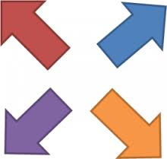
Basic Idea
Can we look outside the four corners of the will to ascertain at-death property distribution?

Slide 3
Defined
Something which has a legal purpose independent of disposing of property at death (not a testamentary instrument).
Thus, can be effective to impact new owner of property without compliance with will formalities.

Slide 4
Examples
1. Welch – p. 213
  Determine terms of trust from predeceased brother’s will.

Slide 5
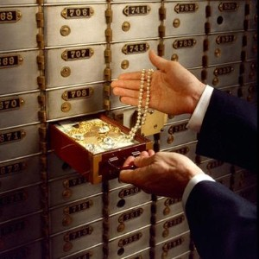
Examples
2. Safe deposit box contents – n. 3, p. 216

Slide 6
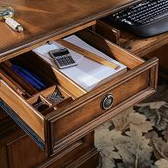
Examples
3. Note in desk drawer – n. 4, p. 216

Slide 7
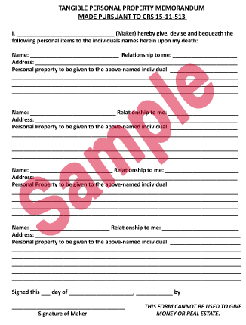
Tangible Personal Property Document

Slide 8
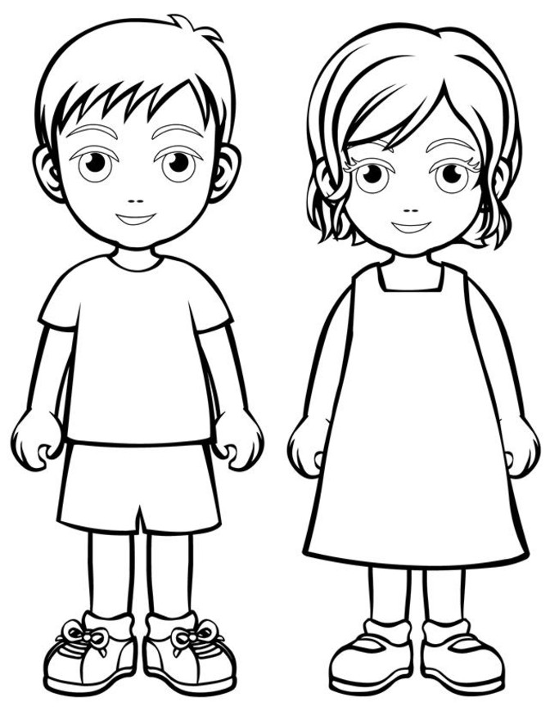
Examples
4. Identity of class gift members

Slide 9
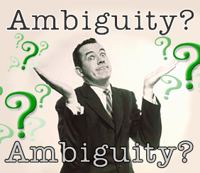
Examples
5. Evidence to resolve ambiguities

Slide 10
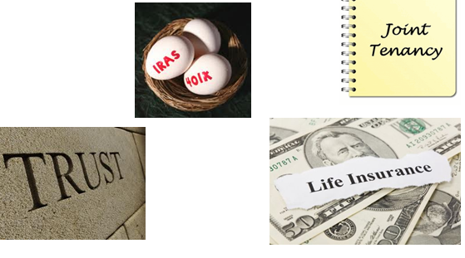
Examples
6. Non-probate transfers

Slide 11

Examples
7. Tagging items of personal property
To my daughter, Doris.

