Slide 1
Incorporation by Reference

Slide 2
Basic Idea
Treat written material that is not physically part of the text of the will as being in the will.
A “legal fiction” (pretending).

Slide 3

Requirements
1. Testator must intend to incorporate.

Slide 4
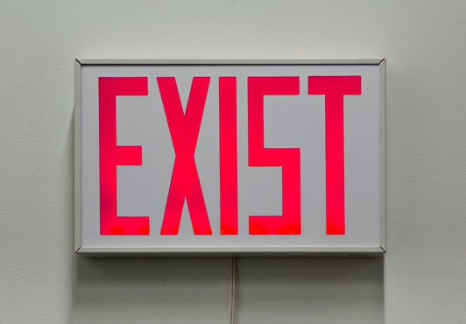
Requirements
2. Incorporated writing must be in existence when testator executes the will.

Slide 5

Requirements
3. Incorporated writing must be reasonably identified.

Slide 6
Issues
1. Validity of incorporated writing irrelevant.
  Does not need to be signed or witnessed.
  Could be written without capacity, under undue influence, fraud, etc.
    Allday v. Cage – p. 206

Slide 7
Issues
2. Codicil incorporates will (basis of republication)

Slide 8
Issues
2. Codicil incorporates will (basis of republication)
  What result if:
  a. Valid will + Valid codicil

Slide 9
Issues
2. Codicil incorporates will (basis of republication)
  What result if:
  b. Valid will + Invalid codicil

Slide 10

Issues
2. Codicil incorporates will (basis of republication)
  What result if:
  c. Invalid will + Valid attested codicil

Slide 11
Issues
2. Codicil incorporates will (basis of republication)
  What result if:
  d. Invalid attested will + Valid holographic codicil
    Hinson v. Hinson – p. 208
X

Slide 12

Issues
2. Codicil incorporates will (basis of republication)
  What result if:
  e. Invalid holographic will + Valid holographic codicil

