Slide 1
Interpretation and Construction

Slide 2
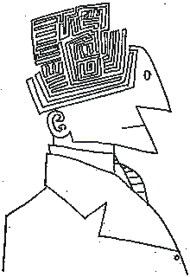
Interpretation
Determine testator’s actual intent from will or permissible extrinsic evidence.

Slide 3
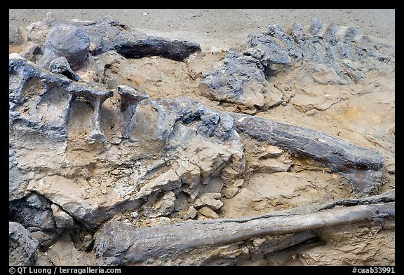
Construction
Determine testator’s presumed intent from will or permissible extrinsic evidence.

Slide 4
When issue arises?
1. Before probate (not often)
2. After probate (most common)

Slide 5
Who raises issue?
1. Personal Representative
Desire to perform job correctly by distributing to correct beneficiary.
2. Beneficiaries and heirs
Desire to get as much of the estate as possible.

Slide 6
Basic Rules
1. Fact that the testator left a will, especially if it has a residual clause, indicates an intent not to die intestate.

Slide 7
Basic Rules
2. Among two or more contradictory provisions, the last one prevails as it was written closer to death (even if just by a few seconds).

Slide 8
Basic Rules
3. The interpretation that results in the least unequal distribution among takers of equal relationship to the testator is preferred.

Slide 9
Basic Rules
4. A will is construed as a whole, not from isolated parts out of context.

