Slide 1
Revocation by Physical Act

Slide 2

Requirements to Revoke by Physical Act
1. Mental Capacity

Slide 3

Requirements to Revoke by Physical Act
2. Revocation Intent

Slide 4

Requirements to Revoke by Physical Act
3. Physical Act – EC § 253.002
“destroying or canceling”
By testator, or
By proxy in testator’s presence.

Slide 5
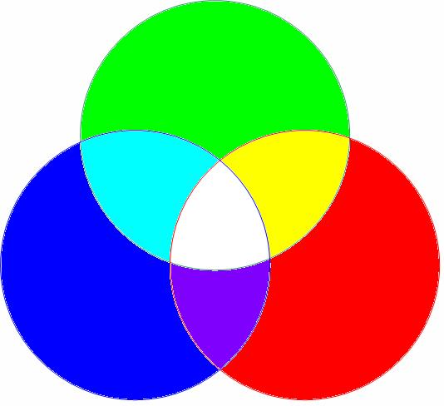
Requirements to Revoke by Physical Act
4. Concurrence of first three requirements.

Slide 6

Problems 1-4 on pages 165-166

Slide 7
Remedy if intent and physical act do not mesh
1. If no evil conduct
No remedy – will is not revoked.

Slide 8
Remedy if intent and physical act do not mesh
2. If evil conduct
Constructive trust.
Morris v. Morris – p. 166

Slide 9
Partial revocation by physical act
Examples:
I leave $10,000 to Steve McGarrett.
I leave $10,000 to each of Steve McGarrett and Daniel Williams.
Approach varies by jurisdiction:
Effective to revoke gift
No effect on gift
What policy supports each approach?

Slide 10
Partial revocation by physical act
Texas
Typed will – Leatherwood v. Stephens – p. 168
Holographic will

Slide 11
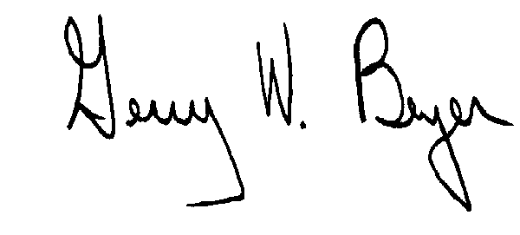
Partial revocation by physical act
1. I leave my house to X.
2. I leave $10,000 to Y.
3. I leave the rest to Z.
What result?

