Slide 1
Lapse

Slide 2
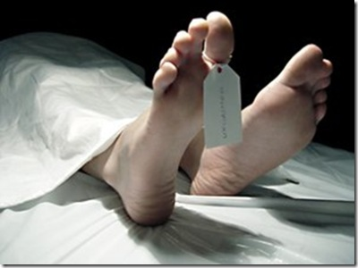
Lapse defined
Gift fails (lapses) because beneficiary dies before testator.

Slide 3
Distribution of Lapsed Gifts -- Overview
1. Under express terms of will.
EC § 255.151

Slide 4
Distribution of Lapsed Gifts -- Overview
1. Under express terms of will.
2. Saved by legal rule.
Private Gift – Anti-lapse statute
Charitable Gift – Cy pres doctrine

Slide 5
Distribution of Lapsed Gifts -- Overview
1. Under express terms of will.
2. Saved by legal rule.
3. Via residuary clause.
EC § 255.152

Slide 6
Distribution of Lapsed Gifts -- Overview
1. Under express terms of will.
2. Saved by legal rule.
3. Via residuary clause.
4. Via intestacy.
EC § 255.152

Slide 7
Anti-Lapse Statutes -- Generally
1. Save gift for descendants of deceased beneficiary.

Slide 8
Anti-Lapse Statutes -- Generally
2. Jurisdictions vary regarding the relationship needed between the testator and the beneficiary to trigger anti-lapse statute.
Only if B is lineal descendant of T.
Only if B is related as [ ] of T.
Applicable in all cases where B predeceases T even if no blood relationship.

Slide 9
Texas Anti-Lapse -- EC § 255.153
1. Beneficiary is descendant of:
Testator, or
Child
Grandchild, etc.
Testator’s parent.
Brother/sister
Niece/nephew, etc.

Slide 10
Texas Anti-Lapse -- EC § 255.153
2. Beneficiary physically or legally dies before testator.
Biological death first.
Biological death within 120 hours or testator specified survival period.
Disclaims gift.

Slide 11
Texas Anti-Lapse -- EC § 255.153
3. Beneficiary left at least one surviving descendant.

Slide 12
Texas Anti-Lapse -- EC § 255.153
4. Beneficiary’s descendant outlives testator by 120 hours.

Slide 13
Texas Anti-Lapse -- EC § 255.153
5. Gift then passes to beneficiary’s descendants per capita with representation.

Slide 14
Texas Anti-Lapse -- EC § 255.151
6. Ways to avoid:
Provide alternate gift in will.
Require survival in will.

Slide 15
Partial Lapse in Residuary Clause
Fact Pattern:
“I leave remainder of my estate to A, B, and C.”
A dies before Testator.
Anti-lapse statute based on relationship status is inapplicable.
Issue:
Who gets A’s share?

Slide 16
Partial Lapse in Residuary Clause
Orthodox View
Swearingen v. Giles – p. 161
Passes by intestacy.

Slide 17
Partial Lapse in Residuary Clause
Modern View
EC § 255.152
Imply survivorship language.

Slide 18
Problem 4, p. 162
“I leave $10,000 to A and B in equal shares.”
“I leave remainder to C and D in equal shares.”
A and C predecease Testator.
Assume A and C are not related to Testator.
How should Testator’s estate be distributed?

Slide 19
Problem 4, p. 162
$5,000 to B, residuary to D.
$10,000 to B, residuary to D.
$5,000 to B, 50% of residuary to D, 50% of residuary via intestacy.
$10,000 to B, $5,000 to D, residuary via intestacy.

Slide 20
Cy Pres
Method of saving lapsed charitable gifts.
Testator must have general charitable intent.
Gift saved for equitably equivalent charity.

