Slide 1
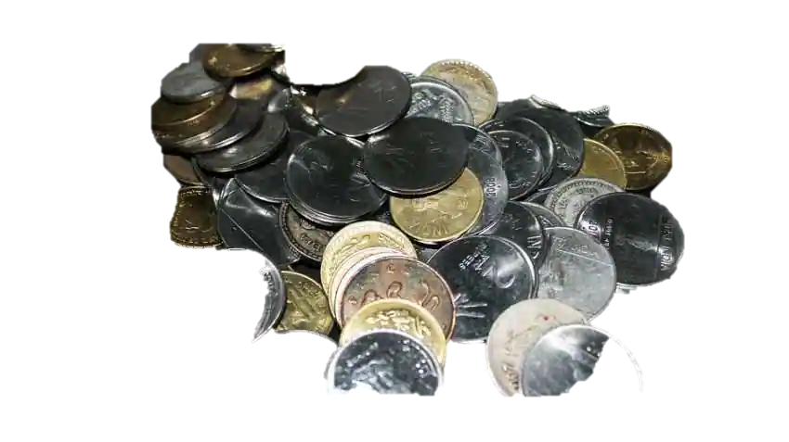
The 20 Coin Problem

Slide 2


Slide 3
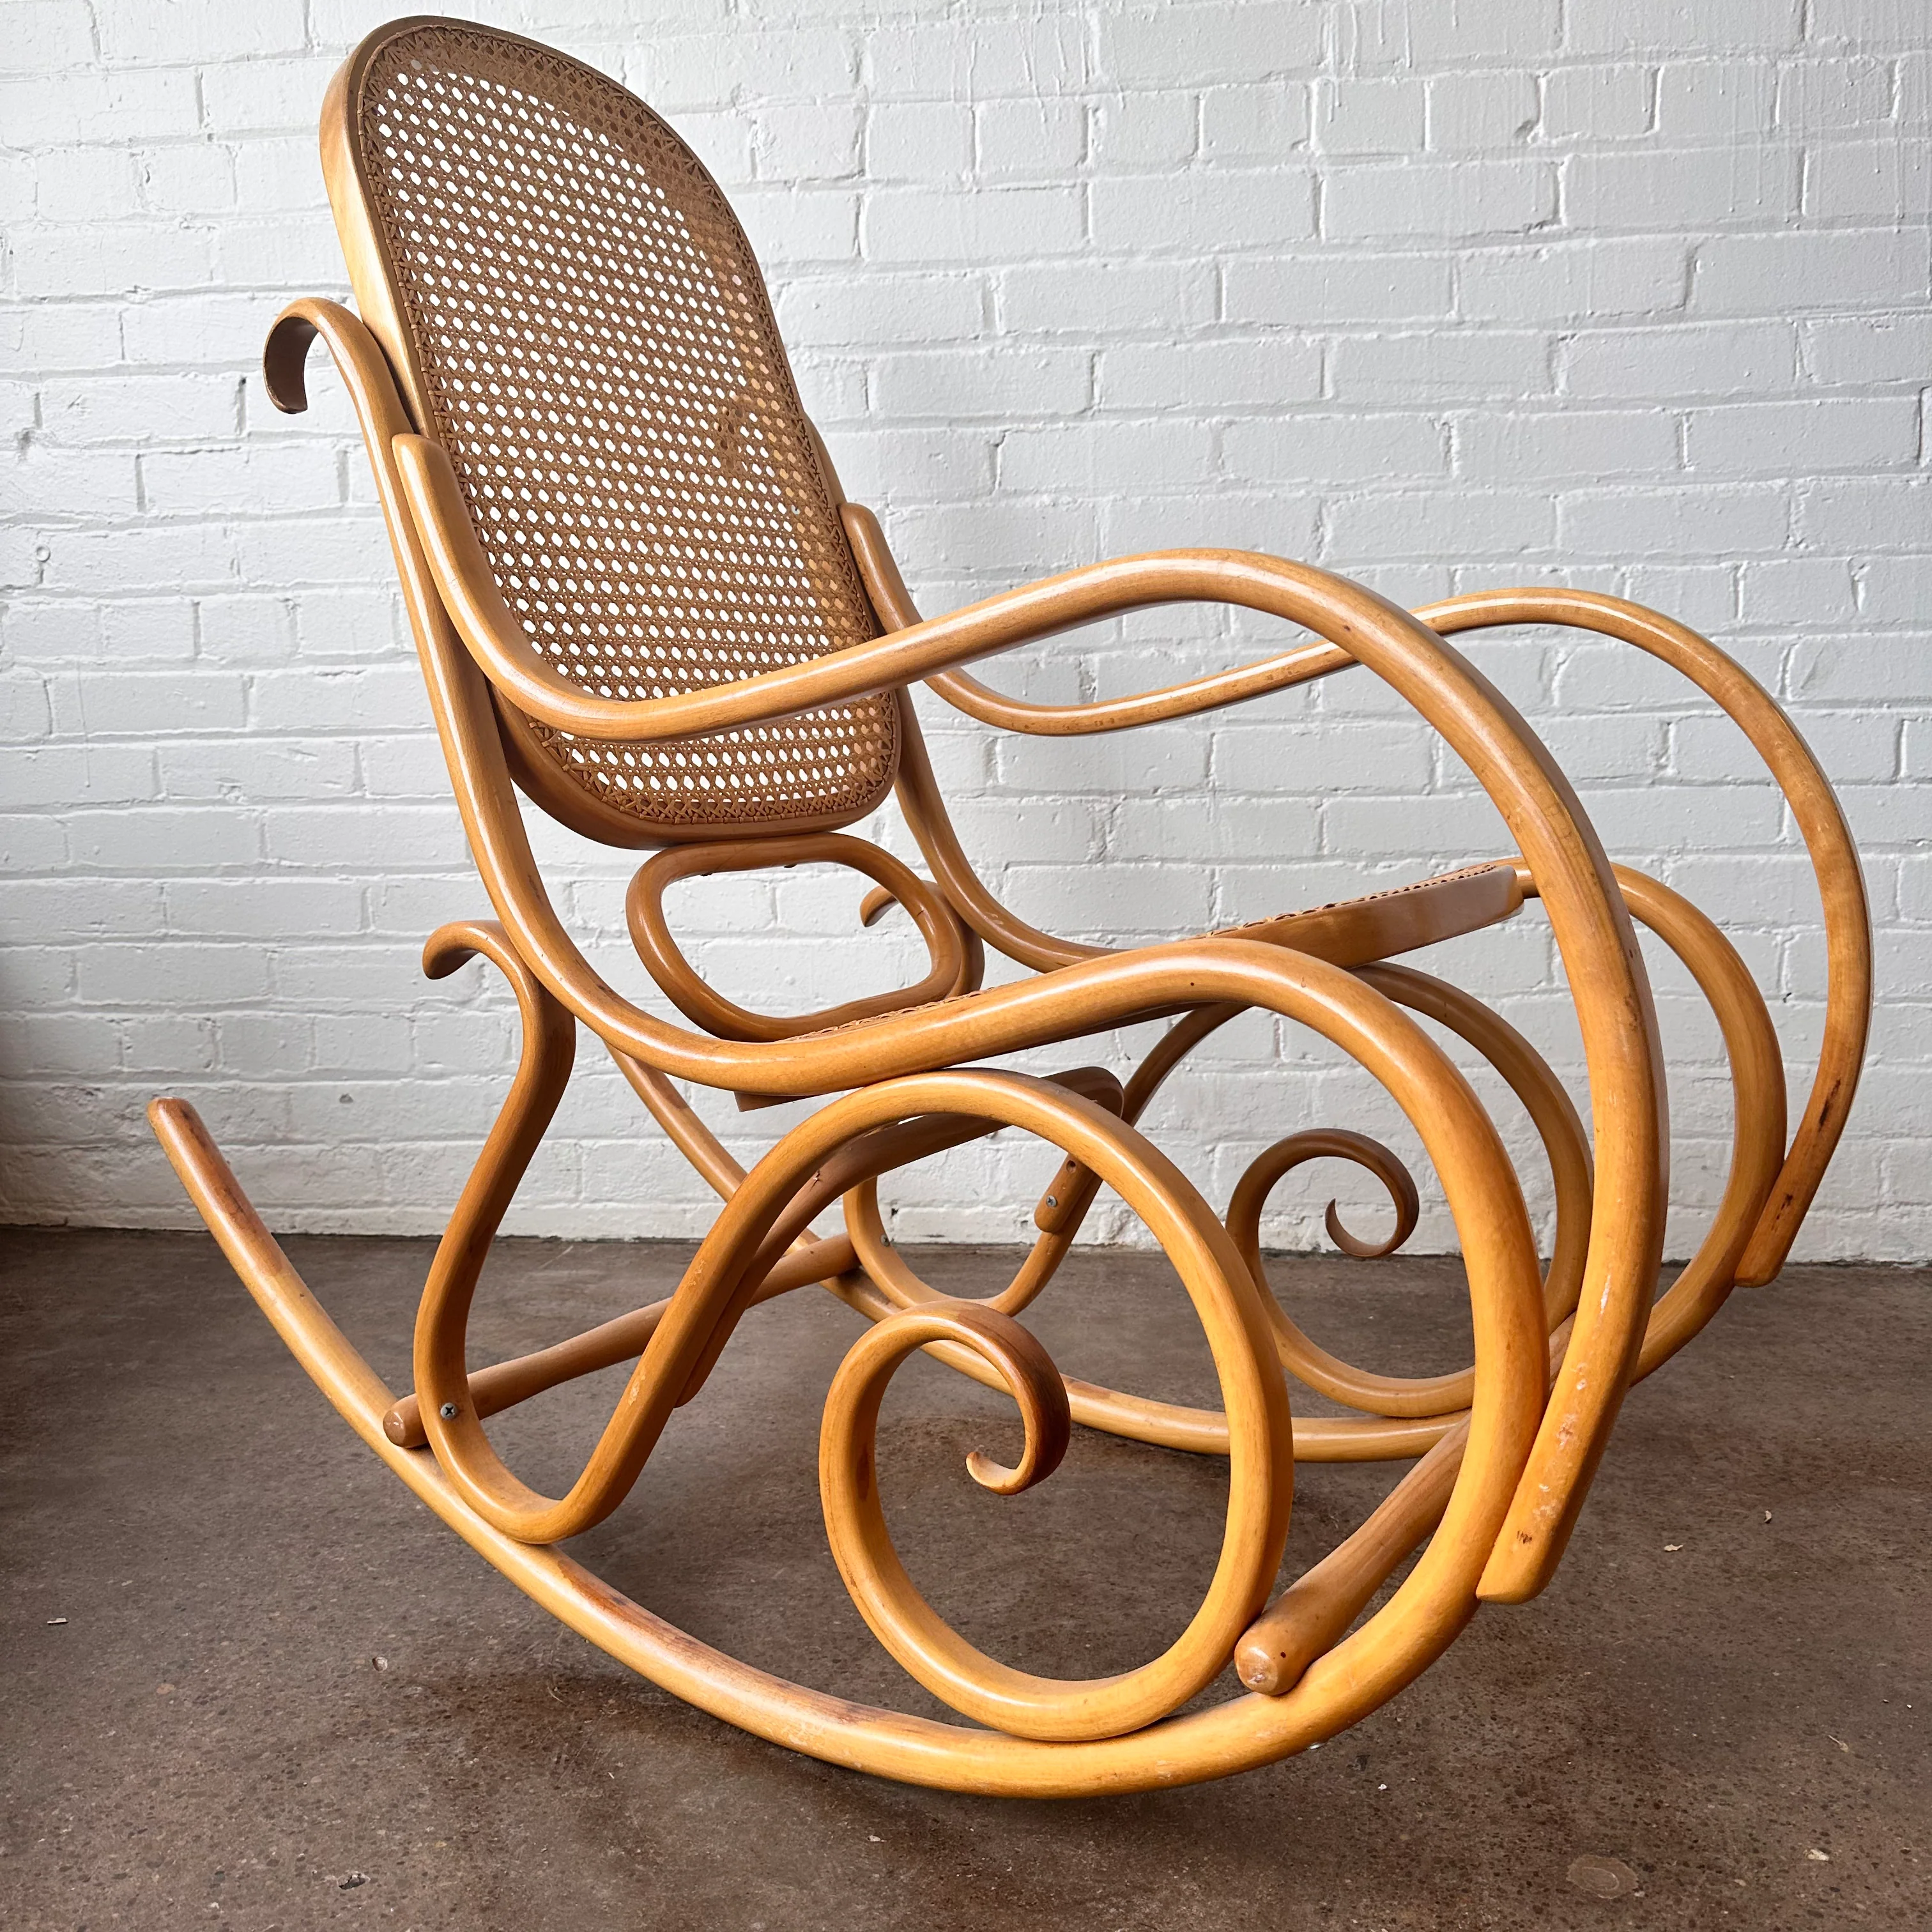
In re McDowell’s Estate

Slide 4
Review – Changes to People
Change to testator
Marriage
Divorce
Change to testator’s children

Slide 5

Pretermitted Children

Slide 6
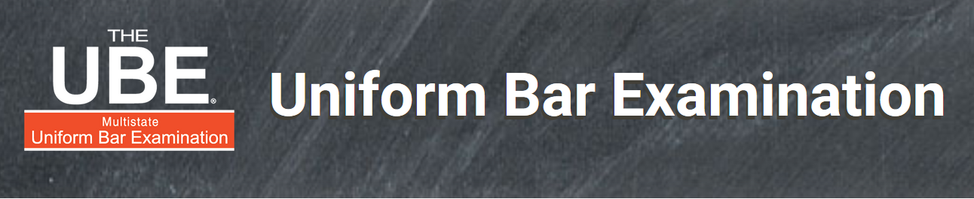
UBE Alert!
Pretermitted children is a common UBE topic.

Slide 7
Defined
Child born or adopted after Testator executes the will.
Note: Some states include children born before will execution who are:
omitted from the will, or
whom the testator erroneously believed were dead.
Governed by:
EC §§ 255.051-255.056

Slide 8
Purpose & Policy
Provide for “left-out” children by giving them a forced share under statutorily-specified circumstances.
Based on theory that the testator would have provided for them if he/she had known they would exist.
Statute designed to carry out a presumed intent but which may not match actual intent.

Slide 9
When Pretermitted Child NOT Entitled to a Share
1. T provided for PC in will
For example,
“I leave my ranch to my children.”
“I leave all my property to my spouse. If my spouse predeceases me, I leave all my property to my children.”

Slide 10
When Pretermitted Child NOT Entitled to a Share
1. T provided for PC in will, or
2. T provided for PC by non-probate asset
For example,
As a beneficiary of a life insurance policy.
As a pay on death beneficiary of a bank account.

Slide 11
When Pretermitted Child NOT Entitled to a Share
1. T provided for PC in will, or
2. T provided for PC by non-probate asset, or
3. T mentioned PC in will.
Example
“I intentionally make no provision for any child born or adopted after I execute this will.”
Who “really” wants this provision?

Slide 12
If Will Makes No Gift to Testator’s Children -- Situations
Testator had no children at time of will execution.
Testator has one or more children at time of will execution but leaves them nothing.

Slide 13
If Will Makes No Gift to Testator’s Children -- Computation
Ascertain amount of estate not passing to PC’s other parent.
Give PC share of this amount as if Testator died intestate with no surviving spouse.
Pretend this amount (community one-half plus separate property) is individual property when doing the computation.

Slide 14
If Will Provides for at Least 1 of Testator’s Then Living Children
Ascertain amount of estate given to T’s children.
Ascertain number of children beneficiaries.
Ascertain number of PCs.
Add Bs plus PCs (Step 2 + Step 3).
Divide Step 1/Step 4 to determine amount each PC receives.
Gifts to other children reduced proportionately using the left/given formula.

Slide 15
Problem 5(a)
Husband == Wife
A
B
C
PC
W’s will gives her entire estate to H.

Slide 16
Problem 5(b)
Husband == Wife
A
B
C
PC
W’s will gives $25,000 to H and the residuary worth $400,000 to the American Red Cross.

Slide 17
Problem 5(c)
Husband == Wife
A
B
C
PC
W’s will gives her entire estate worth $500,000 to the American Red Cross.

Slide 18
Problem 5(d)
Husband == Wife
A
B
C
PC
W’s will gives:
$50,000 to A
$30,000 to B
$20,000 to C
Residuary worth $200,000 to BFF

Slide 19
Problem 5(e)
Husband == Wife
A
B
C
PC
W’s will gives $100,000 to A and residuary worth $250,000 to the Tech Law Foundation.

Slide 20
Problem 5(f)
Husband == Wife
A
B
C
PC
Wife named PC as the beneficiary of her life insurance policy worth $10,000. Wife’s estate is worth $300,000 with each of A, B, & C getting $100,000.

Slide 21
Problem 6(a)
Husband == Wife
PC
W’s will gives her entire estate to H.

Slide 22
Problem 6(b)
Husband == Wife
PC
W’s will gives $25,000 to H and the residuary worth $250,000 to the American Red Cross.

Slide 23
Problem 6(c)
Husband == Wife
PC
W’s will gives her entire estate worth $100,000 to the American Red Cross.

Slide 24
Problem 7
Concubine – Husband == Wife
PC
H’s will leaves entire estate to Wife.

Slide 25
Ozuna v. Wells Fargo – p. 156
T names Ozuna as a will beneficiary.
Later, T adopts Ozuna.
T dies.
Ozuna wants pretermitted child share because it is larger than gift under the will.
How much does Ozuna receive?

Slide 26
Lessons
Always discuss with clients the possibility of a pretermitted child regardless of client’s age or reproductive ability and express that intent in the will.
Adopting a child is always possible and grandparents often adopt grandchildren.
Warn female married clients to talk to male partner about pretermitted child clause of male partner’s will.

