Slide 1

Ademption by Extinction

Slide 2
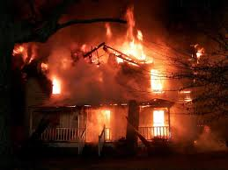

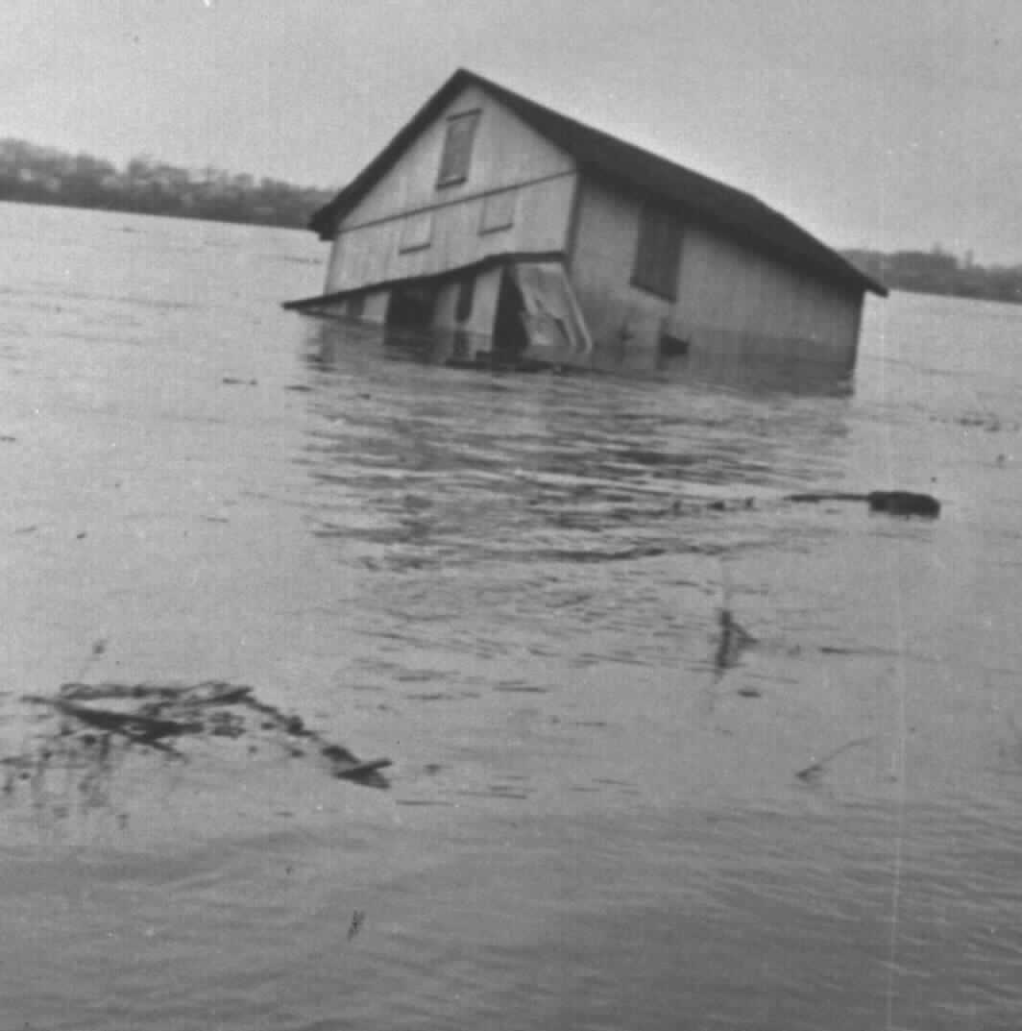
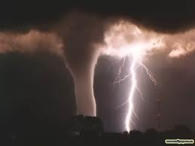


Causes

Slide 3
Basic Principles of Ademption
1. A specific gift adeems, that is, fails.
See Rogers v. Carter – p. 131

Slide 4
Basic Principles of Ademption
2. Voluntary partition among c0-owners
“A, B, and C as joint tenants” each owning undivided one-third.
Partition so each owns 100% of one-third.
Regarding part testator still owns, no ademption.

Slide 5
Basic Principles of Ademption
3. Pro tanto (“only to that extent”)
Testator devised 100 acre farm but dies owning only 75 of those acres.
Regarding part testator still owns, no ademption.

Slide 6
Possible Remedies
1. Beneficiary receives equivalent value
No!

Slide 7
Possible Remedies
2. Executor purchases item for beneficiary
No!

Slide 8
Possible Remedies
3. Tracing into proceeds still identifiable in Testator’s estate
No! – See Shriner’s Hospital – p. 134
Unless, involuntary sale (e.g., by a guardian).
Note: some states allow tracing into insurance proceeds still in estate

Slide 9
Possible Remedies
4. Substantially equivalent gift
No!
Note: UPC and some states allow beneficiary to receive a substantially equivalent gift if contained in testator’s estate.

Slide 10
Application to corporate stock
Specific
Words of Identification
Words of Possession
General
No words of identification or possessione
Note 9, page 138

Slide 11
Practice Advice
Explain to client who makes specific gifts.
Ascertain client’s intent.
Document intent in will

Slide 12
Practice Advice
I leave my 1974 AMC Gremlin to X.
If this car is not in my estate at the time of death,
[this gift adeems.]
[X may select one car from my estate.]
[X receives $25,000.]
[X gets my Dell computer.]

