Slide 1
4. Formalities Military Testamentary Instrument

Slide 2
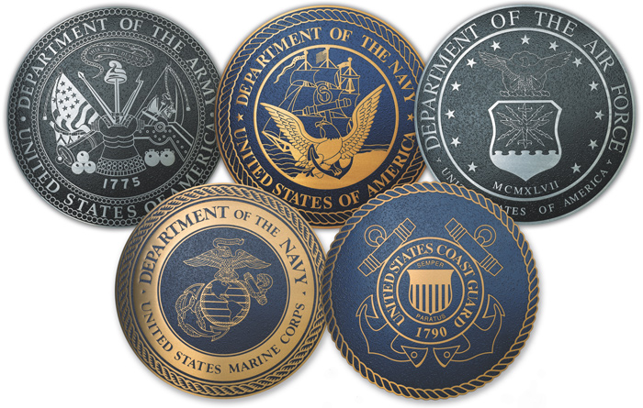
Generally

Slide 3
Basic Idea
If will executed with formalities specified by federal law, deemed to satisfy formalities of all states.

Slide 4
Policy
Allow JAGs to prepare wills for service members without hassling with particular requirements of each state.

Slide 5
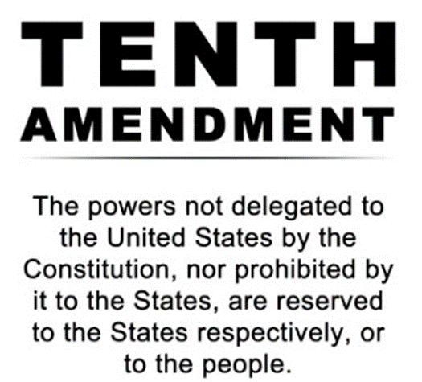
Issue
Does it violate 10th Amendment?

Slide 6
4. Formalities Statutory Wills

Slide 7
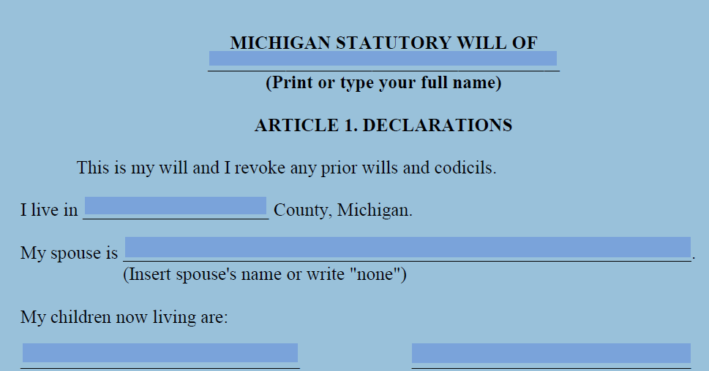
Wills forms provided by state law
California, Maine, Michigan, Wisconsin

Slide 8
4. Formalities Notarized Will

Slide 9
UPC § 2-502(a)(3)
If notarized (acknowledged), no witnesses needed even if not handwritten
Just a few states have enacted. For example:
Colorado
Massachusetts
North Dakota

