Slide 1
4. Formalities Holographic Wills EC § 251.052

Slide 2
Ramification
In about 50% of the states including Texas, removes the attestation requirement.
Some states add requirements before witnessing excused such as:
Dated
Found among valuable papers
Policy – less chance for fraud

Slide 3
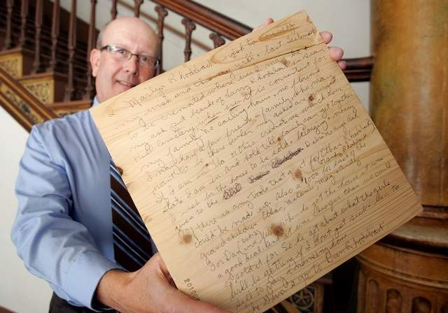
Requirements
1. In writing
Same as for attested wills, except for handwriting requirement.

Slide 4
Requirements
2. Signed
Same as for attested wills, except for handwriting requirement.

Slide 5
Requirements
3. “Wholly” in Testator’s Handwriting
3 approaches

Slide 6
Requirements
3. “Wholly” in Testator’s Handwriting
3 approaches
a. Intent

Slide 7
Requirements
3. “Wholly” in Testator’s Handwriting
3 approaches
b. Surplusage

Slide 8
Requirements
3. “Wholly” in Testator’s Handwriting
3 approaches
c. Material Provision

Slide 9
Which approach does Texas follow?
Intent
Surplusage
Material Provision
I did not read the case so I don’t know.

Slide 10
Requirements
3. “Wholly” in Testator’s Handwriting
Texas
Maul v. Williams – p. 115
Adopts surplusage approach.

Slide 11
Holographic will issues
1. May a holographic will be self-proved?
Yes
No
I don’t know because I did not read the statute.

Slide 12
Holographic will issues
2. What if a handwritten will also has two witnesses?
The will is invalid.
Proponent must prove as attested will.
Proponent must prove as holographic will.
Proponent has choice to prove as attested or holographic will.

Slide 13
Holographic will issues
3. What if testator does not sign at end?
Lawson v. Dawson’s Estate – p. 117
Ajudani v. Walker – p. 118

Slide 14
Holographic will issues
4. When are/should holographic wills used?
a. _______________________________
b. _______________________________
c. _______________________________

