Slide 1
4. Formalities
Introduction

Slide 2
Formalities depend on type of will
Attested (witnessed)
Holographic (handwritten)
Nuncupative (oral) [no longer in Texas]
Others
  Military
  Notarized (UPC)

Slide 3
Formalities Policies
Ritual or cautionary
Evidentiary
Protective
Channeling

Slide 4
4. Formalities
Attested Will
EC § 251.051

Slide 5
Formalities Overview
Written
Signed
Witnessed

Slide 6
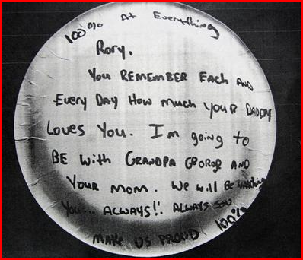
1. In Writing
No requirement regarding what written on or with.

Slide 7
2. Signed by Testator
Any symbol executed or adopted by the testator with present intent to authenticate the will.
Gov’t Code § 311.005(6).

Slide 8
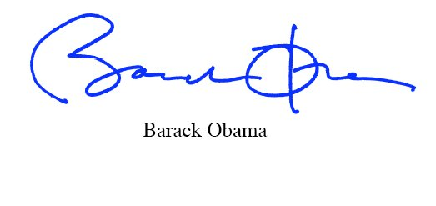
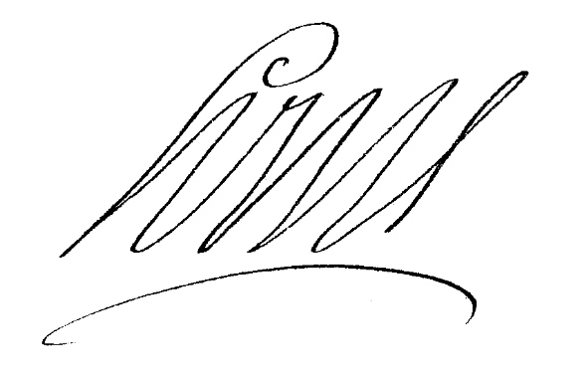



Sample Signatures

Slide 9
Proxy Signatures
1. Estates Code
  By the testator’s direction, and
  In the testator’s presence.

Slide 10
Proxy Signatures
Your best client calls you and says, “I just saw four wiggling feet in my bed. Please tear up my will.” You comply. What result?
  Will is revoked.
  Will remains effective.
  Will might be revoked.

Slide 11
Proxy Signatures
2. Notary under Gov’t Code § 4040.0165
  In presence of a witness.
  But only if testator physically unable to sign.

Slide 12

Location
None specified in Texas.
Should be at the end or “foot” of will.

Slide 13
3. Attestation
Number = at least two
In re Estate of Iverson – p. 94
Substantial compliance approach rejected.

Slide 14

Capacity of Witnesses
1. Legal Capacity
  Above 14
+

Slide 15
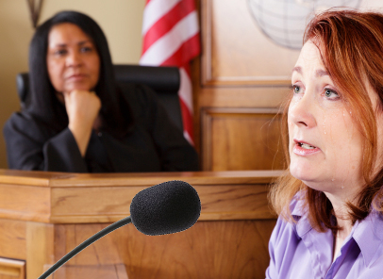
Capacity of Witnesses
2. Attestation Capacity
  Credible; qualified to testify in court

Slide 16
Capacity of Witnesses
3. Time
  When attestation occurred

Slide 17
Capacity of Witnesses
4. Knowledge
  Publication not required (witnesses do not need to know they are witnessing a will)
  Davis v. Davis, p. 96
  But is needed for SPA

Slide 18

Order of Events
What if witnesses attest before testator signs?
  Strict View
  Continuous Transaction View [Texas]

Slide 19
Attestation by Mark
Not allowed.
  Statute says “their names”

Slide 20
Attestation by Proxy
Not allowed.
  Statute says “in their own handwriting”

Slide 21
Location of Attestation
Statute says “subscribe”
But, case law not strict

Slide 22

Presences
1. Witnesses attest in presence of testator?
  Required in Texas.
  “Conscious Presence” defined – Nichols p. 99
  Visually-impaired testators
  Morris – p. 102, note 5

Slide 23
Presences
2. Witnesses attest in each other’s presence?
  Not required in Texas.

Slide 24
Presences
3. Testator signs (or acknowledges a prior signature) in presence of witnesses?
  Not required in Texas.

Slide 25
Witness as Beneficiary -- EC § 254.002
1. Effect on will
  None – will remains valid.

Slide 26
Witness as Beneficiary -- EC § 254.002
2. Effect on beneficiary’s gift
  Void, unless an exception applies.

Slide 27
Witness as Beneficiary -- EC § 254.002
3. Exceptions
  a. If beneficiary is also an heir, beneficiary receives smaller of will and intestate share.

Slide 28
Witness as Beneficiary -- EC § 254.002
3. Exceptions
  b. Will is otherwise established (e.g., another witness).

Slide 29
Witness as Beneficiary -- EC § 254.002
3. Exceptions
  c. Corroboration by disinterested and credible person.

Slide 30
Self-Proving Affidavit
EC §§ 251.104 & 251.1045
Substitutes for in-court testimony of witnesses when will probated.
Saves time, expense, and inconvenience when probating will.
Does not “strengthen” the will.

Slide 31
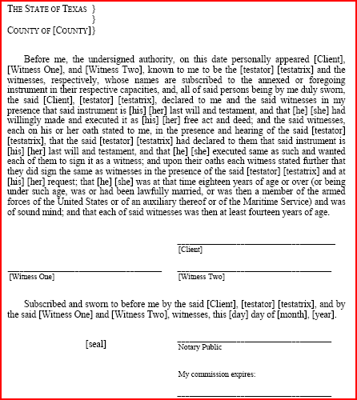
Self-Proving Affidavit
EC §§ 251.104
1. Traditional –
two-step with
“double”
signatures.
SPA is separate
document.

Slide 32
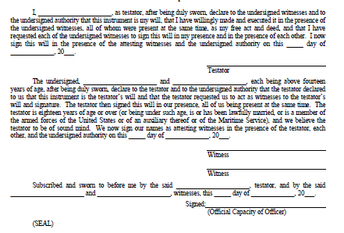
Self-Proving Affidavit
EC § 251.1045
2. Modern (as of
September 1,
2011) – one-
step with
“single”
signatures.
SPA is inside
the will.

Slide 33
Self-Proving Affidavit
Timing of execution of affidavit
Impact of invalid affidavit

Slide 34
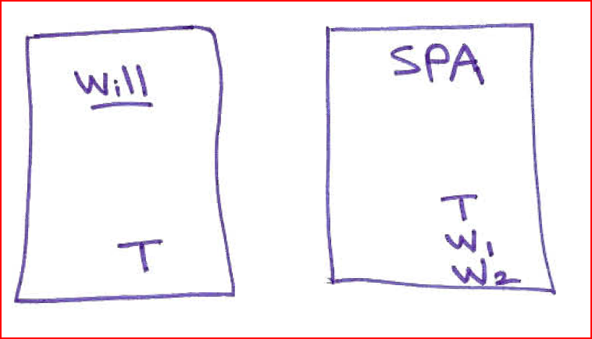
Self-Proving Affidavit
The Boren issue – p. 104

Slide 35
Self-Proving Affidavit
The Boren issue solved in 1991
  EC § 251.105
  “A signature on a self-proving affidavit is considered a signature to the will if necessary to prove that the will was signed by the testator or witnesses or both, except that, in that case, the will may not be considered a self-proved will.”

Slide 36
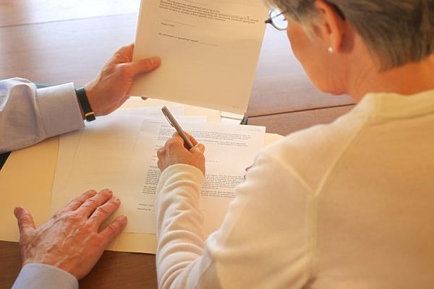
Selecting Witnesses

Slide 37
Selecting Witnesses
Normally, little thought given or than to meet basic requirements:
  Age
  Competent
  Not a beneficiary
Less than 5% of wills are contested.
But, if anticipate a will contest, select witnesses with special care.

Slide 38

Selecting Witnesses
1. Witnesses familiar with testator

Slide 39

Selecting Witnesses
2. Supernumerary (extra) witnesses

Slide 40

Selecting Witnesses
3. Youthful and healthy witnesses

Slide 41

Selecting Witnesses
4. Traceable witnesses

Slide 42

Selecting Witnesses
5. Witnesses who would favorably impress judge and jury.

Slide 43

Will Execution Ceremony

Slide 44

Will Execution Ceremony -- Purposes
1. Psychological benefits

Slide 45

Will Execution Ceremony -- Purposes
1. Psychological benefits
2. Effectuate client’s intent

Slide 46

Will Execution Ceremony -- Purposes
1. Psychological benefits
2. Effectuate client’s intent
3. Limit exposure to malpractice claims

Slide 47
Will Execution Ceremony
Steps Before
Proofread will carefully
  “I leave $10.000 to Barry Allen.”
  “I enjoyed cooking my friends and my children.”
  The texting lookout:
    “The police are now here.”
    “The police are nowhere.”

Slide 48
Will Execution Ceremony
Steps Before
Assure internal integration to avoid fraudulent page insertion or removal.
  Same type, size color, etc. of paper.
  Same font styles.
  Same darkness of toner/ink.
  Ex toto pagination (page x of y).
  Avoid blank spaces.

Slide 49

Will Execution Ceremony
Steps Before
Review will with client
  Consider reward if client finds errors (either real ones or ones you inserted as a test).

Slide 50
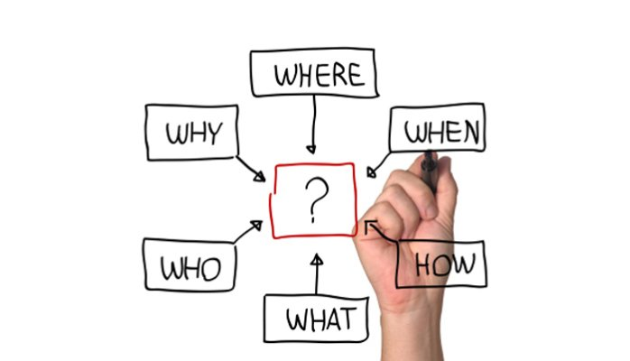
Will Execution Ceremony
Steps Before
Explain ceremony to client

Slide 51
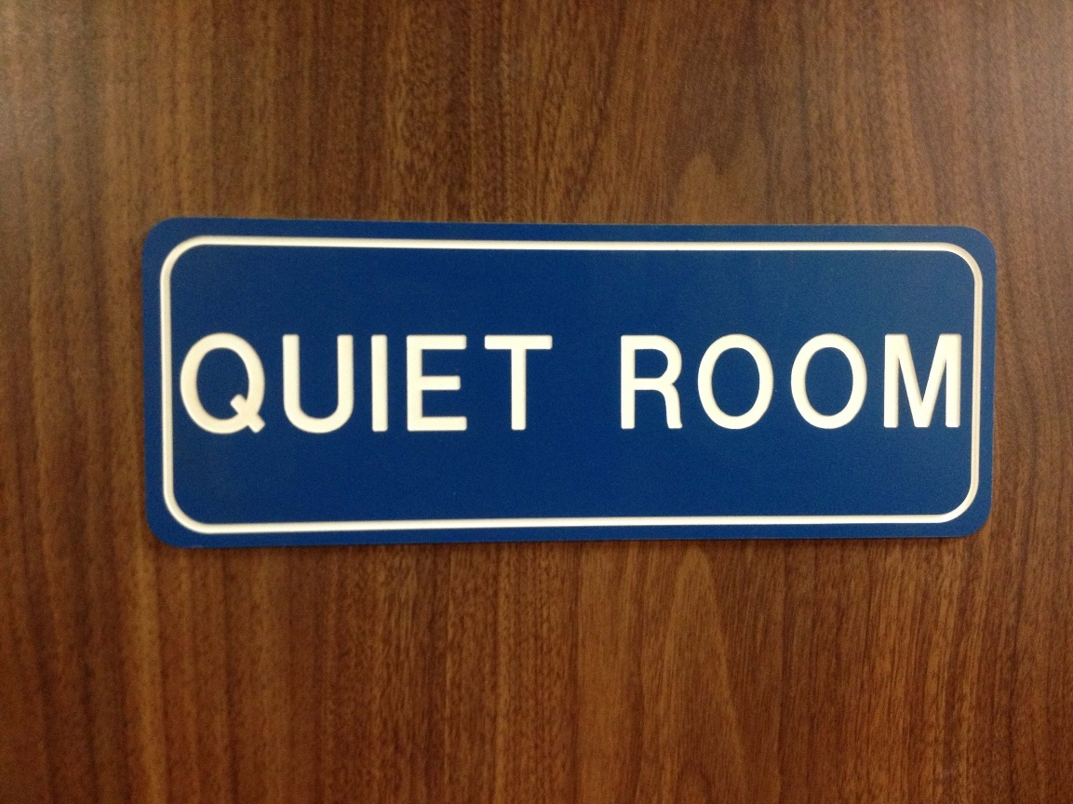
Will Execution Ceremony
The ceremony itself
Select proper location

Slide 52

Will Execution Ceremony
The ceremony itself
Seat participants strategically
Testator/Testatrix
Attorney
Notary
Witness One Witness Two

Slide 53
Will Execution Ceremony
The ceremony itself
Conduct ceremony complying with state law requirements for a valid will.

Slide 54
Will Execution Ceremony
The ceremony itself
Ceremony basics
  Ask questions to establish capacity (if needed).
  Ask questions to establish intent.
  Testator/Testatrix initials each page and signs at end.
  Witnesses initial each page and attest.
  Notary completes self-proving affidavit.

Slide 55
Will Execution Ceremony
After ceremony
Discuss safekeeping of will
  Attorney?
  Client?
  Third party?
Regardless, give or obtain receipt.

Slide 56
Will Execution Ceremony
After ceremony
Provide post-will instructions
  Avoid self-help changes.
  Update will when situation changes:
    Divorce
    Births
    Deaths
    Change in feelings about included and excluded relatives
    Change in composition or value of estate
    Law changes

Slide 57
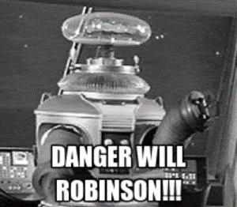
Warning!!!
Drafting a will and supervising a will execution ceremony = the practice of law.
Do NOT engage in this conduct until licensed.
NO exception that testator knows you are unlicensed or you are not being paid.

