Slide 1
3. Testamentary Intent

Slide 2
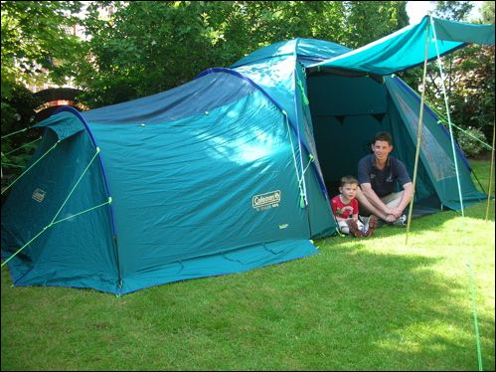
“Intent” not “in tent”

Slide 3

Basic Concept
Testator must intend the very instrument the testator executes to be the will.

Slide 4

Price v. Huntsman – p. 88
A classic “letter” case.

Slide 5

Shiels v. Shiels – p. 90
A classic “initiation” case.

Slide 6
Evidence of Intent
Looks like will – can bring in evidence to show no intent.
Does not look like will – cannot bring in evidence to show intent.

