Slide 1
2. Testamentary Capacity

Slide 2

“Sound Mind” -- EC § 251.001

Slide 3
Elements of Testamentary Capacity
1. Understand what doing

Slide 4
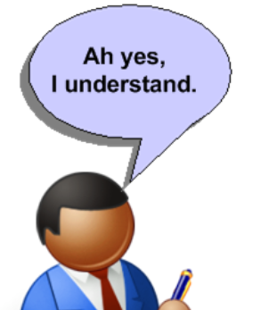
Elements of Testamentary Capacity
2. Comprehend effect of what doing.

Slide 5
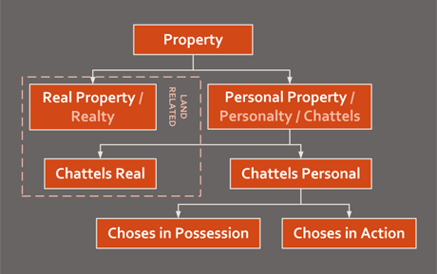
Elements of Testamentary Capacity
3. Know general nature and extent of property.

Slide 6


Elements of Testamentary Capacity
4. Know natural objects of bounty.

Slide 7
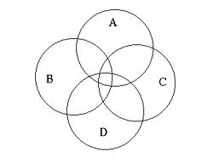
Elements of Testamentary Capacity
5. Achieve above four elements simultaneously.

Slide 8
Testamentary Capacity Issues
1. When = at time of will execution

Slide 9
Testamentary Capacity Issues
2. Effect of incapacity adjudication = rebuttable presumption of lack of capacity

Slide 10





Testamentary Capacity Issues
2. Sane person may lack capacity.

Slide 11
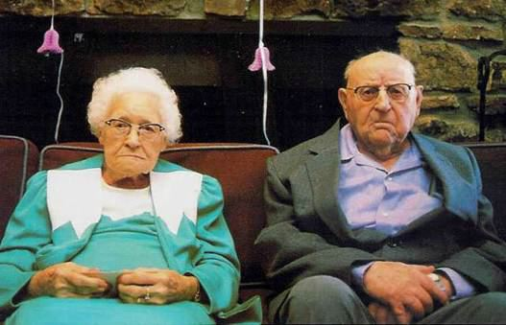
Testamentary Capacity Issues
3. Impact of aging process.

Slide 12

Testamentary Capacity Issues
4. Contract capacity compared.

Slide 13
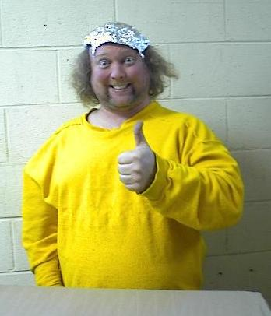
Testamentary Capacity Issues
5. Client with Questionable Capacity

Slide 14
Testamentary Capacity Issues
6. Evidence
  Warren v. Harnett – p. 86
  Lay testimony.
  Expert testimony.
  Evidence Rule 704.

Slide 15
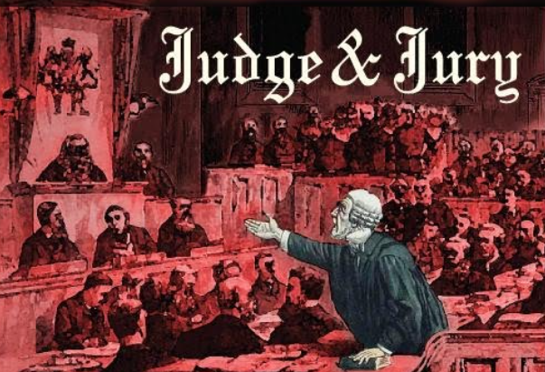
Testamentary Capacity Issues
7. Reactions of fact finders

