Slide 1
Other Intestacy Matters

Slide 2
Escheat – Prop. Code § 71.001
Only if no heirs.
Note that many states stop looking at a designated generation to avoid “laughing heirs.”

Slide 3
Intestacy Presumption – Prop. Code § 71.003
Person dead for 7 years and no will probated.

Slide 4
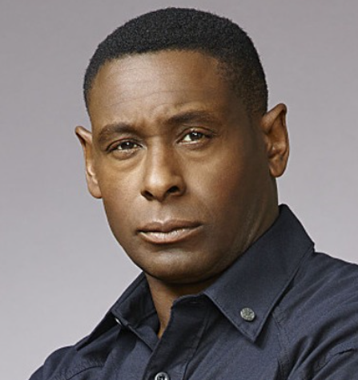
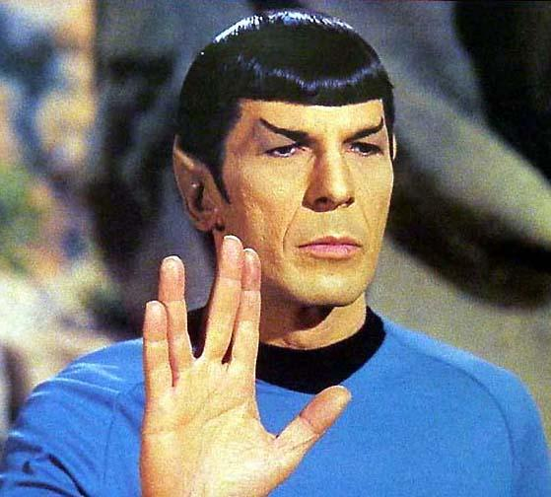

Aliens – EC § 201.060
Irrelevant.

Slide 5
Passage of Title EC §§ 101.001 & 101.003
Immediately from decedent to heir or will beneficiary.
But, subject to decedent’s debts.
But, PR has superior right to possess.
2017 Legislative developments
Uniform Partition of Heirs Property Act
Adverse possession against co-heirs

Slide 6
Posthumous Heirs -- EC § 201.056
For an heir to inherit, the heir must either be:
Born when the intestate dies, or
Be in gestation when the intestate dies.
Presumed to be in gestation if born within 300 days of intestate’s death.
Thus, after death ART children are not heirs.

Slide 7
Conflict of Laws – Marital Rights [which spouse owned property]
Law of spouse’s domicile at time of property acquisition determines whether property is community or separate.
“inception of title”

Slide 8
Conflict of Laws – Succession Rights
Personal Property = Domicile at death

Slide 9
Conflict of Laws – Succession Rights
Real Property = Situs of Property

Slide 10
Conflict of Laws – Estate of Hanau – p. 65
No equitable adjustment upon death of separate property acquired elsewhere that would have been community property if acquired in Texas.
Note: Some states do so by recognizing “quasi-community” property.

Slide 11
Tortious Interference with Inheritance Rights
Texas Supreme Court in the 2018 case of Archer v. Anderson held, “The tort of intentional interference with inheritance is not recognized in Texas.”
The court reasoned that “existing law affords adequate remedies for the wrongs the tort would redress” such as a constructive trust.
The court closed the door on this issue which was left open by the court’s opinion in Kinsel v. Lindsey (p. 68).

Slide 12
Negative Will – EC § 251.002
Recognized in Texas.

Slide 13
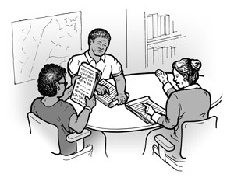
Designation of Heirs
Not allowed in Texas

Slide 14

Locating Heirs

