Slide 1
Equitable Conversion

Slide 2
Basic Idea
Real property treated as personal property, or
Personal property treated as real property.
Example = between (1) signing of real property sales contract and (2) closing

Slide 3
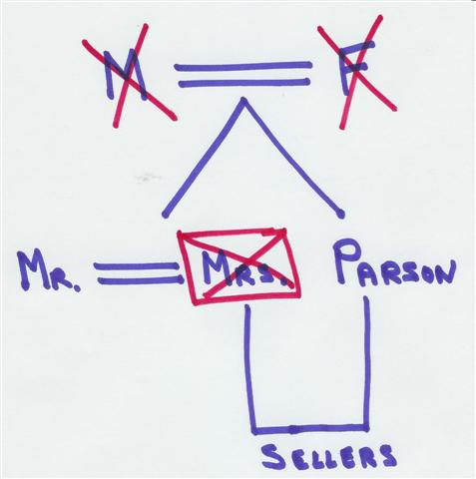
Parson v. Wolfe – p. 60

