Slide 1
Release and Conveyance of Expectancy to Inherit

Slide 2
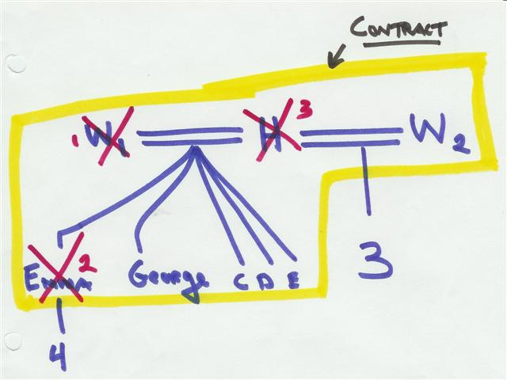
Mow v. Baker – p. 54

Slide 3
Birk v. First Wichita Nat’l Bank – p. 57
The court stated, “An expectancy may be conveyed.” What do you think?
  Court correctly stated the law and decided correctly.
  Court correctly stated the law but decided incorrectly.
  Court incorrectly stated the law and decided incorrectly.
  Court incorrectly stated the law but decided correctly.

Slide 4
Assignments -- EC § 122.201
After an intestate’s death, the heir may assign (sell or give) the interest to anyone the person desires before the interest is actually distributed to the heir.

