Slide 1
Disclaimers

Slide 2

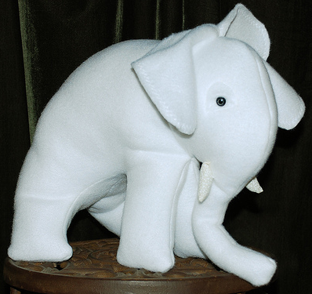
Reasons to Disclaim
1. Onerous Burdens

Slide 3

Reasons to Disclaim
1. Onerous Burdens
2. Tax Savings

Slide 4

Possible Reasons to Disclaim
1. Onerous Burdens
2. Tax Savings
3. Avoid creditors, except
IRS
Child support judgment

Slide 5
Disclaimer History in Texas
1. Separate provisions in Estates and Trust Codes.
Similar but different.
Many unanswered questions.
Not comprehensive.

Slide 6
Disclaimer History in Texas
2. Modeled After Federal Tax Law
Not reasonable now that tax threshold is very high.

Slide 7
Disclaimer History in Texas
3. Texas Uniform Disclaimer of Property Interests Act
Effective September 1, 2015.
Repealed most of separate provisions.
Added Property Code Title 13.
Decoupled from federal tax law, especially by removing requirement that disclaimer be done within 9 months of death.
Simpler procedures.
More comprehensive.

Slide 8
Requirements – PC § 240.009
1. In writing.
2. Describe property that is being disclaimed.
3. Signed by disclaimant.
4. Delivered to:
Personal representative, or if none because estate not open,
File in county where decedent was:
Domiciled at death, or
Owned real property.

Slide 9
Basic Disclaimer Principles
1. Wills, life insurance policies, etc. may provide disclaimer methods and designate who receives disclaimed property.

Slide 10
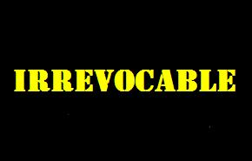
Basic Disclaimer Principles
2. Irrevocable
PC § 240.009

Slide 11

Basic Disclaimer Principles
3. Partial disclaimers (“cherry-picking”) allowed. PC § 240.006

Slide 12
Basic Disclaimer Principles
4. Acceptance precludes later disclaimer. PC § 240.151. Examples include:
Take possession
Exercise dominion
Control
Sell or convey
Use as collateral

Slide 13
Basic Disclaimer Principals
5. Tax disclaimer effective – PC § 240.056
If disclaimer valid under federal tax law, it is valid in Texas even if not meet all Texas requirements.

Slide 14

Basic Disclaimer Principals
6. Notarize so can record in deed records if necessary.

Slide 15
Basic Disclaimer Principles
7. Disclaimed property passes as if disclaimant predeceased decedent. EC § 240.051
Disclaimant cannot control where property goes.
Treated as legally dead although biologically alive vis-à-vis the disclaimed property.

Slide 16
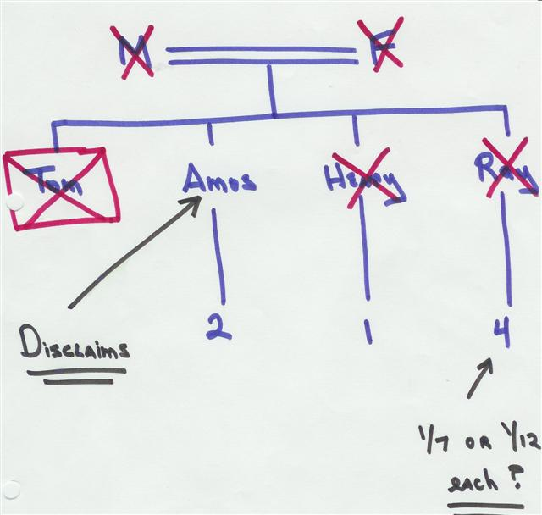
Welder v. Hitchcock – p. 50

Slide 17
Situation
Husband died intestate survived by his wife and their four adult and competent children.
All children want wife/mother to receive all husband/dad’s property.
They all execute valid disclaimers.
What fact do you need to know if children’s plan worked?

Slide 18
Basic Disclaimer Principles
8. Lack of understanding of effect of disclaimer (e.g., who receives the disclaimed property) ≠ ground for undoing

Slide 19
Basic Disclaimer Principles
9. Lack of understanding of what property is being disclaimed = ground for undoing

