Slide 1
Advancements

Slide 2
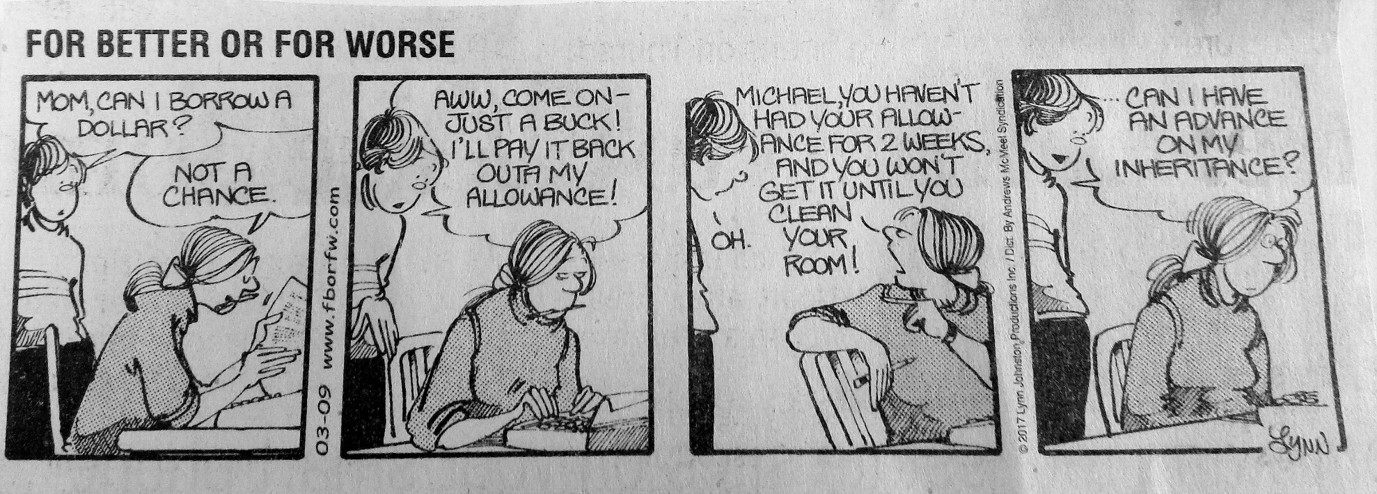
Advancement in Popular Press

Slide 3
Basic Idea
Prepayment of inheritance.
Thus, must account for it when intestate dies.
But, transfer from intestate to heir is presumed to be a non-advancement gift.

Slide 4
How prove gift is advancement? EC § 201.151
1. Contemporaneous writing of advancer (intestate decedent)

Slide 5
How prove gift is advancement? EC § 201.151
1. Contemporaneous writing of advancer (intestate decedent), or
2. Written acknowledgment by advancee (heir) at any time.

Slide 6
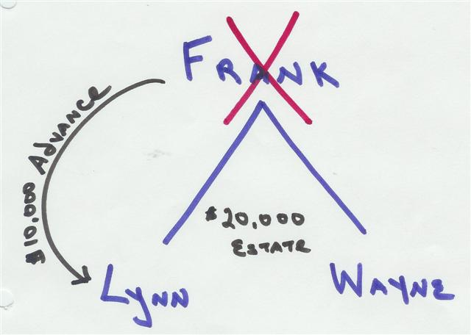
Problem 4, Page 49

Slide 7
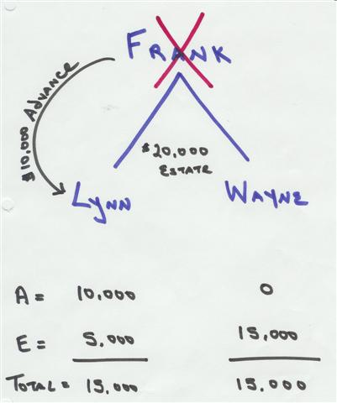
Problem 4, Page 52

Slide 8
Value of Advanced Property
Date of advancement value
Not date of death value.

Slide 9
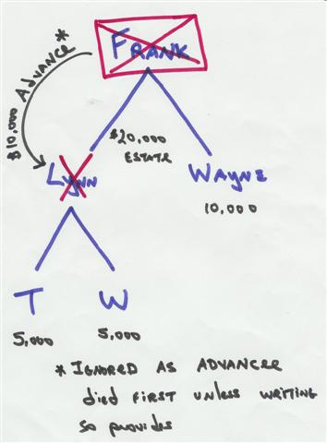
Problem 6, Page 49

Slide 10
No debt created
If heir’s advancement is greater than hotchpot share, heir keeps entire advancement but get nothing from estate.

Slide 11
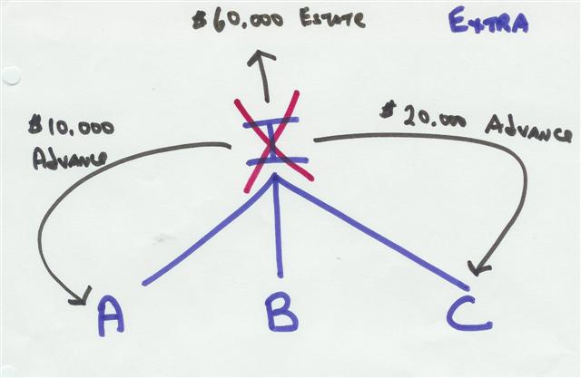
Extra Problem

Slide 12
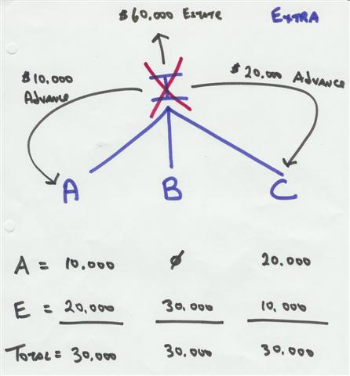
Extra Problem

