Slide 1
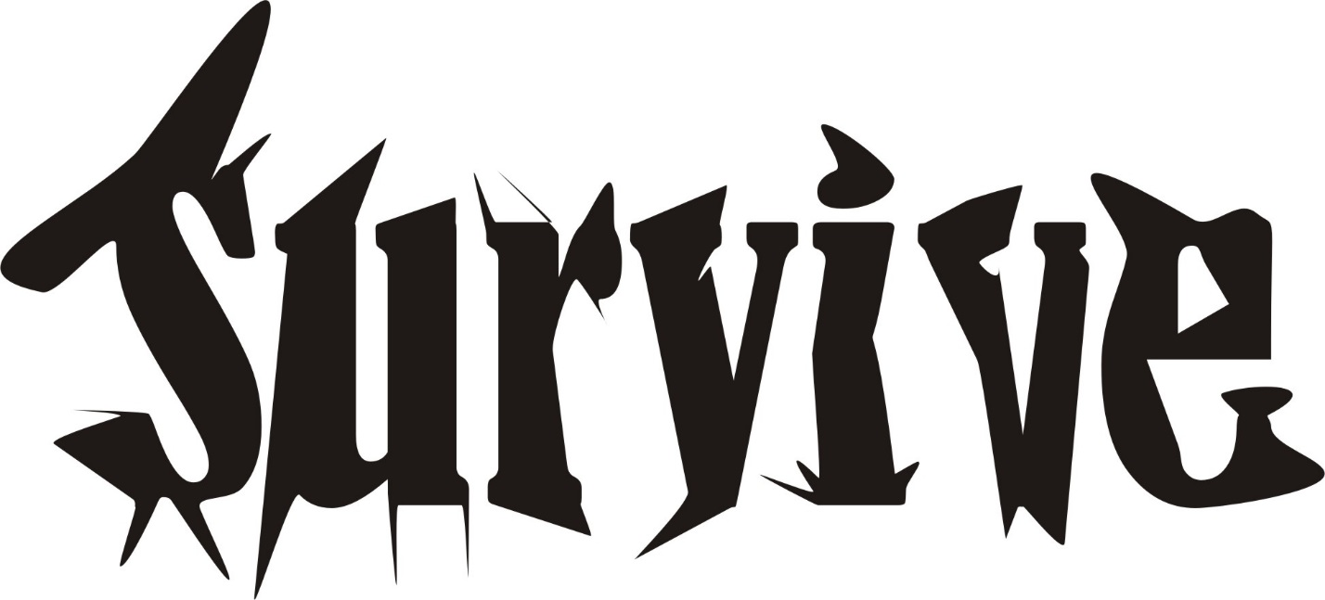
Survival

Slide 2
Glover v. Davis – p. 45
Who gets life insurance proceeds?
  If Daughter survived, all to her heirs.
  If Father survived, all to contingent beneficiaries named in policy.

Slide 3

EC § 121.052
120 hour survival requirement

Slide 4
Where does property go?
As if person who did not survive long enough died first.
A “constructive death.”

Slide 5
Policies
Prevent multiple administrations of property.
Avoid proof problems and gruesome evidence.
Carry out intent.

Slide 6
Spouses and Survival
If they die within 120 hours, each spouse’s one-half of community and separate passes as individual property.
  Each spouse treated as dying without a surviving spouse.

Slide 7
Common Disaster
Typical but not required.

Slide 8
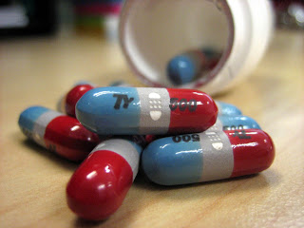
The Tylenol Case

Slide 9
“Evil” use of survival statute?
Problem 5, page 48

