Slide 1


Slide 2


Slide 3


Slide 4

Unworthy Heirs

Slide 5
1. Forfeiture
Upon felony or treason conviction, all property to government.
Prohibited in Texas.
Constitution Art. I, § 21
EC § 201.058(a)

Slide 6
2. Civil Death
Upon conviction of serious crime, property passes to heirs.
Not recognized in Texas; biological death of intestate is required.

Slide 7
3. Corruption of the Blood
Upon conviction of serious crime, prohibited from being an heir.
Not recognized in Texas.
EC § 201.058(a)

Slide 8
4. Suicide
Common law = forfeiture often occurred.
Texas = irrelevant when determining heirs
EC § 201.061

Slide 9
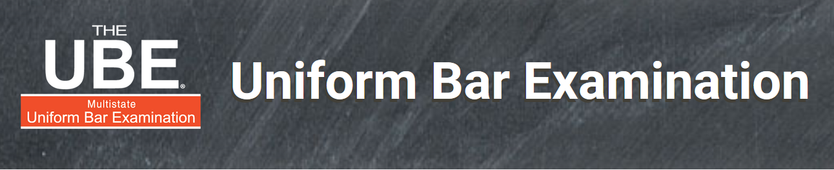
UBE Alert!
Decedent’s death caused by heir or beneficiary is a common UBE topic!

Slide 10
5. Heir Killing Intestate
Texas slayer statute limited to life insurance.
Pritchett v. Henry (p. 38)
Husband murders wife.
Husband then wants to receive property under wife’s will.
Wife’s parents complain.
Court adopts the _____________________ approach to prevent Husband from keeping Wife’s property.

Slide 11
5. Heir causing death, but not murder
Negligently
Voluntary manslaughter
While insane

Slide 12
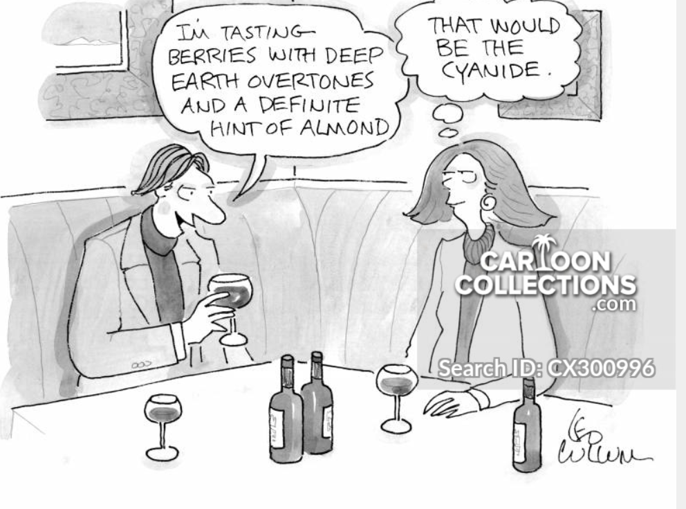
5. Heir causing death, but not murder
Competing policies:
Not deprive of inheritance without just cause.
Allowing killers to take promotes devious schemes.

Slide 13
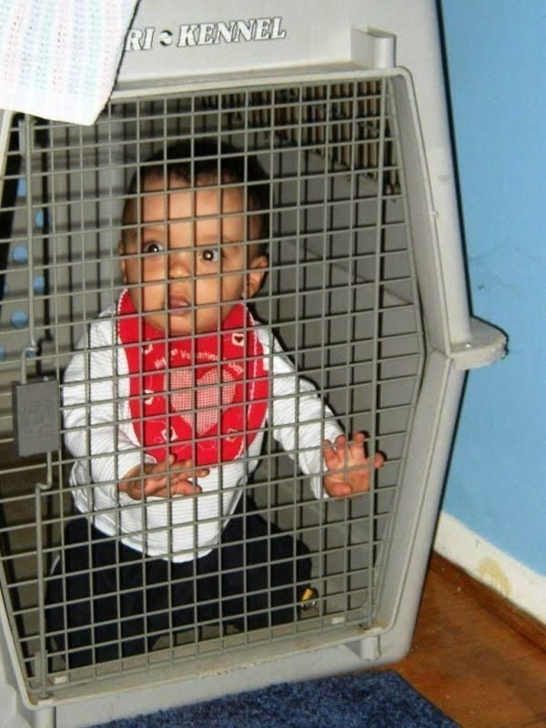
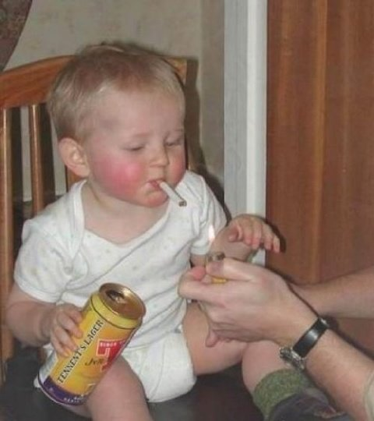
6. Bad Parents
When will a parent be precluded from inheriting from his/her child?

Slide 14
6. Bad Parents -- EC § 201.062
1. Discretionary with court.

Slide 15
6. Bad Parents -- EC § 201.062
1. Discretionary with court.
2. Intestate child must be under age 18.

Slide 16
6. Bad Parents -- EC § 201.062
1. Discretionary with court.
2. Intestate child must be under age 18.
3. Evil acts proved by clear and convincing evidence.

Slide 17
6. Bad Parents -- EC § 201.062
1. Discretionary with court.
2. Intestate child must be under age 18.
3. Evil acts proved by clear and convincing evidence.
4. Evil conduct (what makes parent “bad”):
Abandon and fail to support for three years.
Knowingly abandoned pregnant mother.
Criminally responsible for death or serious injury to a child (not necessarily the intestate child).
Attorney General opinion in 2008 that this may be unconstitutional forfeiture.

Slide 18
6. Bad Parents -- EC § 201.062
Result
Evil parent treated as having predeceased the child when determining intestate heirs of child.

Slide 19
7. Bad Spouse -- EC § 123.101-123.104
1. Divorce pending at the time of intestate spouse’s death based on his/her lack of mental capacity,
or

Slide 20
7. Bad Spouse -- EC § 123.101-123.104
2. Divorce not pending at time of death but:
a. Decedent married < 3 years, and

Slide 21
7. Bad Spouse -- EC § 123.101-123.104
2. Divorce not pending at time of death but:
a. Decedent married < 3 years, and
b. Application < 1 year after spouse’s death, and

Slide 22
7. Bad Spouse -- EC § 123.101-123.104
2. Divorce not pending at time of death but:
a. Decedent married < 3 years, and
b. Application < 1 year after spouse’s death, and
c. Ground = lack of mental capacity at time of marriage, and

Slide 23
7. Bad Spouse -- EC § 123.101-123.104
2. Divorce not pending at time of death but:
a. Decedent married < 3 years, and
b. Application < 1 year after spouse’s death, and
c. Ground = lack of mental capacity at time of marriage, and
d. Decedent never recovered and recognized the marriage.

Slide 24
7. Bad Spouse -- EC § 123.101-123.104
2. Result
Bad spouse not considered a surviving spouse for any purpose under Texas law
Not an heir.
No homestead rights.

Slide 25
7. Bad Spouse – other states
Some states preclude a spouse from inheriting if:
Surviving spouse was unfaithful, or
Surviving spouse abused (physically or financially) the deceased spouse.

