Slide 1
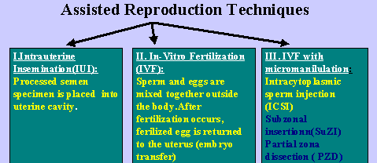
Children from Alternative (Assisted) Reproductive Technologies

Slide 2

ART Children – “Who’s your daddy?”
Possibilities:
Sperm supplier
Spouse of egg supplier
Spouse of woman who gestates child
Man who hired surrogate mother

Slide 3
ART Children – “Who’s your mama?”
Possibilities:
Woman who supplies egg
Woman who gives birth to the child
Spouse of man who supplied sperm
Woman who hired surrogate mother

Slide 4
ART Children – State Laws
State laws vary from comprehensive to non-existent.
State laws may have different result for who is a parent:
(1) while child alive and
(2) after child dies.

Slide 5
Basic Analysis
Step 1: Is the resulting individual a “child” of the intestate parent?
Step 2: If yes, does that child qualify as an heir?
First fact to ascertain: When did conception occur?

Slide 6
Determination of Parents
1. Pre-Death Reproduction
Genetic material donor generally not a parent. Family Code § 160.702.
Exception in Family Code § 160.7031.
Thus, who are the parents?

Slide 7
Determination of Parents
1. Pre-Death Reproduction
Mother is birth mother.
Father is mother’s husband if he:
a. Provides sperm, or
b. Both consent in writing, or
c. Both openly treat child as theirs.
Note: If mother is unmarried, child may have no father.

Slide 8
Determination of Parents
2. After-Divorce Reproduction
Ex-spouse whose material is used without consent is not a parent.

Slide 9
Determination of Parents
3. After-Death Reproduction
Deceased spouse whose material is used without consent is not a parent.
Note: Texas has no law regarding after death harvesting of sperm or eggs.

Slide 10
Determination of Parents
4. Gestational Agreements
Mother = Intended mother (not birth mother).
Father = Intended mother’s husband regardless of who contributed sperm.

Slide 11
Recommendations
1. Both “parents” should adopt resulting “child.”
2. Die testate with a will expressly explaining how to treat ART children, grandchildren, etc.

