Slide 1
Adopted Individuals

Slide 2
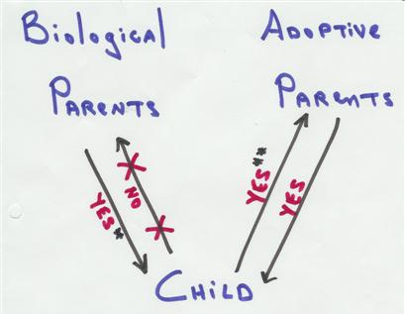
Summary of Inheritance Rights
EC § 201.054
* Unless:
(1) adopted as adult, or
(2) inheritance rights terminated
under Family Code.

Slide 3
What result?
Mother and Father have Child in 1985.
Mother dies in 1990.
Father marries Step-Mother in 1995.
In 2005, Step-Mother adopts Child [20 years old].
In 2019, Father died intestate.
Is Child an heir?

Slide 4
How solve prior problem?

Slide 5
Little v. Smith – p. 13
Child adopted in 1932.
Child’s biological mother dies in 1969.
Child’s biological grandmother dies in 1982 leaving property to predeceased mother which would pass to her children.
Child learns identity of biological mother in 1989.
Child sues in 1991 to recover share under grandmother’s will.

Slide 6
Little v. Smith – p. 13
Texas Supreme Court rejects discovery rule exception to statute of limitations for adopted individuals to ascertain biological parents and to inherit from/through them.
So, what should an adopted child do?

Slide 7
Adopted Children
Impact of type of adoption?
  Formal or statutory
  By estoppel (equitable adoption)

Slide 8
Dampier v. Williams – p. 22
This case holds that ___________________
_______________________________________.

Slide 9
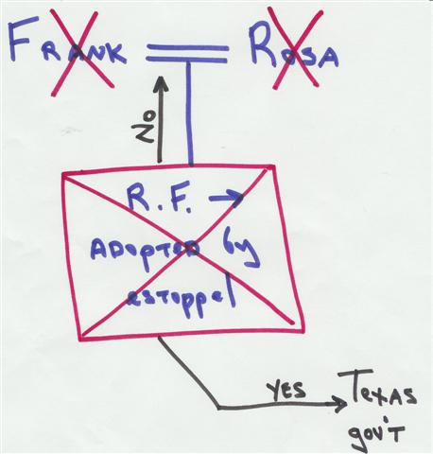
Heien v. Crabtree – p. 27

Slide 10
Heien v. Crabtree – p. 27
Overruled in 2017 by enactment of § 201.054(e).

