Slide 1
Half-Blooded Heirs

Slide 2
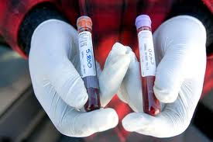
Whole Blood
Collateral relatives of the intestate (e.g., siblings) who share both parents in common.

Slide 3
Half Blood
Collateral relatives of the intestate (e.g., siblings) who share only one parent in common.
X

Slide 4
Relevancy -- Generally
When will the issue arise?

Slide 5
Relevancy – EC § 201.057
1. Modern rule = irrelevant
2. Texas (Scottish) rule = each half-blood receives half as much as each whole-blood

Slide 6
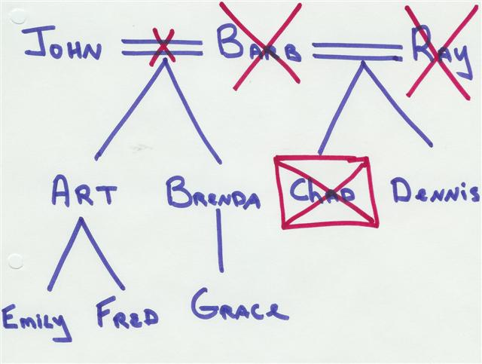
Problem 2, page 12
Answer in percentages such as 100, 75, 50, 33, 25, 12.5, etc.
How much does Dennis receive?
How much do each of Art and Brenda receive?

Slide 7
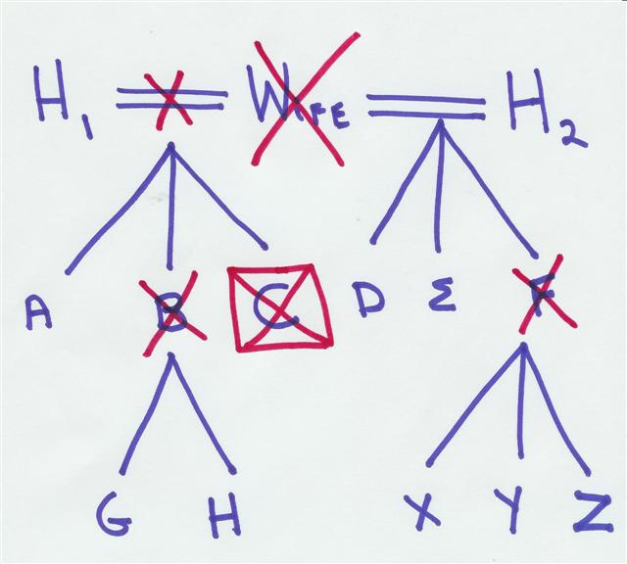
Additional Problem
Answer in fractions but use a period instead of a slash. So, ½ would be 1.2 and ¼ would be 1.4.
How much does H1 receive?
How much does A receive?
How much do each of G and H receive?
How much do each of D & E receive?
How much do each of X, Y, and Z receive?

