Slide 1
Intestate Succession

Slide 2

When does intestacy occur?
1. As to person – total intestacy

Slide 3
When does intestacy occur?
1. As to person – total intestacy
2. As to property – partial intestacy
  Why would this happen?
    _____________________
    _____________________
    _____________________

Slide 4
Introductory Comments
Basic idea
State variations
Supporting theory
Real vs. personal property

Slide 5
Protection of Surviving Spouse at Common Law
Problem at common law = spouse not an heir

Slide 6
Protection of Surviving Spouse at Common Law
1. Dower for Widow
  Life estate in 1/3 of the real property husband owned at death or anytime during the marriage.

Slide 7
Protection of Surviving Spouse at Common Law
2. Curtesy for Widower
  Life estate in all wife’s real property if, and only if, at least one child was born to the marriage.

Slide 8
Protection of Surviving Spouse at Modern Law
1. Spouse made an heir – EC § 22.015

Slide 9
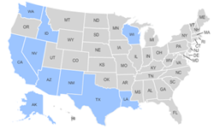
Modern Protections for Surviving Spouse
2. Common law marital property states = forced (elective) share

Slide 10
Modern Protections for Surviving Spouse
3. Community property marital property states = community property

Slide 11
Intestate Succession -- Texas
Starting point = Was intestate married at time of death?
  If no, follow “individual” property scheme.
  If yes, follow “community” and “separate” property schemes.
  [Warning: If intestate died before 9/1/1993, rules are different.]

Slide 12
Married Intestate
Community Property – EC § 201.003
1. No surviving descendants
  SS inherits all of DS’s community
  [SS ends up owning all community property].

Slide 13
Married Intestate
Community Property
2. At least one surviving descendant
  Only marital descendants =
  SS inherits all of DS’s community property
  [SS ends up owning all community property].

Slide 14
Married Intestate
Community Property
2. At least one surviving descendant
  At least one non-marital descendant =
  DS’s descendants inherit DS’s community
  [SS inherits none of the community]
  [SS still has his/her ½]

Slide 15
Married Intestate
Separate Property – EC § 201.002
1. At least one surviving descendant
  Personal Property =
    Surviving Spouse = 1/3
    Descendants = 2/3

Slide 16
Married Intestate
Separate Property
1. At least one surviving descendant
  Real Property =
    Surviving Spouse = Life estate in 1/3
    Descendants = 2/3 (outright) plus remainder of SS’s life estate.

Slide 17
Married Intestate
Separate Property
2. No surviving descendants
  Personal Property =
    Surviving Spouse = 100%

Slide 18
Married Intestate
Separate Property
2. No surviving descendants
  Real Property =
    Surviving Spouse = ½
    Parents, siblings, and their descendants = ½ using the individual property scheme.
      Note: If no parents or their descendants, then all to SS.

Slide 19
Intestate Succession
Individual Property – § 201.001
1. Descendants

Slide 20
Intestate Succession
Individual Property
1. Descendants
2. Parents – ½ to Mom and ½ to Dad

Slide 21
Intestate Succession
Individual Property
1. Descendants
2. Parents
3. If one parent predeceased, ½ to surviving parent and ½ to siblings and their descendants. [If none, all to surviving parent.]

Slide 22
Intestate Succession
Individual Property
1. Descendants
2. Parents
3. If one parent predeceased, ½ to surviving parent and ½ to siblings and their descendants. [If none, all to surviving parent.]
4. If both parents predeceased, all to siblings and their descendants.

Slide 23
Intestate Succession
Individual Property
1. Descendants
2. Parents
3. If one parent predeceased, ½ to surviving parent and ½ to siblings and their descendants. [If none, all to surviving parent.]
4. If both parents predeceased, all to siblings and their descendants.
5. Grandparents and their descendants, etc., etc., etc.

Slide 24
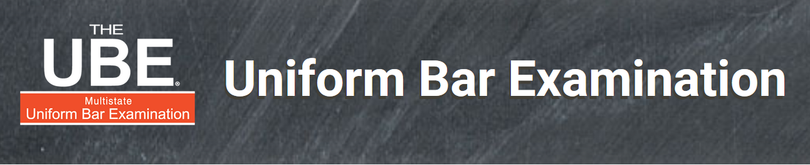
UBE Alert!
Intestate share of children and descendants is second most commonly tested UBE topic!

Slide 25
Distribution Methods
When there are heirs from more than one generation, you must determine how the state allocates among the different generations.
Three approaches.

Slide 26
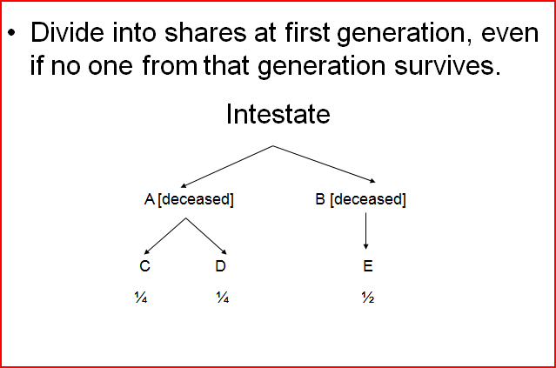
1. Per Stirpes

Slide 27
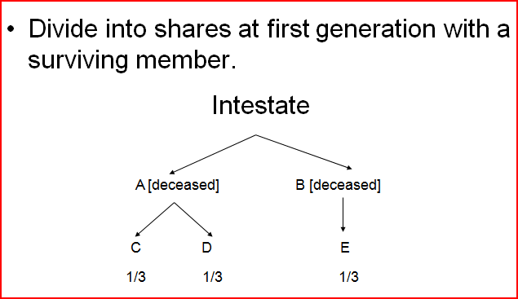
2. Per Capita with Representation
EC § 201.101

Slide 28
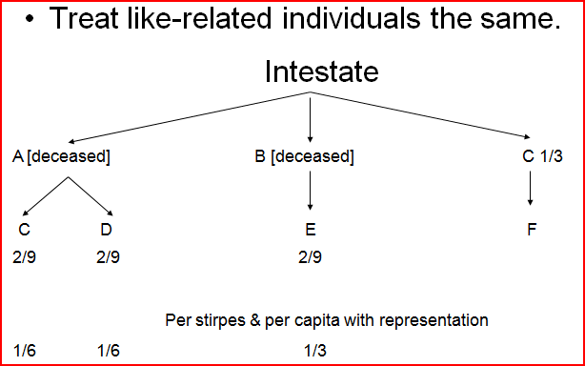
3. Per Capita at Each Generation

Slide 29
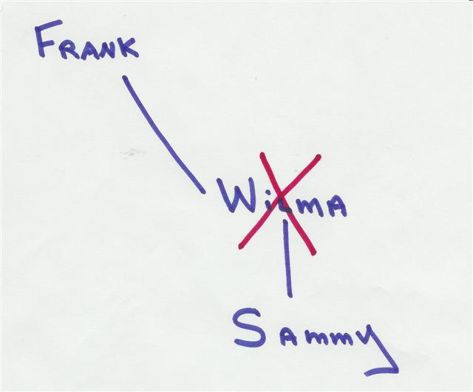
Problem 1, Page 5
Who receives Wilma’s estate?
Frank 100%
Sammy 100%
Frank and Sammy each receive 50%
Frank 25%, Sammy 75%

Slide 30
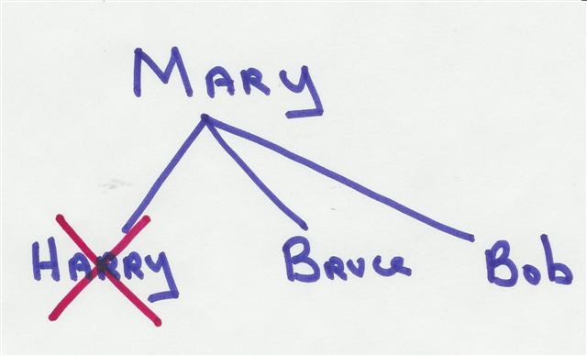
Problem 2, Page 5
Who receives Harry’s estate?
Mary 100%
Bruce and Bob each receive 50%
Mary, Bruce, and Bob each receive one-third
Mary receives 50% and each of Bruce and Bob receive 25%

Slide 31
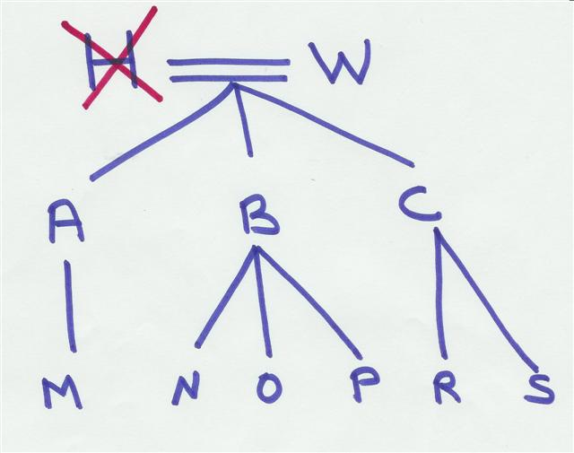
Problem 3a, Page 6
How is H’s share of community distributed?
All to W.
One-third to each of A, B, and C
One quarter to each of W, A, B, and C.
I have no clue.

Slide 32
Problem 3a, Page 6
How is H’s share of separate personal distributed?
All to W.
1/3 to each of A, B, and C
1/3 to W and 2/9 to each of A, B, and C .
I have no clue.

Slide 33
Problem 3a, Page 6
How is H’s share of separate real distributed?
All to W.
Life estate in 1/3 to W, 2/9 outright to each of A, B, and C. Each of A, B, and C also get 1/3 of the remainder.
Life estate in 1/3 to W, 2/9 outright to each of A, B, and C. Each of A, B, and C also get 1/9 of the remainder
I have no clue.

Slide 34
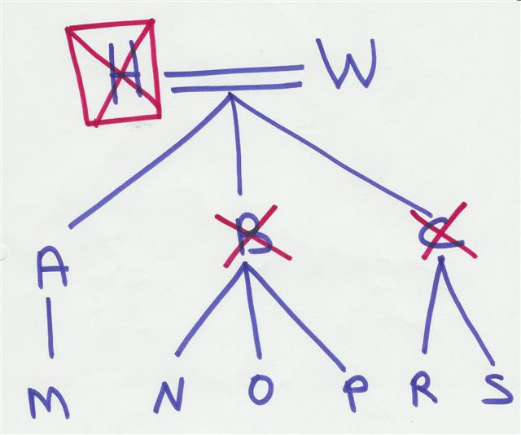
Problem 3b, Page 6
How is H’s share of community distributed?
All to W.
One-third to A, 1/9 to each of N, O, & P and 1/6 to each of R & S.
All to A.
I have no clue.

Slide 35
Problem 3b, Page 6
How is H’s share of separate personal distributed?
All to W.
1/3 to A, 1/9 to each of N, O, & P, 1/6 to each of R & S.
1/3 to W, 2/9 to A, 2/27 to each of N, O, & P, 1/9 to each of R & S.
I have no clue.

Slide 36
Problem 3b, Page 6
How is H’s share of separate real distributed?
All to W.
Life estate in 1/3 to W, 2/9 outright to A; 2/27 outright to each of N, O, & P, 1/9 outright to each of R & S. Also, A receives 1/3 of the remainder, N, O, and P receive 1/9 of the remainder, and R & S receive 1/6 of the remainder.
Life estate in 1/3 to W, 2/9 outright A, 4/45 outright to each of N, O, P, R, and S. A gets 1/3 of the remainder and N, O, P, R, and S each receive 2/15 of the remainder.
I have no clue.

Slide 37
Problem 3b, Page 6
How is H’s share of separate real distributed IF Texas followed per capita at each generation?
All to W.
Life estate in 1/3 to W, 2/9 outright to A; 2/27 outright to each of N, O, & P, 1/9 outright to each of R & S. Also, A receives 1/3 of the remainder, N, O, and P receive 1/9 of the remainder, and R & S receive 1/6 of the remainder.
Life estate in 1/3 to W, 2/9 outright A, 4/45 outright to each of N, O, P, R, and S. A gets 1/3 of the remainder and N, O, P, R, and S each receive 2/15 of the remainder.
I have no clue.

Slide 38
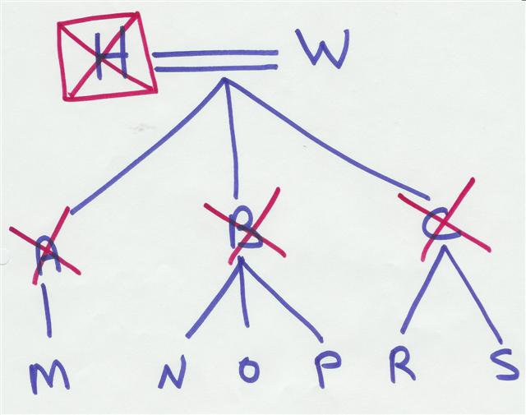
Problem 3c, Page 6
How is H’s share of community distributed?
All to W.
One-third to each of A, B, and C
One quarter to each of W, A, B, and C.
I have no clue.

Slide 39
Problem 3c, Page 6
How is H’s share of separate personal distributed?
All to W.
1/3 to W, 2/9 to M, 2/27 to each of N, O, & P, 1/9 to each of R & S.
1/3 to W, 1/9 to each of M, N, O, P, R, & S.
I have no clue.

Slide 40
Problem 3c, Page 6
How is H’s share of separate real distributed?
All to W.
Life estate in 1/3 to W, 2/9 outright to M; 2/27 outright to each of N, O, & P, 1/9 outright to each of R & S. Also, M receives 1/3 of the remainder, N, O, and P receive 1/9 of the remainder, and R & S receive 1/6 of the remainder.
Life estate in 1/3 to W, 1/9 outright to each of M, N, O, P, R, and S. Each grandchild also receives 1/6 of the remainder.
I have no clue.

Slide 41
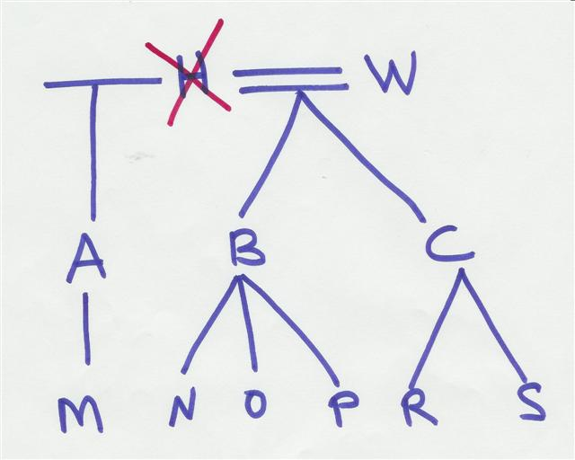
Problem 3d-1, Page 6
How is H’s share of community distributed?
W receives all.
W receives ½ and each of A, B, and C receive 1/6.
A, B, and C each receive 1/3 (1/6 of the total).
I have no clue.

Slide 42
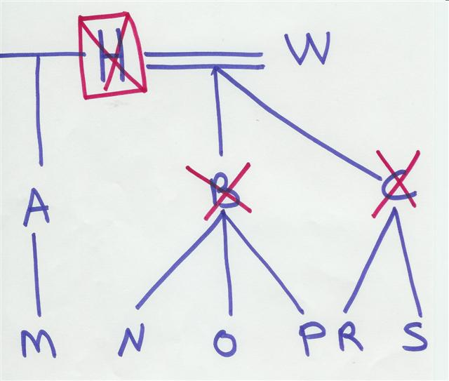
Problem 3d-2, Page 6
How is H’s share of community distributed?
W receives all.
W receives ½, A receives 1/6, each of N, O, and P receive 1/18, and each of R and S receive 1/12.
A receives 1/3 (1/6 of total), N, O, and P each receive 1/9 (1/18 of total), and each of R & S receive 1/6 (1/12 of total).
I have no clue.

Slide 43
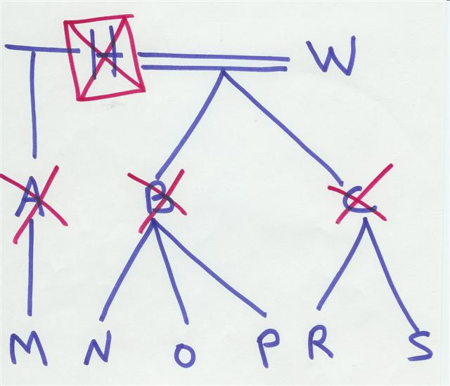
Problem 3d-3, Page 6
How is H’s share of community distributed?
W receives all.
W receives ½, M receives 1/6, each of N, O, and P receive 1/18, and each of R and S receive 1/9.
Each grandchild receives 1/6 (1/12 of total).
I have no clue.

Slide 44
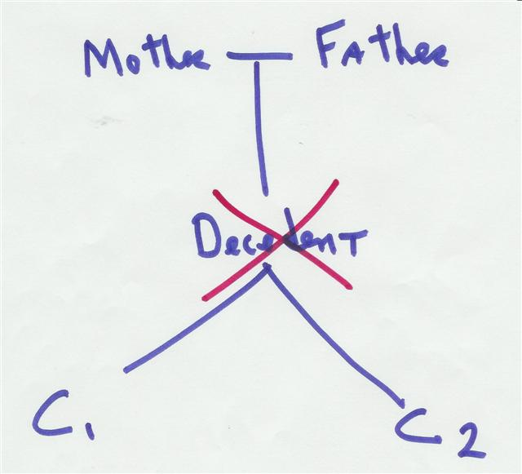
Problem 4, Page 6
Who receives the decedent’s community property?
C1 and C2 each receive ½.
Mother and Father each receive ½.
Mother, Father, C1, and C2 each receive ¼.
This question is a non sequitur.

Slide 45
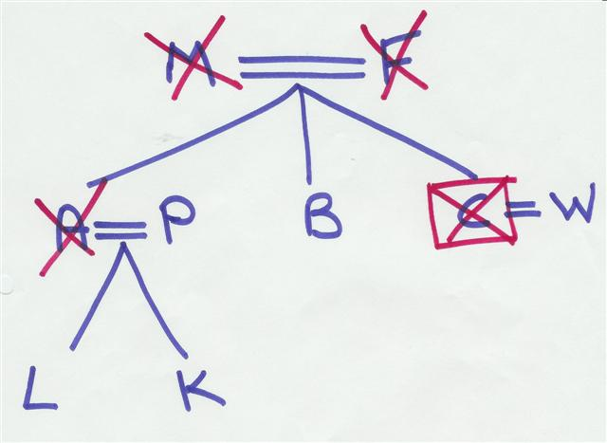
Problem 5, Page 6
How is C’s community distributed?
W receives all.
P and B each receive ½.
W, P, and B each receive 1/3.
I have no clue.

Slide 46
Problem 5, Page 6
How is C’s separate personal distributed?
W receives all.
P and B each receive ½.
W, P, and B each receive 1/3.
I have no clue.

Slide 47
Problem 5, Page 6
How is C’s separate real distributed?
W receives all.
L & K each receive ¼ and B receives ½.
W receives ½, B receives ¼, and each of L and K receive 1/8.
I have no clue.

Slide 48
Ancestral Property
EC §§ 201.102 & 201.103
Common law doctrine abolished.
  Assets inherited from father went to father’s side if no descendants.
  Assets inherited from mother went to mother’s side if no descendants.
All of an intestate’s property now treated as if the intestate was the original purchaser.

Slide 49
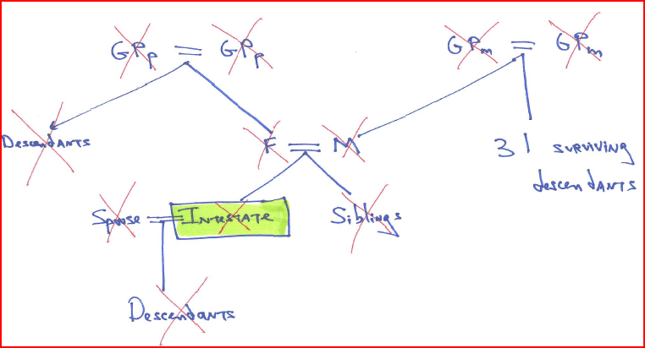
What if one side of family has “died out”?
State v. Estate of Loomis – p. 7

Slide 50
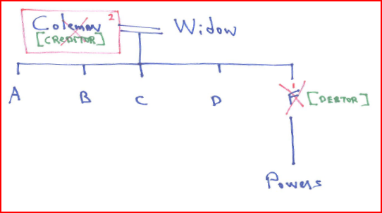
How does inheritance pass if an intermediary predeceases?
Powers v. Morrison – p. 10

