Slide 1
Wills & Trusts
Before class tasks:
Pick up name signs, and
Register attendance on Top Hat

Slide 2
Wills and Trusts
Prof. Gerry W. Beyer Fall 2024
https://app.tophat.com/register/
6-digit join code Section 1 (9 a.m.): 097587 Section 2 (11 a.m.): 438549
Gerry W. Beyer
Governor Preston E. Smith Regents Professor of Law
Texas Tech University School of Law

Slide 3
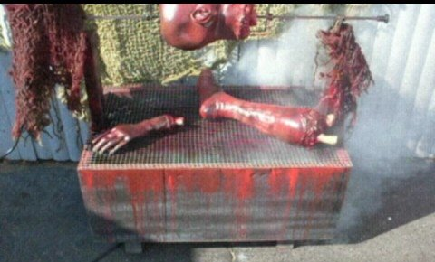
1. Fact or Urban Legend?
Request to be cooked and then eaten by friends and family as part of a human BBQ.

Slide 4
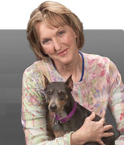
Body for Human Barbecue
Ingrid Newkirk

Slide 5

2. Fact or Urban Legend
To be impaled through the heart with a steel rod upon death.

Slide 6
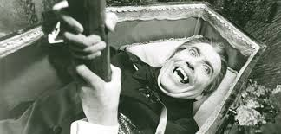
Doctor to impale with steel stake
Harold West?

Slide 7
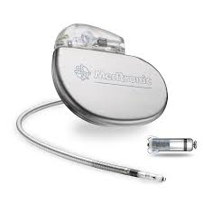
3. Fact or Urban Legend
Give my pacemaker to my dog when I die.

Slide 8
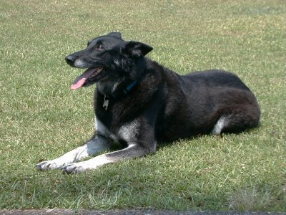
Pacemaker to dog
Sunshine

Slide 9
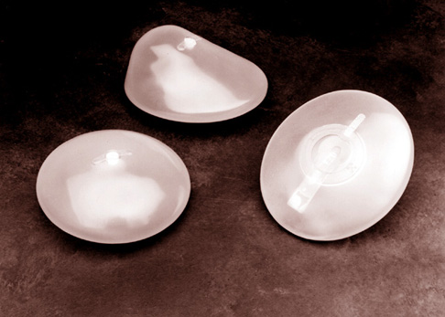
4. Fact or Urban Legend?
Husband’s cremains used as a filler in wife’s breast implants.

Slide 10
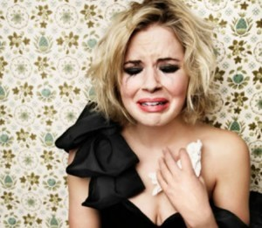
Cremains in Breast Implants
Sandi Canesco

Slide 11
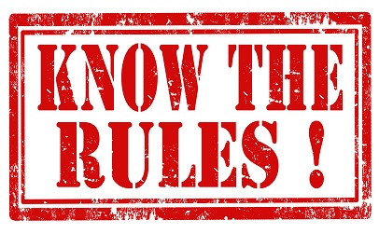

Slide 12



Slide 13
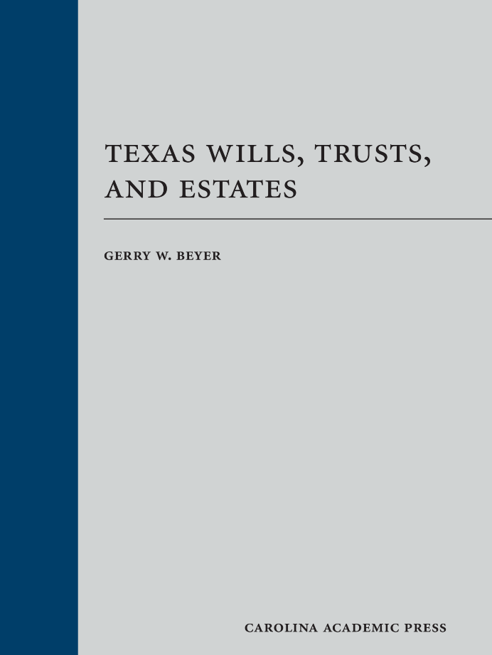
Course Materials
1. Texas Wills, Trusts, & Estates

Slide 14
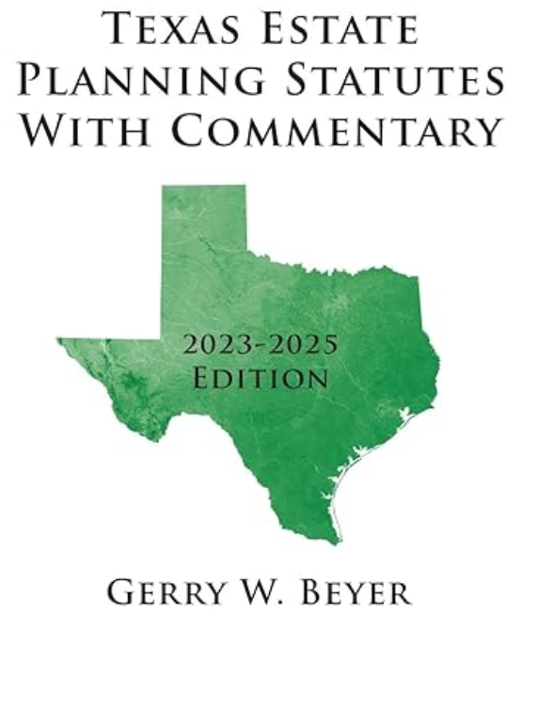
Course Materials
2. Texas Estate Planning Statutes with Commentary (2023-2025 edition)

Slide 15


Office Information

Slide 16

E-mail Updates

Slide 17
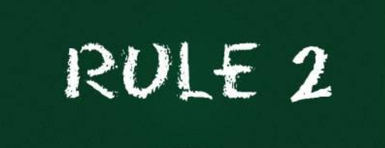
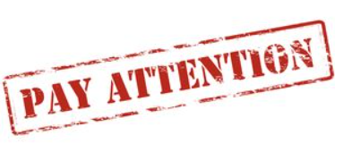

Slide 18

Attendance
Attendance taken
via Top Hat.
Attendance will close when class starts.

Slide 19

Technology Etiquette

Slide 20
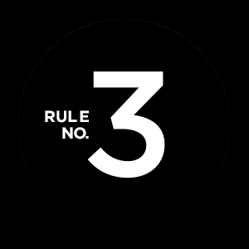
Respond when requested

Slide 21
Class Procedure
Combination of:
Lecture
Socratic Method
Top Hat Responses
Discussion

Slide 22
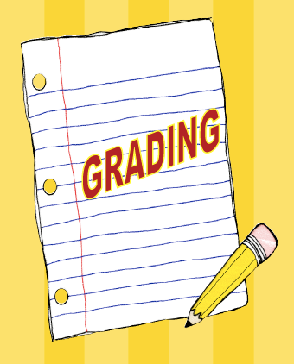
Grading

Slide 23
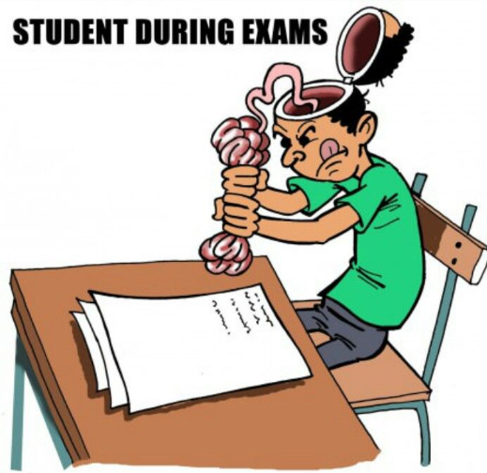
Examinations – 80%
Mid-Term (40%)
Intestacy & Wills
October 18, 2024
Final (40%)
Trusts
December 2, 2024

Slide 24

Quizzes – 20%

Slide 25
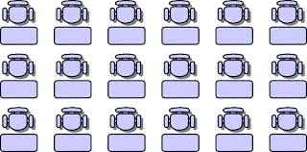
Seating Chart
Tuesday!

Slide 26

Course Purposes

Slide 27

Course Outline

Slide 28
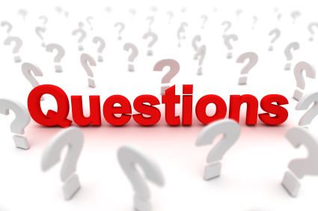
Questions?

Slide 29
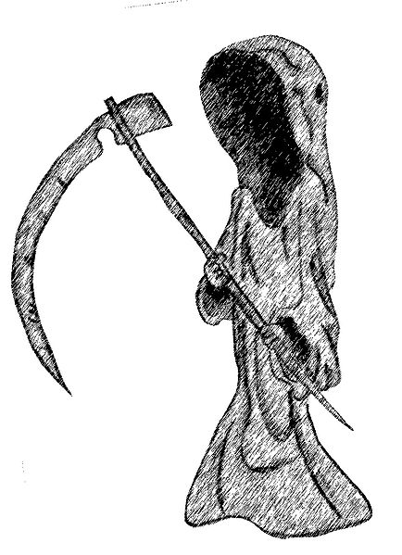
Basic Premise
Life is 100% fatal.
“That game of life is hard to play. I'm gonna lose it anyway.
The losing card I'll someday lay.”

Slide 30
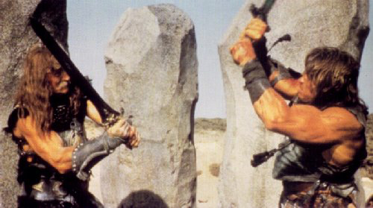
History of At-Death Property Disposition
1. Physical Strength and/or Finding

Slide 31
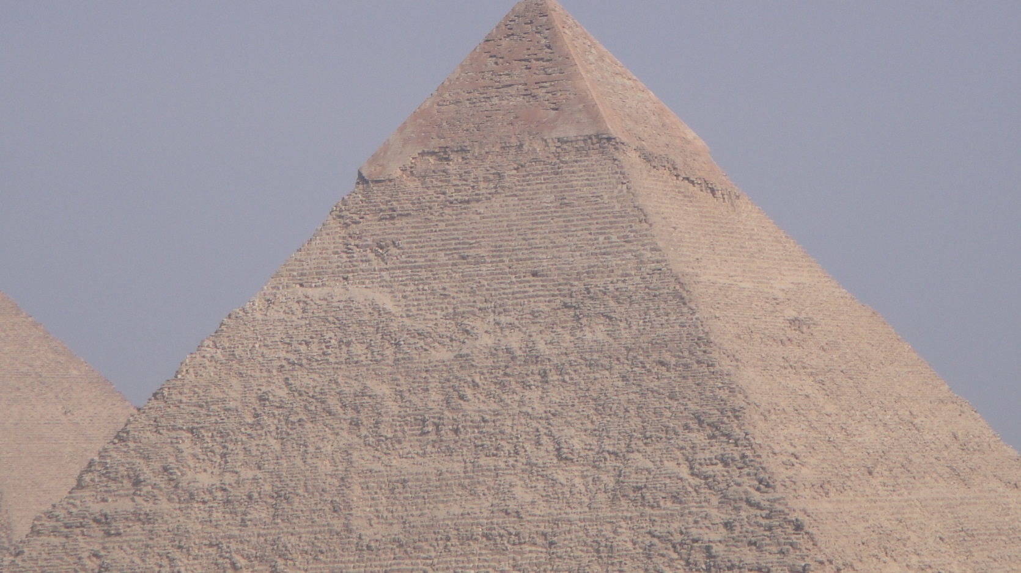
History of At-Death Property Disposition
2. Bury with Decedent

Slide 32
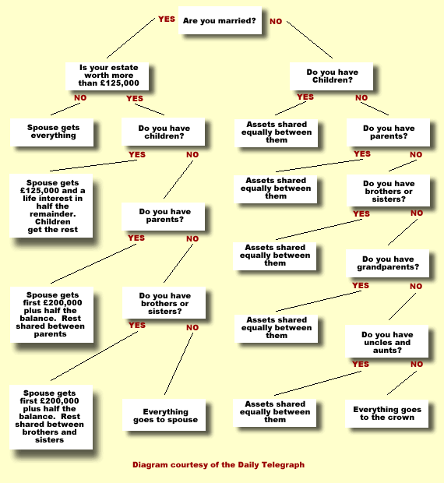
History of At-Death Property Disposition
3. Intestate Succession

Slide 33
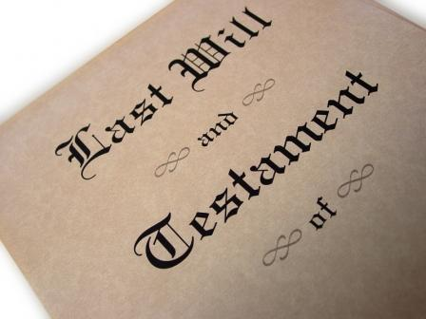
History of At-Death Property Disposition
4. Wills

Slide 34
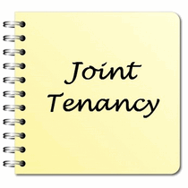
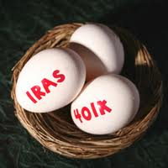
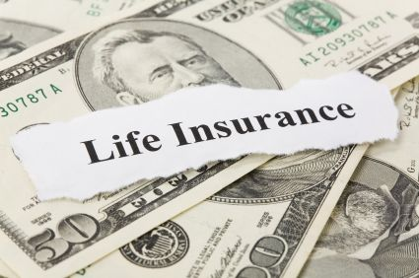
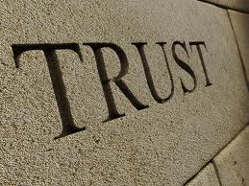
History of At-Death Property Disposition
5. Will Substitutes

Slide 35
Modern Law
Based on common law (except Louisiana).
Great similarity but key rules often very different
Will valid in Texas might be invalid in New York.
Default rules may be completely opposite.
Uniform Probate Code – not widely accepted (only about 15 states)

Slide 36

Texas
Statehood to 1956 – Uncodified statutes
1956 to December 31, 2013 – Probate Code
January 1, 2014 to present – Estates Code

Slide 37
Intestate Succession Terminology

Slide 38
Intestate Succession
Common Law Split:
Crown = real property
Church = personal property

Slide 39
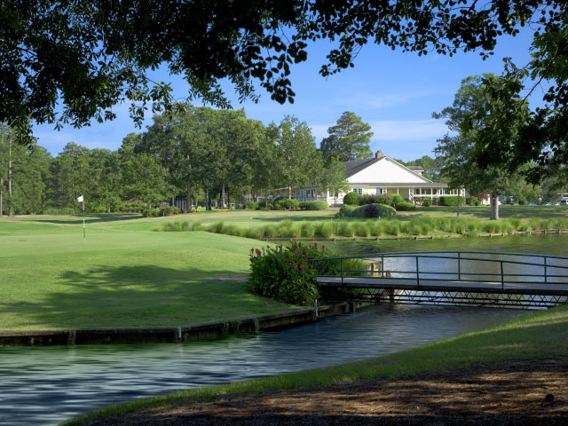
Intestate Succession -- Terminology
Descent = succession to real property

Slide 40

Intestate Succession -- Terminology
Distribution = succession to personal property

Slide 41
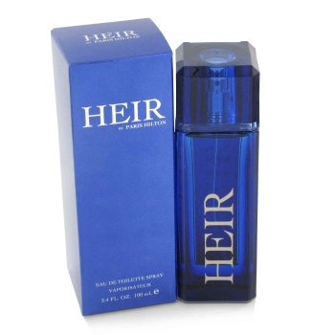
Intestate Succession -- Terminology
Heir = person who receives property from an intestate decedent

Slide 42
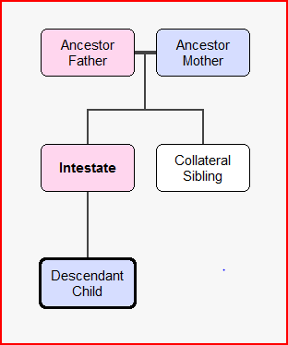
Intestate Succession -- Terminology

Slide 43
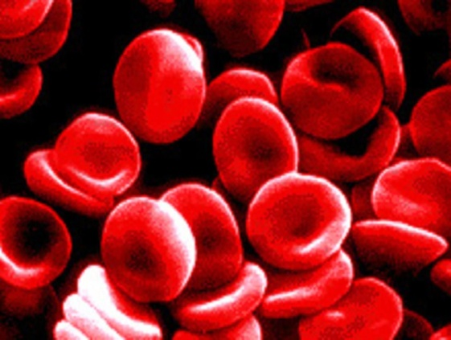
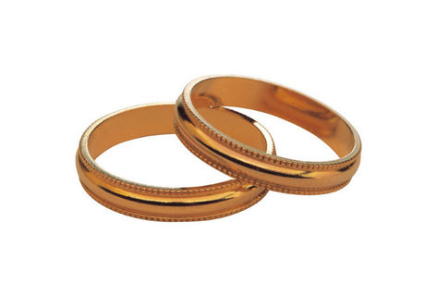
Intestate Succession -- Terminology
Consanguinity = blood
Affinity = marriage

Slide 44
Testate Succession Terminology

Slide 45
Testate Succession -- Terminology
At common law –
Will = real property
Testament = personal property

Slide 46
Testate Succession -- Terminology
Devise = gift of real property

Slide 47
Testate Succession -- Terminology
Bequest = gift of personal property

Slide 48
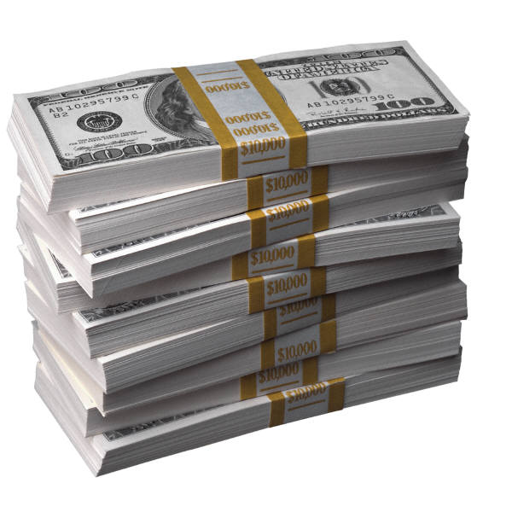
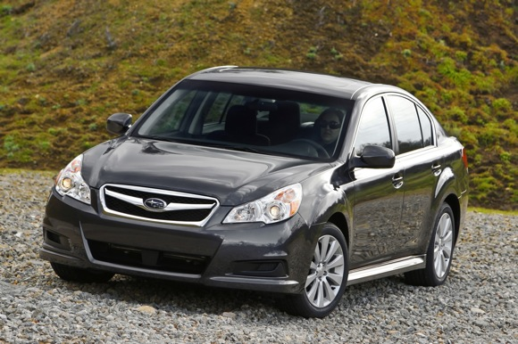
Testate Succession -- Terminology
Legacy – gift of money
X

Slide 49

Testate Succession -- Terminology
Beneficiary = any recipient of property (any type)

Slide 50
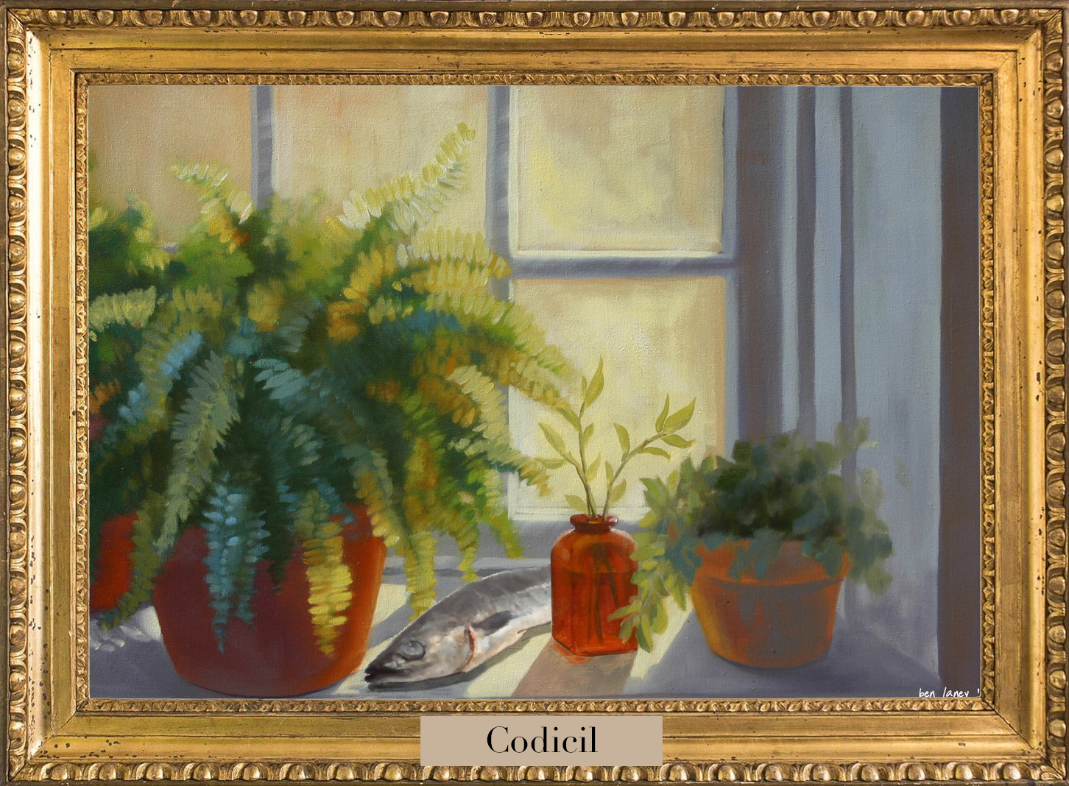
Testate Succession -- Terminology
Codicil = amendment to an existing will

Slide 51
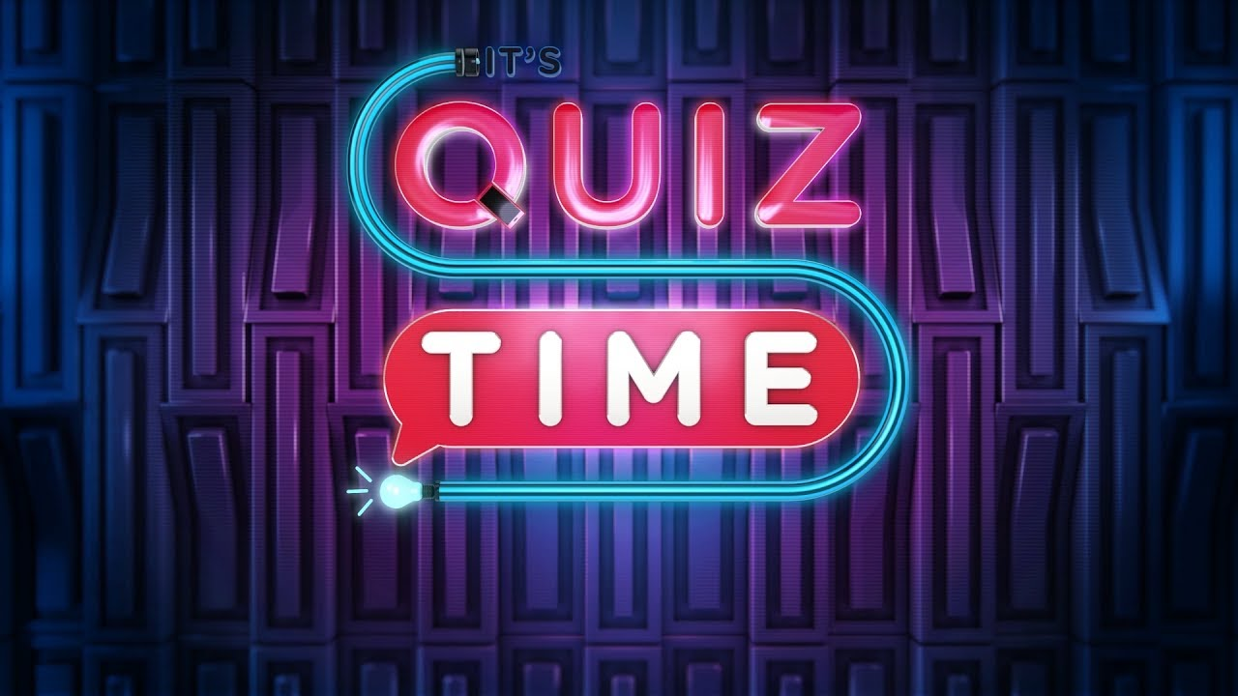

Slide 52
Seating Chart

