Slide 1
Property Review Session One
Gerry W. Beyer
Governor Preston E. Smith Regents Professor of Law
Texas Tech University School of Law

Slide 2
Agenda
How to succeed on law school exams
Format of mid-term exam
Review of personal property
Break
Door prizes
Review of personal property (continued)
Practice exam essay question
Discussion of answer to practice question

Slide 3
How to Succeed on Law School Exams
Before – The preparation
During – The performance
After – The critique

Slide 4

Exam Preparation
Be confidently prepared

Slide 5

Exam Preparation
Start now

Slide 6
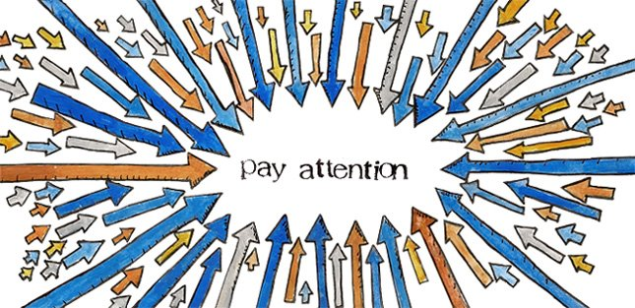
Exam Preparation
Pay attention to my “hints”

Slide 7

Exam Preparation
Prepare your own outline
No commercial outlines
No outlines from prior students

Slide 8

Exam Preparation
Learn correct rules of law

Slide 9

Exam Preparation
Use study time wisely

Slide 10
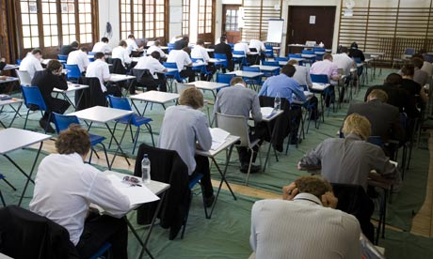
Exam Preparation
Write essay answers under simulated exam conditions

Slide 11
Exam Preparation
Write essay answers under simulated exam conditions
Study the topic
Obtain sample question
Set timer for allotted time
Write answer
Compare your answer with model answer

Slide 12
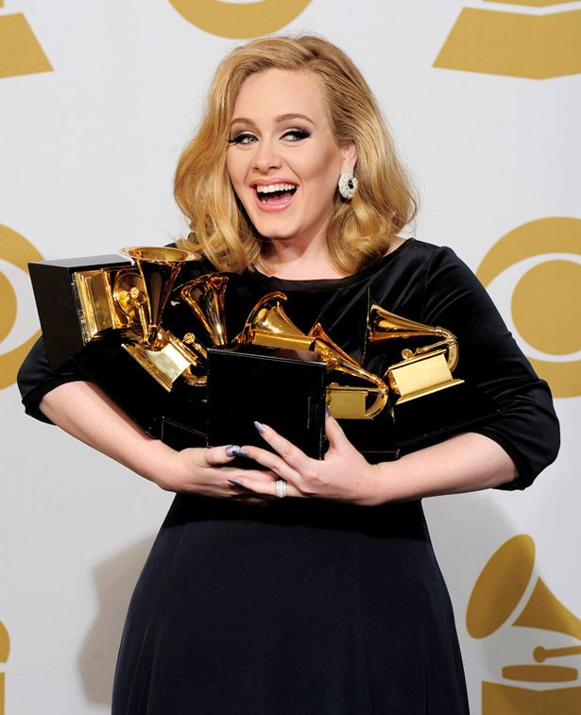
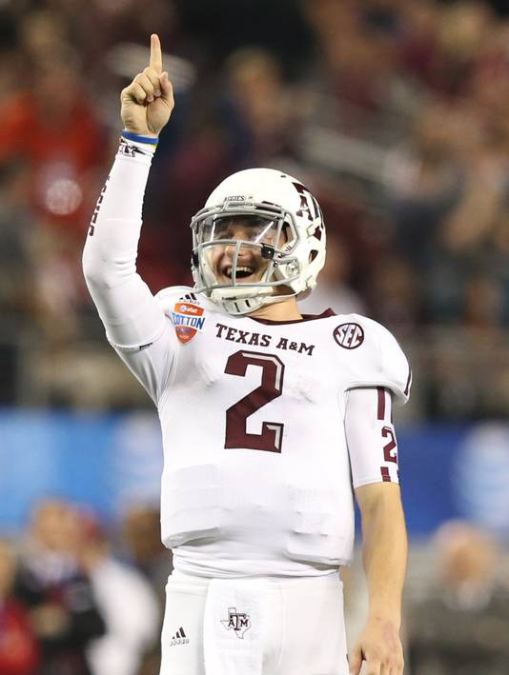
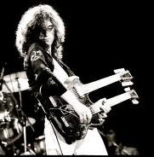
Exam Preparation
Must practice

Slide 13

Exam Preparation
Good night’s sleep – do not cram night before exam

Slide 14

Exam Preparation
Arrive on time and at right location

Slide 15
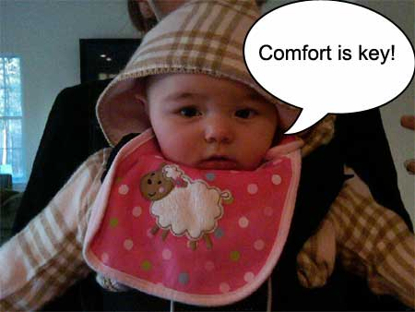
Taking the exam -- Generally
Make exam environment comfortable

Slide 16
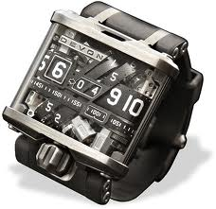
Taking the exam -- Generally
Bring time-keeping device

Slide 17
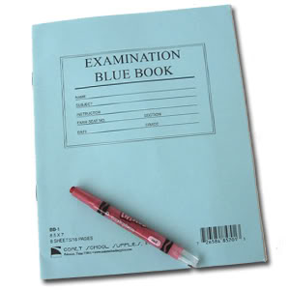
Taking the exam -- Generally
Review entire exam
Determine types of questions
Determine point value of each

Slide 18

Reading the Question
Spend about one-third of allotted time reading the question and thinking about your answer

Slide 19

Reading the Question
Get facts correct

Slide 20

Reading the Question
Determine purpose of each word

Slide 21

Reading the Question
Watch for missing facts

Slide 22

Reading the Question
Determine what is being asked and answer that question

Slide 23

Organizing your Answer
1. Spot issue(s) – use issue checklist

Slide 24
Organizing the issues
Horizontal
Vertical (stacking)
Chronological
Threshold
Order of rights of the parties

Slide 25
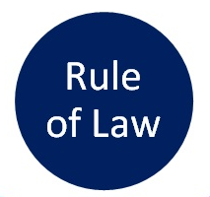
Organizing your Answer
2. Rule

Slide 26

Organizing your Answer
3. Analysis

Slide 27
Organizing your Answer
4. Conclusion
Therefore, . . . . .
Consequently, . . . . .
Accordingly, . . . .

Slide 28

Writing your Answer
Think before you write

Slide 29

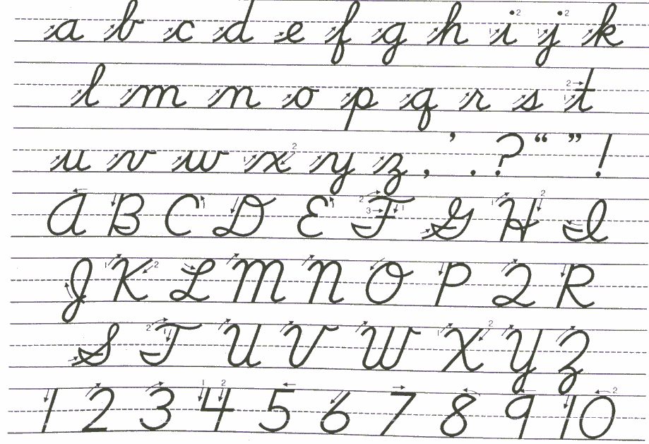
Writing your Answer
Write neatly or use computer

Slide 30

Writing your Answer
Follow professor’s instructions

Slide 31

Writing your Answer
Write concisely and avoid ambiguity

Slide 32

Writing your Answer
Avoid abbreviations unless obvious or explained
X

Slide 33
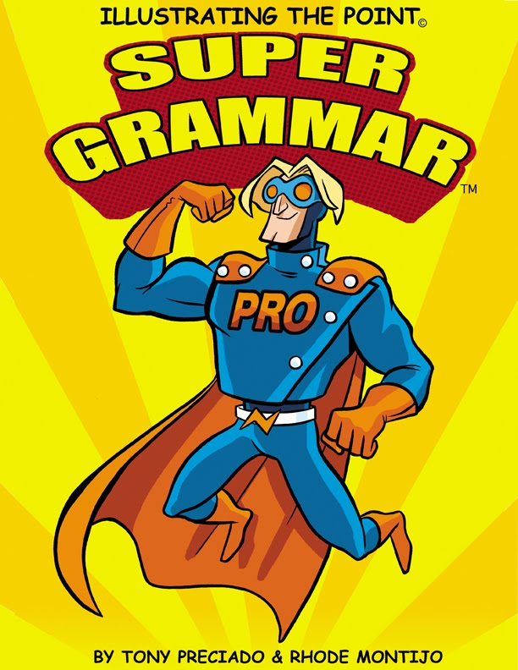
Writing your Answer
Use good grammar
Select words with care

Slide 34

Writing your Answer
Don’t make up law

Slide 35

Writing your Answer
Explain fully

Slide 36
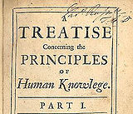
Writing your Answer
Avoid treatise answer
X

Slide 37
Writing your Answer
On my exams, no citations to cases or statutes are needed

Slide 38

Writing your Answer
Budget your time carefully

Slide 39

Writing your Answer
Avoid repeating yourself

Slide 40
Writing your Answer
Avoid writing useless things
“I have no more time.”
“Rushed for time.”
“Out of time.”

Slide 41

Writing your Answer
Avoid slang, swearing, jokes, etc.

Slide 42

Writing your Answer
Label segments of your answer

Slide 43
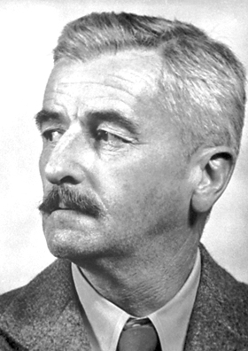

Writing your Answer
One main idea per paragraph
X

Slide 44
Writing your Answer
Re-read all your answers
“The police are no where.”
“The police are now here.”

Slide 45

After the Exam
Do not discuss exam

Slide 46

After the Exam
Do not worry

Slide 47

After the Exam
Relax (or study for next exam)

Slide 48
Property Mid-Term
Subjects covered
Personal Property
Estates and Future Interests
Concurrent Ownership

Slide 49

Property Mid-Term
Closed book

Slide 50
Property Mid-Term
Types of Questions
50 Objective
2 Essay
Personal property
Estates & future interests, concurrent ownership

Slide 51
Finding
Determine type of found property and appropriate rules.

Slide 52
Finding
First occupant
If real property, more likely property owner.
If personal property, more likely finder.
But if finder is employee, employer may have superior right.

Slide 53
Finding
Lost property
Finder normally has rights superior to all but true owner.
But, if embedded in ground, may be treated as real property.

Slide 54
Finding
Misplaced/Mislaid Property
Property owner (rather than finder) normally has superior right to possess.

Slide 55
Finding
Abandoned property
First person to actually take property with intent to possess normally prevails.

Slide 56
Finding
Treasure trove
At common law, finder prevailed.
Many states, including Texas, abandon this classification and treat as lost or mislaid.

Slide 57
Bailments
Determine type of bailment and apply applicable rules.

Slide 58
Bailment
Sole benefit of bailor = slight care
Sole benefit of bailee = great care
Mutual benefit or for hire = reasonable care (ordinary negligence standard)
Modern Trend = treat all under reasonable care standard

Slide 59
Bona Fide Purchaser
BFP can prevail over true owner
Common Law
Transferee paid value
Transferee had no notice of true owner’s claim

Slide 60
Bona Fide Purchaser
BFP can prevail over true owner
UCC
True owner entrusts goods
Bailee/seller is a merchant
Bailee/seller deals in goods of the kind that were entrusted
Purchaser is BIOCOB
Good faith
Without knowledge
Pay value

Slide 61
Unauthorized possession
Who prevails between two non-true owners?
First?
Second?

Slide 62
Unauthorized possession
When can unauthorized possessor become true owner?
Adverse possession = running of time period
Statute of limitations for conversion = running of time period with application of discovery rule

Slide 63
Accession (mistaken improvement)
Basic rule = tracing
Change in identity (manufacturing) exception
Relative value exception

Slide 64
Inter Vivos Gifts
1. Present donative intent
2. Delivery
Actual
Constructive
Symbolic
3. Acceptance

Slide 65
Engagement Gifts
Ascertain true nature of gift
Courtship (irrevocable)
Engagement (perhaps revocable)
Ascertain approach used in state
Fault
Donor breaks engagement = irrevocable
Donee breaks engagement = revocable
Mutual breakup = revocable
No-Fault (revocable regardless of fault)

Slide 66
Gifts Causa Mortis
In addition to regular gift elements, donor made in contemplation of impending or imminent death.
Approaches if donor survives peril:
Traditional = automatically revoked
Modern = failure of donor to revoke timely makes gift irrevocable

Slide 67
Gratuitous Transfers upon Death
Intestacy to heirs
Will to beneficiaries
Probate avoidance techniques

Slide 68
Sample Question
http://timer.onlineclock.net/

Slide 69

Sample Answer

