Slide 1
Recording

Slide 2
Purpose
Resolve priorities between competitors for the same property. [party vs. non-party]
Does not impact the relationship between the original parties to the instrument.

Slide 3
Example conflicts
Owner grants land to A today and to B tomorrow. Who owns the land?
Owner mortgages property to A today and to B tomorrow. Whose mortgage has priority?
Owner mortgages property to A today and sells land to B tomorrow? Is B subject to mortgage?

Slide 4
What documents are recorded?
Generally, anything that affects title to real property.
Deeds
Mortgages and deeds of trust
Easements
Covenants
Releases of mortgages/deeds of trust
Assignments of mortgages/deeds of trust
Powers of attorney
Mechanics liens
Tax liens
Wills

Slide 5
Mechanics of recording
Prepare deed in proper form.

Slide 6
Required notice on first page
NOTICE OF CONFIDENTIALITY RIGHTS: IF YOU ARE A NATURAL PERSON, YOU MAY REMOVE OR STRIKE ANY OF THE FOLLOWING INFORMATION FROM THIS INSTRUMENT BEFORE IT IS FILED FOR RECORD IN THE PUBLIC RECORDS: YOUR SOCIAL SECURITY NUMBER OR YOUR DRIVER'S LICENSE NUMBER.

Slide 7
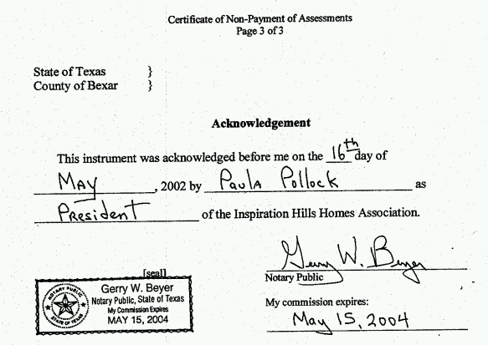
Sample Acknowledgment

Slide 8
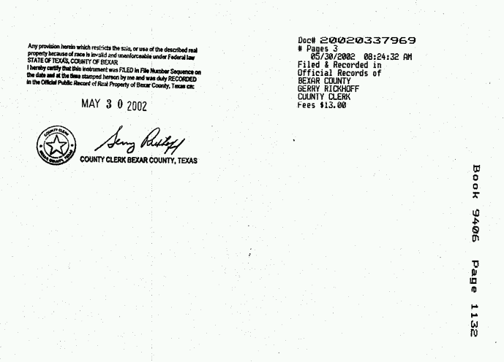
Sample bottom 3½ inches
Document number
Book & page

Slide 9
Mechanics of recording
Prepare deed in proper form.
Take deed to proper office.

Slide 10
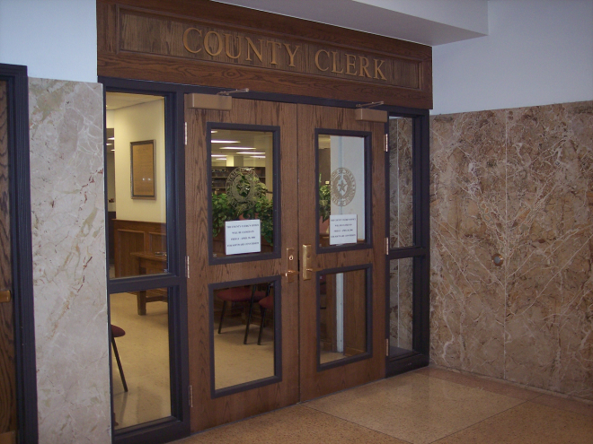
Lubbock County Clerk Office

Slide 11
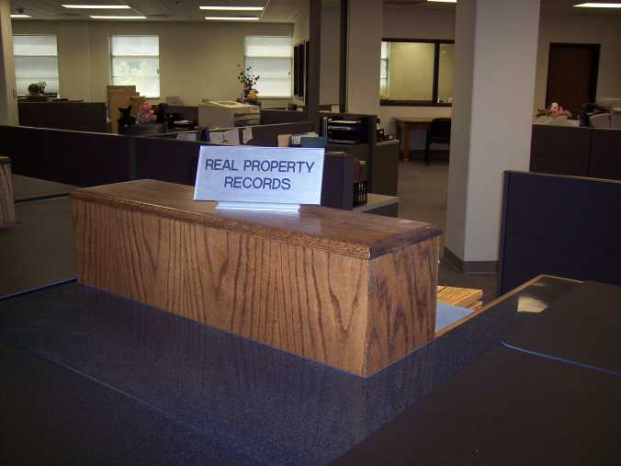
Lubbock County Clerk Real Property Records

Slide 12
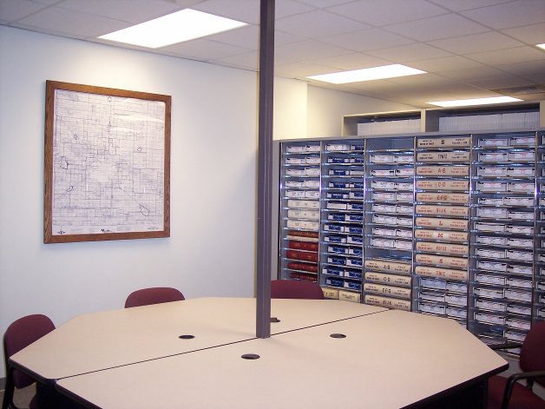
Lubbock County Clerk Office – Paper Index

Slide 13
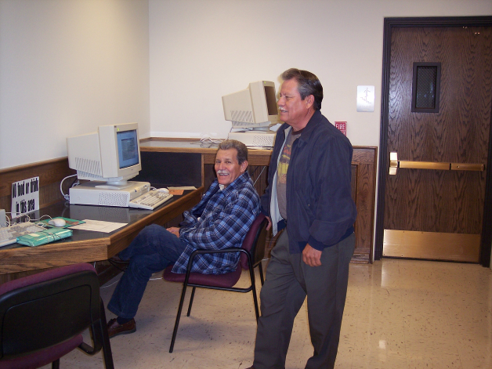
Lubbock County Clerk Office – Computer Index

Slide 14
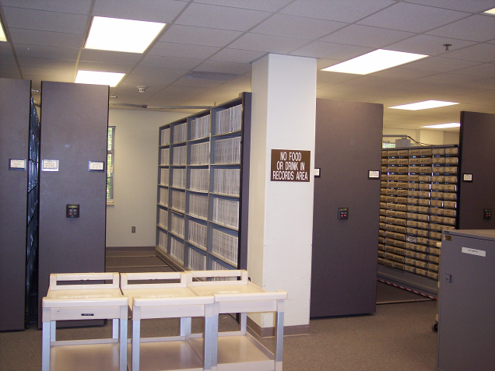
Lubbock County Clerk Office – Deeds & Maps

Slide 15
Mechanics of recording
Prepare deed in proper form.
Take deed to proper office.
Pay fee.

Slide 16
Mechanics of recording
Prepare deed in proper form.
Take deed to proper office.
Pay fee.
Clerk copies document into official records.

Slide 17
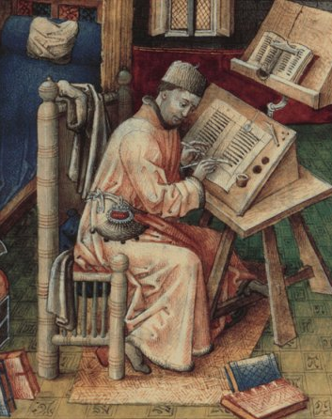
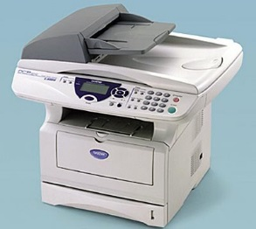
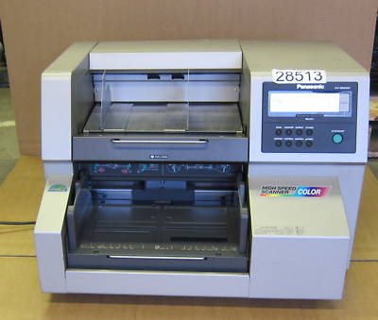
Mechanics of recording
Clerk copies document into official records.

Slide 18
Mechanics of recording
Prepare deed in proper form.
Take deed to proper office.
Pay fee.
Clerk copies document into official records.
Document given identification.

Slide 19
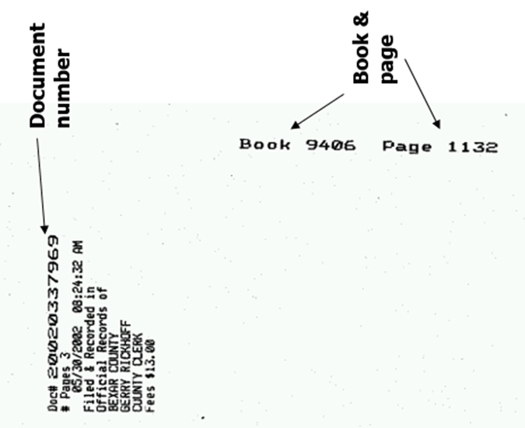
Mechanics of recording

Slide 20
Mechanics of recording
Prepare deed in proper form.
Take deed to proper office.
Pay fee.
Clerk copies document into official records.
Document given identification.
Clerk indexes document.

Slide 21
Mechanics of recording
Prepare deed in proper form.
Take deed to proper office.
Pay fee.
Clerk copies document into official records.
Document given identification.
Clerk indexes document.
Original returned to filer.

Slide 22
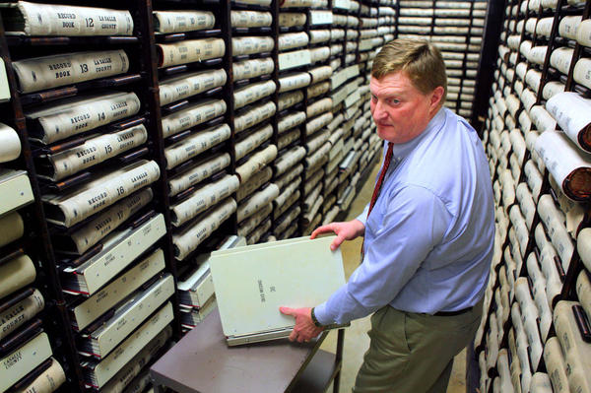
Searching a title

Slide 23
Searching a Title

Slide 24
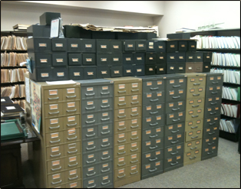
Who does it?
Purchaser
Attorney
Title company

Slide 25
Basic process
Ascertain chain of title (hopefully, back to grant from government).
aka vertical privity

Slide 26
Basic process
Ascertain chain of tile (hopefully, back to grant from government).
Determine adverse conveyances.
Easements, mortgages, covenants, etc.

Slide 27
Basic process
Ascertain chain of tile (hopefully, back to grant from government).
Determine adverse conveyances.
Study each document for problems.

Slide 28
Basic process
Ascertain chain of tile (hopefully, back to grant from government).
Determine adverse conveyances.
Study each document for problems.
Check relevant document in other offices such as:
Tax liens
Judgment liens
Probate records

Slide 29
Basic process
Ascertain chain of tile (hopefully, back to grant from government).
Determine adverse conveyances.
Study each document for problems.
Check relevant document in other offices.
Warning: off record claims may exist
Adverse possession
Prescriptive easements
Homestead rights

Slide 30
Recording Systems

Slide 31
The Situation
Grantor sells land and gives deed to Purchaser A (Grantee 1) today.
Grantor sells land and gives deed to Purchaser B (Grantee 2) tomorrow.
Who prevails between A and B for the land?
Of course, Grantor is liable to the loser.

Slide 32
How Purchase B (second grantee) may become BFP and win?
Provide valuable consideration.
In other words, pay for the land.
Donees cannot become BFPs.
Win under the BFP laws which are based on the recording system the state follows:
Race
Race-Notice
Notice

Slide 33

Recording Systems
1. Race
First grantee to record wins.
Irrelevant that first to record knows about a prior unrecorded interest.
Used in only a few states

Slide 34
Recording Systems
2. Race-Notice
Second grantee wins if:
No notice (actual or constructive) of prior interest at time of purchase, and
Records first.
In other words, at time of purchase:
Empty head, plus
Empty records, plus
Records first

Slide 35
Recording Systems
3. Notice
Second grantee wins if:
No notice (actual or constructive) of prior interest.
No filing needed to protect against prior interest but would need to file to protect against subsequent interest.
In other words, at time of purchase:
Empty head, plus
Empty records.
First grantee’s “fault” for not filing first and “warning” second grantee.

Slide 36
Texas Property Code § 13.001
“A conveyance of real property or an interest in real property or a mortgage or deed of trust is void as to a creditor or to a subsequent purchaser for a valuable consideration without notice unless the instrument has been acknowledged, sworn to, or proved and filed for record as required by law.”
Race
Race-Notice
Notice
A different approach

Slide 37
Shelter Rule
Evil Grantor sells to X and Y.
Y has priority in a notice state.
Y then gives or sells to Z who has notice of X’s interest.
Who prevails between X and Z?

