Slide 1
Deeds

Slide 2
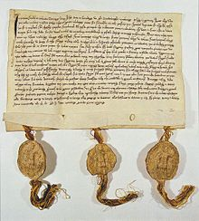
Brief History

Slide 3
Ohio Statutory General Warranty Deed
. . . . . . (marital status), of . . . . . . . County,. . . . . . for valuable consideration paid, grant(s), with general warranty covenants, to . . . . ., whose tax-mailing address is . . . , the following real property:
(description of land or interest therein and encumbrances, reservations, and exceptions, if any)
Prior Instrument Reference: Volume . . . ., Page . . .
. . . . . ., wife (husband) of the grantor, releases all rights of dower therein.
Executed this . . . . . . . day of . . . . . ..
. . . . . . . . . . . . . . . . . . . . . . . . . .
(Signature of Grantor)
(Execution in accordance with Chapter 5301. of the Revised Code)”

Slide 4
Types of Deeds
1. Warranty Deed
Grantor personally makes the “standard” warranties regarding the title being transferred.

Slide 5
Types of Deeds
2. Special or Limited Warranty Deed
Grantor personally makes some, but not all, of the “standard” warranties regarding the title being transferred.

Slide 6
Types of Deeds
3. Quitclaim Deed
Grantor conveys what the grantor has but does not warrant that the grantor has anything.

Slide 7
Elements of Typical Deed
1. The Premises
Designation of parties
Words of grant
Description of land
Estate granted
Consideration paid
Typically, just nominal, not actual price paid

Slide 8
Elements of Typical Deed
2. Habendum
Statement of limitations if estate is not fee simple.

Slide 9
Elements of Typical Deed
3. Reddendum
Portions of estate the grantor is retaining.

Slide 10
Elements of Typical Deed
4. Warranties of Title

Slide 11
Elements of Typical Deed
5. Signatures

Slide 12
Elements of Typical Deed
6. Acknowledgment

Slide 13
Deeds [continued]

Slide 14
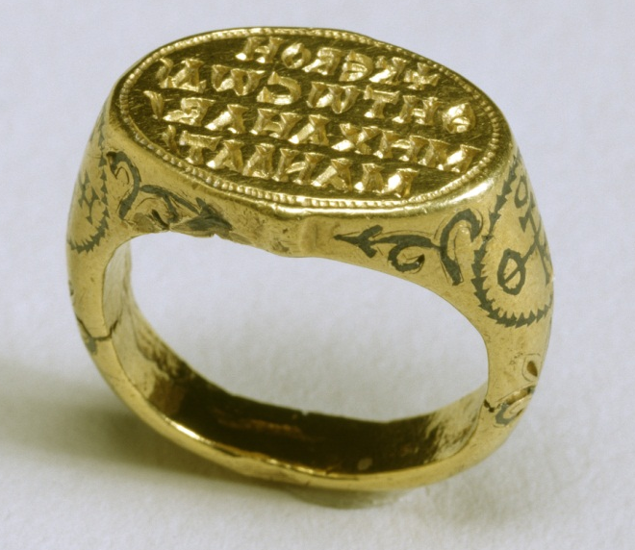
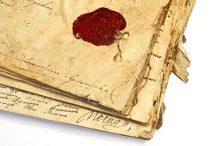
Execution Formalities
1. Seal
Not required under modern law.

Slide 15
Execution Formalities
2. Signatures
Grantor = yes
Grantee = no

Slide 16
Execution Formalities
3. Witnesses
States vary

Slide 17
Execution Formalities
4. Acknowledgment/Notarization
States vary whether it is essential for valid deed.
Often, required to file in public records.

Slide 18
Execution Formalities
5. Delivery to Grantee and Acceptance by Grantee

Slide 19
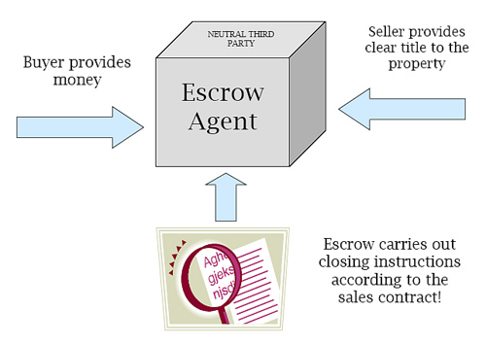
Escrow

Slide 20
Legal Description of Property
1. Metes and Bounds
Beginning with a corner at the intersection of two stone walls near an apple tree on the north side of Muddy Creek road one mile above the junction of Muddy and Clear Creeks, north for 150 rods to the end of the stone wall bordering the road, then northwest along a line to a large standing rock on the corner of John Smith's place, thence west 150 rods to the corner of a barn near a large oak tree, thence south to Muddy Creek road, thence down the side of the creek road to the starting point.

Slide 21
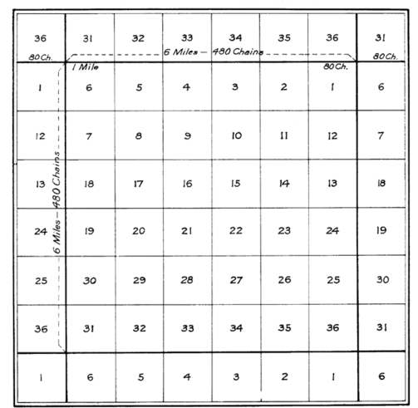
2. Rectangular Survey (Government) System
E ½ of the NW ¼ of the SW1/4 of Section 8, etc.

Slide 22

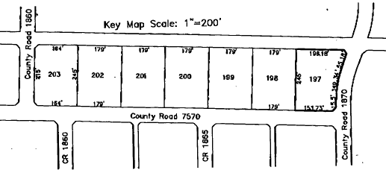
3. Lot and Block – Plat Maps

