Slide 1
Real Estate Contract

Slide 2
Basic Requirements
Parties have contractual capacity
Contract has legal purpose
Offer
Acceptance
Consideration
Statute of Frauds compliance

Slide 3
Key Factor
Because equity regards all land as unique, the non-breaching party can request specific performance as monetary damages are inadequate.

Slide 4
Statute of Frauds

Slide 5

Statute of Frauds -- 1677
1. The agreement or some memorandum or note thereof must be in writing.
2. Signed.

Slide 6
Common Issues
Oral contract – Void vs. Unenforceable
Signed vs. Subscribed
Signed by whom?
  Both
  Party to be charged
  Seller

Slide 7
Purpose
Avoid false claims by requiring written evidence.

Slide 8
Part performance
Contract enforceable if proof of oral contract plus (depending on jurisdiction):
  Possession by purchaser
  Possession plus payment
  Possession plus valuable improvements
  Possession plus change in position causing irreparable injury
  Writing needed, period!

Slide 9
Contents of Writing
1. Identity of Buyer and Seller
2. Description of Property
3. Key terms (price, date of sale, etc.)
4. Signature

Slide 10
Contract Forms

Slide 11
No true “standard” contract
Contract must:
  Comply with state law
  Be adapted to local customs
  Individualized for client’s exact situation

Slide 12
Sources of Forms
State Real Estate Commission
State Bar Associations
Commercial Publications
  Form books
  Computer programs
User developed forms

Slide 13

Forms
Benefits from using forms:
Warnings:

Slide 14
Time for Performance

Slide 15
No Time Stated
Reasonable time from contract date
  Based on exact facts of case

Slide 16
Exact time stated
At law = time deemed of the essence
At equity (specific performance) = time not deemed of the essence

Slide 17
“Time of the essence”
By express statement
By surrounding facts and circumstances
Nature of property (especially in an unstable market)

Slide 18
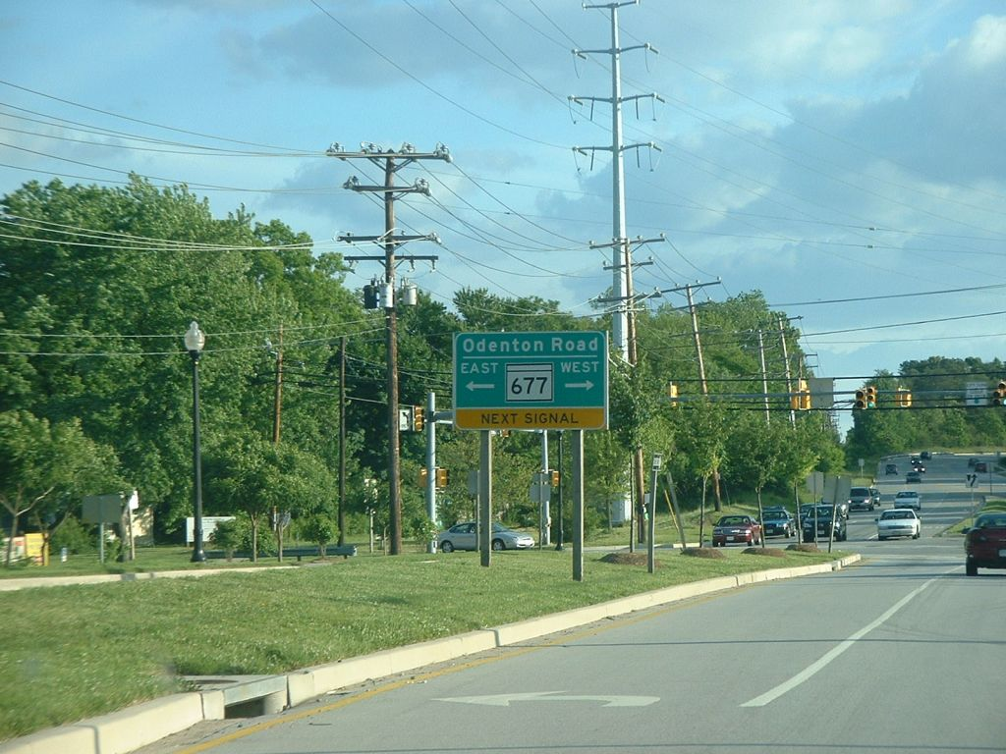
Kasten Construction
Close to Maple Ridge Subdivision
Notes:
http://www.lostagain.net/mdends/100/170/index.php

Slide 19
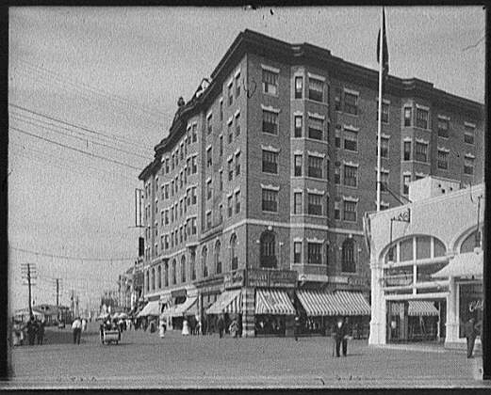
Doctorman v. Schroeder
Similar building to where closing was to occur in Atlantic City, NJ.
Notes:
http://www.helloatlanticcity.com/images/Youngs%20Hotel%20c1905.jpg

Slide 20
Financing Arrangements
[Buyer’s performance]

Slide 21

The Situation
A person wants property but does not have money.
  Person needs to become a debtor.

Slide 22

Seller’s Options
1. Refusal

Slide 23
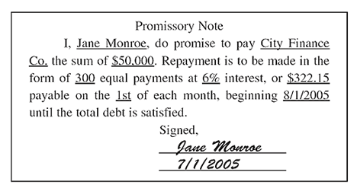
Seller’s Options
2. Obtain promise to repay
  Unsecured creditor
  General creditor

Slide 24

Seller’s Options
3. Obtain surety
  Co-signer
  Accommodation party
  Guarantor

Slide 25

Seller’s Options
4. Obtain Collateral
  Mortgage
  Deed of trust

Slide 26
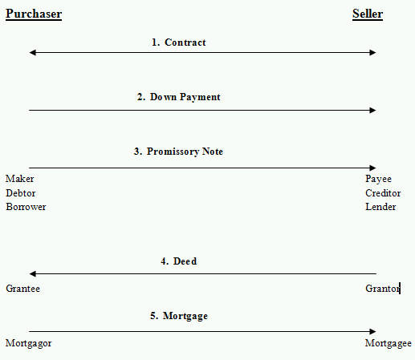
Purchase-Money Mortgage
Seller = Lender [owner financing]

Slide 27
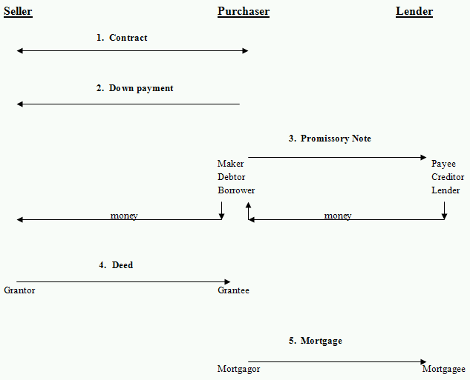
Purchase-Money Mortgage
Seller ≠ Lender [bank financing]

Slide 28
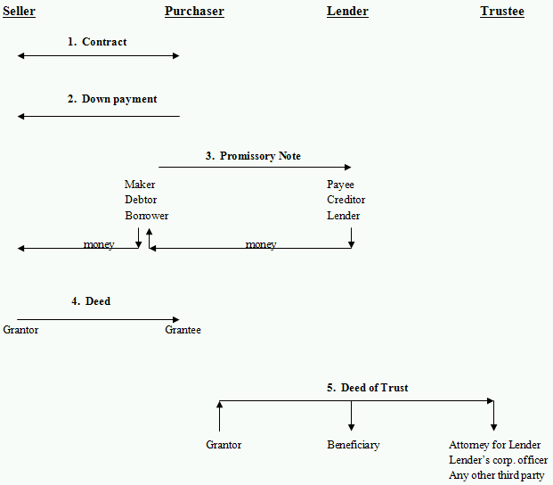
Deed of Trust

Slide 29
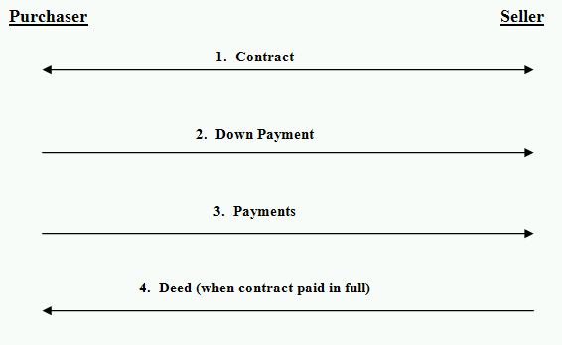
Installment Land Contract
Contract for Deed

Slide 30
Failure to Pay Mortgage
Common law = mortgagor lost all rights to property
Equity of Redemption
Strict Foreclosure (rare)
Foreclosure by Sale (common)

Slide 31
Real Estate Contract
[continued]

Slide 32
Failure to Pay Deed of Trust
Includes power of “trustee” to sell without court proceedings
  Faster and cheaper than traditional mortgage foreclosure.
  Over time, states have add protections for purchaser.

Slide 33
Failure to Pay Installment Land Contract
Traditional approach
  Seller keeps all payments and land.
  Buyer has no redemption rights.
Modern trend
  Provide buyers with protections.

Slide 34
Merchantable /Marketable
Title
[Seller’s performance]

Slide 35
Tests to Determine M.T.
Reasonable person test
  Title not subject to doubt by reasonable person purchasing the property.
Specific performance test
  Title good enough that a court would order specific performance of sales contract.

Slide 36
Examples that make title UM
Unless otherwise agreed by parties:
  Interest less than fee simple absolute
  Encumbrances (mortgage, tax lien, etc.)
  Restrictions (easements, covenants, etc.)
  Break in chain of title (lack of vertical privity)

Slide 37
Correction of defects
Before seller in breach, buyer must:
  Give seller notice of defects, and
  Allow seller a reasonable time to fix.

Slide 38
Quiet Title Suit
Remedy for unmerchantable title.
Bring all claimants to court and have claims resolved.

Slide 39
Tender

Slide 40
Importance of Proper Tender
One party must tender to place other party in breach
  Buyer tenders money (or agreed financing).
  Seller tenders deed which conveys merchantable title (as modified by contract).

Slide 41
Assignment

Slide 42
Basic Concepts
Parties may assign their rights.
Why would they?
  Seller
  Buyer

Slide 43
Remedies

Slide 44
Purchaser’s Remedies
Terminate contract
Specific performance
Damages
  Common law (English rule) = only if bad faith on seller’s part [pre-contract position]
  Modern law (American rule) = benefit of bargain
  [market value minus contract price]
  [as if contract fully performed]

Slide 45
Seller’s Remedies
Specific performance
Damages
  Benefit of bargain
  [contract price minus market price]
  Out of pocket
  Liquidated damages (keep down payment) [often deemed void as a penalty]
Terminate contract

Slide 46
Equitable Conversion

Slide 47
Basic Idea
Between (1) signing of real property sales contract and (2) closing:
  Purchaser regarded as equitable owner and thus has interest in real property.
  Seller regarded as a creditor holding title as security for payment and thus has interest in personal property.
Logic = Specific performance is available as a remedy.

Slide 48
Possible significance
How property passes by intestacy or under a will if death occurs between contract and closing.
Method for creditors to reach the property.
Risk of loss.

Slide 49
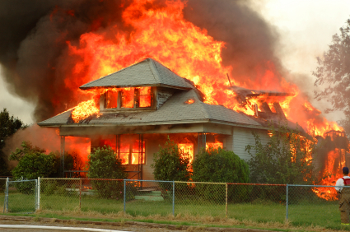
Risk of Loss

Slide 50
Risk of Loss
Prior to contract = all risk on seller
After closing = all risk on buyer
During contract period = ???

Slide 51
Risk of Loss Allocation – Good Practice
Express agreement of parties in the real estate contract

Slide 52
Risk of Loss Allocation if Contract Silent
1. Majority (English) Rule
  Purchaser has risk of loss because of equitable conversion.

Slide 53
Risk of Loss Allocation if Contract Silent
2. Minority (Massachusetts) Rule
  Seller has risk of loss because of implied condition that premises will be transferred as they existed on date of contract.

Slide 54
Risk of Loss Allocation if Contract Silent
3. Uniform Vendor and Purchaser Risk Act
  Seller has risk of loss unless purchaser has taken possession.

